Slide 1
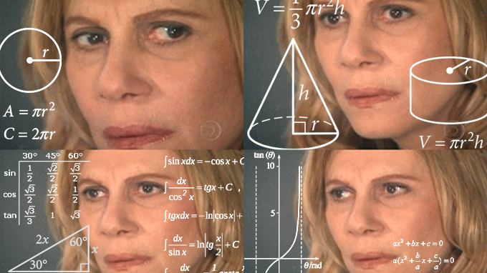
Critical thinking & reading

Slide 2
Why is it important? What’s the point?

Slide 3
What is critical thinking & reading?
What do you think it means?

Slide 4
What is critical thinking & reading?
Careful, active, reflective, analytic
Involves being thoughtful of context:
Each piece of academic writing is part of an ongoing intellectual conversation, with debates, key figures and concepts.
It was written at a certain time in a particular cultural context to do something.

Slide 5
Key goals of critical thinking/reading
REFLECT – Reflect on the validity of what you have read in light of prior knowledge, your understanding of the world, new knowledge you’re gaining
CONNECT, RELATE - Figure out how this new info and these new ideas connect with what you already know. Does it change your perspective on something?
APPLY - Put the new stuff you’ve learned into action! Consider how you can use new concepts, methods, and knowledge elsewhere.

Slide 6
What does “critical” mean?
Critical here doesn’t mean “being mean.”
It means being aware there is a context in which this thing is written and that there is something this author intends this writing to do. We therefore have to take the reading with a grain of salt. Make up our minds for ourselves.
Being aware of context and intention, we can then think about how power works. How it affects the thing studied as well as the studier/author.

Slide 7
What does “critical” mean?
Critical means caring about the stakes. Your stakes. The author’s. The stakes of those being studied.
In media studies work, typically the stakes are the humanity of the people whose media is being studied.
In this way, “critical” research can be very compassionate.
(Or domineering and preachy. It’s complicated.)

Slide 8
Putting it into action…
Practically, what should I look for? Recognize those aspects of a discussion that have a concentration of meaning
Title, section headings, abstract, charts, “I argue”…
Intellectually, what do I think about what I find? Think about the interpretation of data from within the text, and if you agree with that interpretation.

Slide 9
Outcomes
What should my notes look like?

Slide 10
Mark up your reading. For ex:
Highlight or underline key sentences.
Marginalia (write in the margins):
What questions, ideas, or connection does X passage or X claim bring up for you.
Star ideas you really like and write “???” next to parts you don’t think make sense.
Draw an eyeball next to something you want to look up afterward.
Write “DEF” next to sentences where key terms are defined.

Slide 11
6 key things to note down…
What is the TOPIC? What’s the phenomenon being studied?
What are the text’s KEY ARGUMENTS? What is it trying to stick up for?
What is the EVIDENCE that supports these arguments? What material does the author use to support the points she makes?

Slide 12
6 key things to note down…
What are its CONCLUSIONS? Do you agree with them?
Who is the AUTHOR? What is their background? How does it impact what they’ve written?
Your ASSESSMENT. What’s missing? What’s great? What needs clarifying? Where does this lead your thinking?

Slide 13
Why take notes?
Marking up the page: Produces signage for Future You, so she can quickly remember the brilliant things Current Reading You has really fresh in her brain right now. It also helps you read more carefully and actively.
6 Key things: It’s kind of wild to put in the effort to read an entire scholarly article, but then not take the extra 5-10 minutes afterward to jot down the notes that will help you remember and apply it later.

Slide 14
Practical steps for critically reading anything
This technique can be applied to scholarly readings or… TV shows, albums, music videos, etc.!

Slide 15
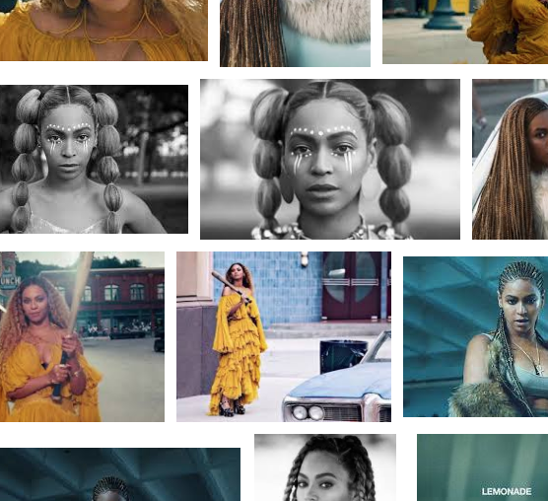

Slide 16
Step 1 – Look through it
Look through reading (or other text).
In a separate document/notepad, write down title and sub-headings. Often they give you the architecture of piece.
Find out who the author is. What is their background? How might that inform what’s written?
Who are they in conversation with? Is it a response to someone? In response to a debate? Who are they citing?
What are the stakes for them?

Slide 17
Step 2 – Read it
Read the piece
What is its TOPIC?
Possible short hand: “explores” “examines” “looks at”
What is its key ARGUMENT?
Possible short hand: “proves that” “argues that” “shows that” “demonstrates” “reveals.”
Every reading/piece is trying to fight for something. What is it fighting for? What is it trying to do?

Slide 18
Step 3 – Find the evidence
On what basis is it mounting this fight? This is its EVIDENCE.
What kind of material is used as evidence? (Interviews? News articles? Policy documents? Archival material? A close reading of a media text?)
Can you judge the quality of the evidence?
Think about where the piece ends.
Might be restatement, a note that encapsulates limitations of that argument, or more things that are needed to be found to make argument stand.

Slide 19
Step 4 – Judge the validity
Not yes or no. Some claims “seem more valid” / are stronger than others. Some seem outlandish but have a ring of truth. Some seem obviously true but if you look closely are shaky.
Think about what you’ve read in relation to this and how that affects your judgments on the validity of this.
Under what conditions do the readings’ claims stand? Under what conditions do they collapse?
Eventually the answer to the question of validity usually becomes, “It depends.” That’s great! You should start there. And then explain: What does it depend on?

Slide 20
Step 5 – Flesh out your notes
You’ve spent a fair bit of time reading. Make sure you can take full advantage of that later by leaving yourself useful notes.
Focus especially on your ASSESSMENT. What do you think of this paper and this scholarly conversation? How does it connect with your other classes? With your concerns and projects? What new questions does it open up for you?
How does power play into the phenomenon studied? Into who gets to study it and what they find?

Slide 21
acknowledgement
These slides were inspired by a series of conversations with Sriram Mohan about some of his teaching practices.
srirammohan.com / @arbitist / sriramm[at]umich.edu
They have been greatly enriched through student input. Many thanks!

