Slide 1
API, Wrapper classes, printf, and methods

Slide 2
The API Library
API stands for “Application Programming Interface”
-In fact, you have been using it
-The Scanner class is one small part
In general, your programs must “import” the API classes they use import java.util.Scanner;
java.util is a “package”
Packages are collections of related classes
Programs automatically import java.lang
-java.lang contains critical classes that many programs need
Math
String
-The automatic import is equivalent this line
import java.lang.*;
The * matches all classes in the package

Slide 3
Wrapper Classes For Primitive Types
A wrapper class : surrounds a relatively simple item in order to add functionality.
Java has wrappers for the primitive types:
Wrapper Class Primitive Type
Integer int
Long long
Float float
Double double
Character char
Defined in java.lang

Slide 4
Wrapper Classes help convert Strings
Number wrappers help with string conversion
Wrapper Class string → number number → string
Integer Integer.parseInt(<string>) Integer.toString(<#>)
Long Long.parseLong(<string>) Long.toString(<#>)
Float Float.parseFloat(<string>) Float.toString(<#>)
Double Double.parseDouble(<string>) Double.toString(<#>)
Various uses, esp. GUI programming

Slide 5
Conversions of Primitive Types
Conversion examples - strings to numbers:
String yearStr = "2011";
String scoreStr = "78.5";
int year = Integer.parseInt(yearStr);
double score = Double.parseDouble(scoreStr);
Conversion examples - numbers to strings :
int year = 2011;
double score = 78.5;
String yearStr = Integer.toString(year);
String scoreStr = Double.toString(score);

Slide 6
Formatted Output with the printf Method
You should strive to make program output be understandable and attractive. To further that goal, format your output. Here's an example of formatted output:
Account Actual Budget Remaining
------- ------ ------ ---------
Office Supplies 1,150.00 1,400.00 250.00
Photocopying 2,100.11 2,000.00 (100.11)
Total remaining: 149.89
The System.out.printf method is in charge of generating formatted output.
Mostly useful for controlling format of numbers

Slide 7
Formatted Output with the printf Method
Here's how to generate the "Total remaining" line in the previous slide's budget report:
System.out.printf(
"\nTotal remaining: $%.2f\n", remaining1 + remaining2);
You can have as many format specifiers as you like in a given format string. For each format specifier, you should have a corresponding data item/argument.
format specifier

Slide 8
Format Specifier Details
Format specifier syntax:
%[flags][width][.precision]conversion-character
-Square brackets mean optional.

Slide 9
Conversion Character
The conversion character tells the Java Virtual Machine (JVM) the type of thing that is to be printed.
Here is a partial list of conversion characters:
s This displays a string.
d This displays a decimal integer (an int or a long).
f This displays a floating-point number (a float or a double)
e This displays a floating-point number (float or double) in
scientific notation.

Slide 10
Conversion Character
This code fragment illustrates how to use the conversion characters:
System.out.printf("Planet: %s\n", "Neptune");
System.out.printf("Number of moons: %d\n", 13);
System.out.printf("Orbital period (in earth years): %f\n", 164.79);
System.out.printf(
"Average distance from the sun (in km): %e\n", 4_498_252_900.0);
Here is the output:
Planet: Neptune
Number of moons: 13
Orbital period (in earth years): 164.790000
Average distance from the sun (in km): 4.498253e+09

Slide 11
Precision and Width
Precision:
Only for floating-point numbers
Consists of a dot and then the number of digits that will be printed to the right of the decimal point.
If the data item has extra fractional digits, then rounding occurs.
If the data item has fewer fractional digits, then zeros are added at the righ.
Width:
Specifies the minimum number of characters that are to be printed.
If the data item contains fewer than the specified number of characters, then spaces are added.
By default, output values are right aligned, so when spaces are added, they go on the left side.

Slide 12
Precision and Width
This code fragment illustrates how to specify precision and width in a format specifier:
System.out.printf("Cows are %6s\n", "cool");
System.out.printf("But dogs %2s\n", "rule");
System.out.printf("PI = %7.4f\n", Math.PI);
Here is the output:
Cows are cool
But dogs rule
PI = 3.1416
6 characters
7 characters

Slide 13
METHODS
Methods reduce code size by factoring similar code into one program location
Using this feature makes code
more self-documenting,
(b) smaller, and
(c) less error prone

Slide 14
METHOD DECLARATIONS
Visibility modifier (e.g. public, private, protected)
Non-access modifiers (e.g. static, final )
Return Type (e.g. void, String, int, boolean[])
Name
Parameter List
Body

Slide 15
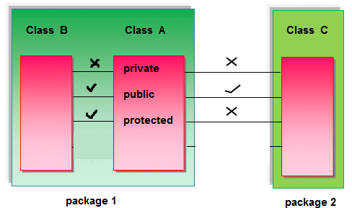
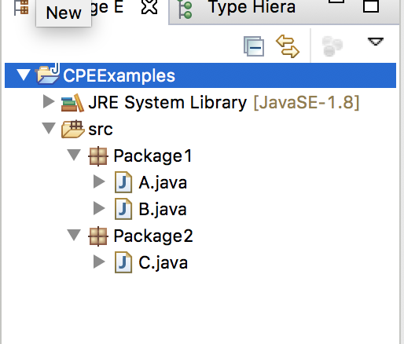
VISIBILITY
A private method can be invoked only from the class in which it is declared
A public method can be invoked from anyone
A protected method can be invoked from the package the method in which it is declared

Slide 16
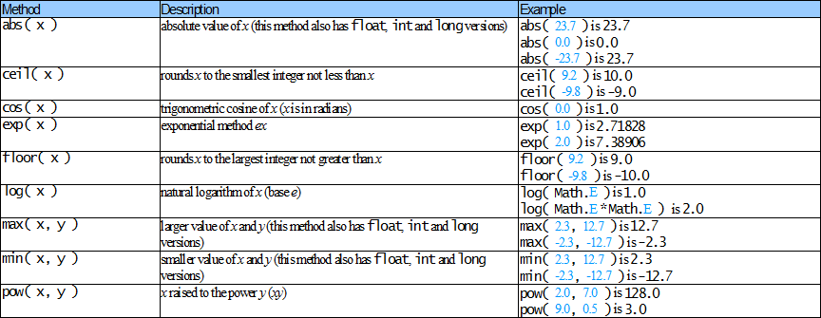
STATIC MODIFIER (IN ACTION)
Math-Class Methods(partial list)

Slide 17
RETURN TYPES
A void method returns no value (but can still return;)
A non-void is marked with a specific return type and must return a value of type on all code paths

Slide 18
RETURN TYPES (VOID)
public static void printPrimes(int[] numbers) {
if (numbers == null || numbers.length == 0) {
return; // Explicit "early-out" from void method
}
for (int number : numbers) {
if (isPrime(number)) {
System.out.println(number);
}
}
// No return _necessary_ from void functions
}

Slide 19
RETURN TYPES
public static double getMax(double[] numbers) {
if (numbers == null || numbers.length == 0) {
return Double.NaN;// Explicit "early-out" with a value
}
double runningMax = numbers[0];
for (int i = 1; i < numbers.length; i++) {
if (runningMax < numbers[i]) {
runningMax = numbers[i];
}
}
return runningMax; // Return necessary from all code paths
}

Slide 20
RETURN TYPES (POSSIBLE RETURNS)
public static String probPrompt(Scanner s, float prob) {
if (Math.random() < prob) {
System.out.print("Enter something: ");
return s.nextLine();
}
// Illegal, method may not produce a value but is non-void
}

Slide 21
RETURN TYPES (POSSIBLE RETURNS)
public static String probaPrompt(Scanner s, float prob) {
if (Math.random() < prob) {
System.out.print("Enter something: ");
return s.nextLine();
}
return null; }

Slide 22
PARAMETER LIST
Parameters are the method's name for input variables
Each parameter has a name and type - can also be final
Arguments are the values someone gives the method
When invoking a method, the arguments and parameters must align

Slide 23
FINAL PARAMETERS
public static void cantChangeMe(final double x) {
x = y + 1; // ILLEGAL
}
public static void canModifyButNotAssignRefTypes(final double[] x) {
x[0] = x[1] / 2; // Go for it
x[1] = x[2] / 2; // Go for it
x = new double[5]; // ILLEGAL
}

Slide 24
OVERLOADING
Two methods can have the same name as long as their parameters differ (in length or type)
The method which is invoked is determined by the method which matches the argument list most closely

Slide 25
OVERLOADING (DIFFERING ARITY)
public static void f(String s) { System.out.print(s); }
public static void f(String s, int i) {System.out.print(s+i); }
public static void test() {
f("foobar"); // ??
f("foobar", 2); // ??
}

Slide 26
OVERLOADING (DIFFERING TYPE)
public static void f(int i, int j) { /* body omitted */ }
public static void f(float i, float j) { /* body omitted */ }
public static void test() {
f(204, 304); //?
f(2.4, 304); //?
f(204, 3.4); //?
f(2.4, 3.4); //?
}

Slide 27
OVERLOADING (DIFFERING TYPE)
public static void f(int i, int j) { /* body omitted */ }
public static void f(float i, float j) { /* body omitted */ }
public static void test() {
f(204, 304); // first
f(2.4, 304); // second
f(204, 3.4); // second
f(2.4, 3.4); // second
}

Slide 28
OVERLOADING (SPECIFIC MATCH)
public static void f(char i, int j) { /* body omitted */ }
public static void f(char i, double j) { /* body omitted */ }
public static void test() {
f('a', 'a'); // first (char -> int more specific than -> double) }

Slide 29
OVERLOADING (AMBIGUOUS MATCH)
public static void f(char i, int j) { /* body omitted */ }
public static void f(double i, char j) { /* body omitted */ }
public static void test() {
f('a', 'a'); // none, is a compiler error (ambiguous call)
}

