Slide 1
Quantitative Thermoacoustic Imaging using a
Clinical Ultrasound Transducer Array
S.K. Patchª, D. Hull^{b}, W.A. See^{c} and G.W. Hanson^{d}
ªDept. of Physics, UW-Milwaukee
^{b}Avero Diagnostics
^{c}Dept. of Urology, Medical College of Wisconsin
^{d}Dept. of Electrical Engineering, UW-Milwaukee

Slide 2
transducer
Thermoacoustic Imaging
inverse source problem
ν_{s} t₂
ν_{s} t₁
- rapid heating (EM ala MRI)
- pressure jump (US)
- spherical sinogram (CT)
prostate
contrast = f(dielectric,
mechanical,
thermal)
dielectric
Ionic content of prostatic fluid negatively correlated to disease state (Kavanagh 1985).
thermal & mechanical
+ homogeneous initial conditions
Apply E so that
σ ~ ionic content
|E| & I(t) are known, |E| homogeneous over 6 cm FOV
MRSI based on citrate suppression (Narayan & Kurhanewicz ‘92)
in vitro NMR more specific than PSA (Serkova 2008).

Slide 3
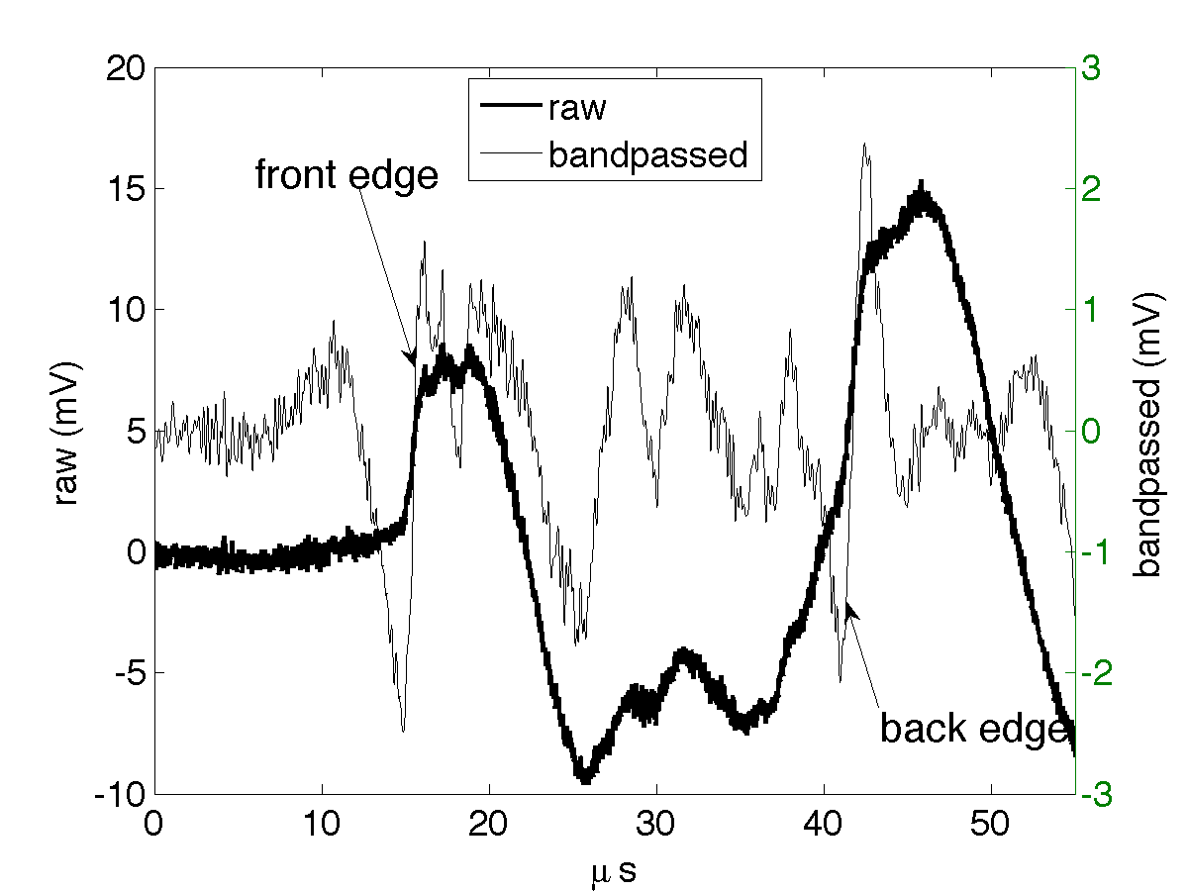
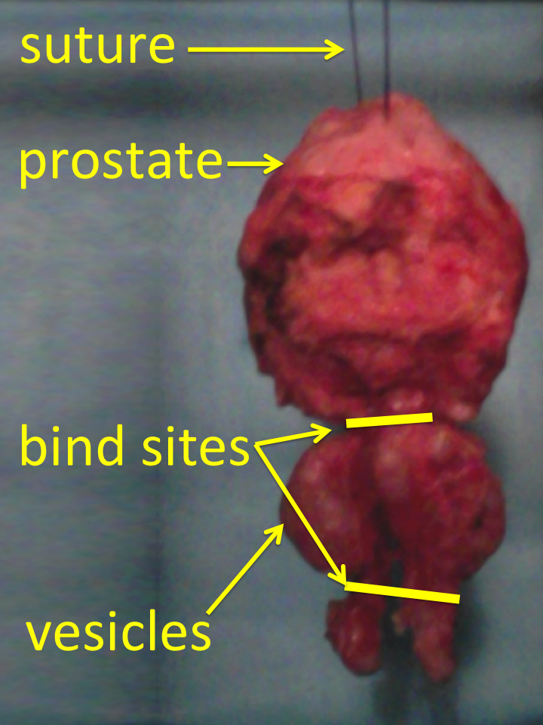
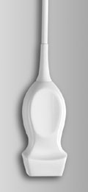
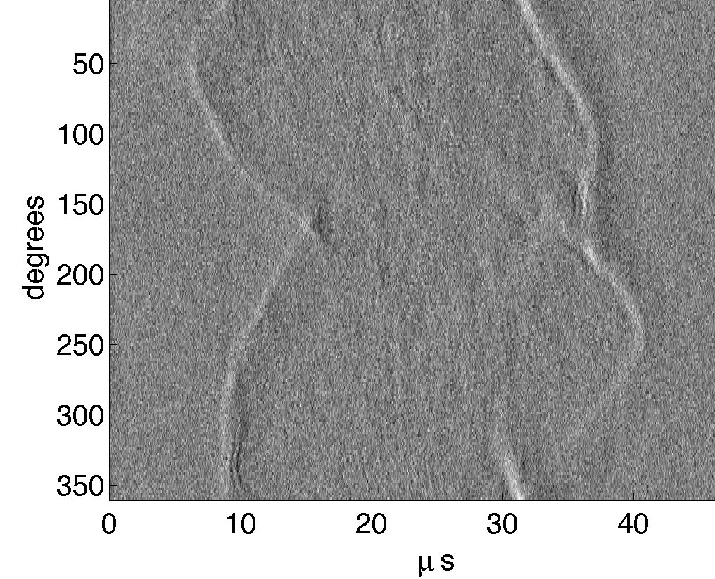
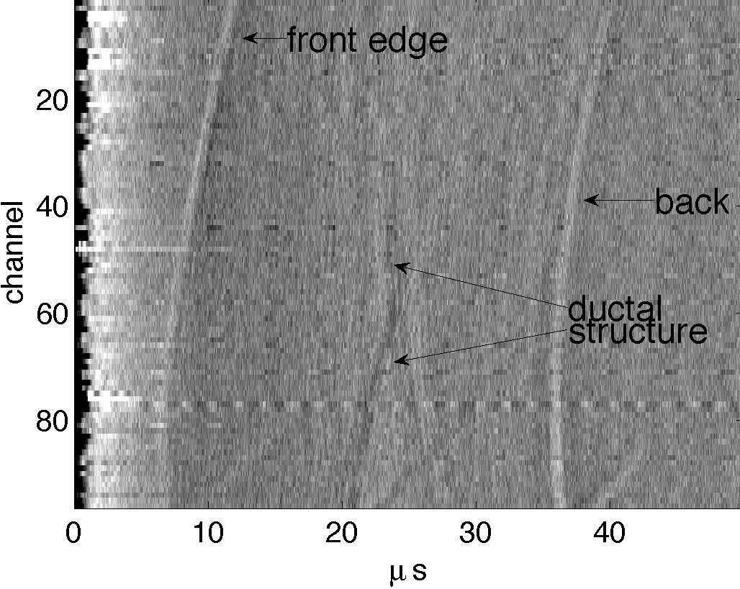
stepper motor
O-scope (4-chan)
TE10 waveguide
known freq response
TA pressures weak, 1-10 Pa
VSX box + host
2.25 MHz focused & heavily damped single
elements + 54 dB preamp, 128 signal aves
P4-1 cardiac array w/96 channels, amplify
43.5 dB, 1024 aves
Δθ = 1.8, Δz = 0.3 & 20 mm, 90 min
acoustic couplant: 15 g/L glycine in DI water

Slide 4
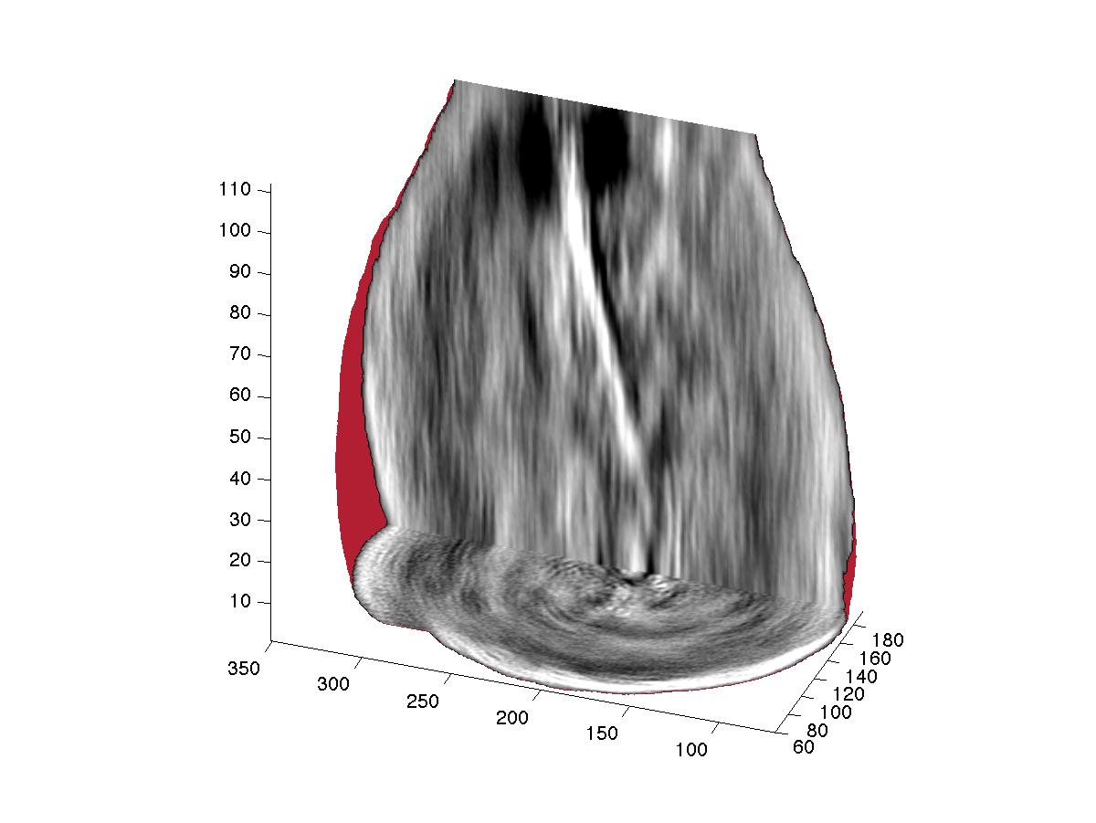
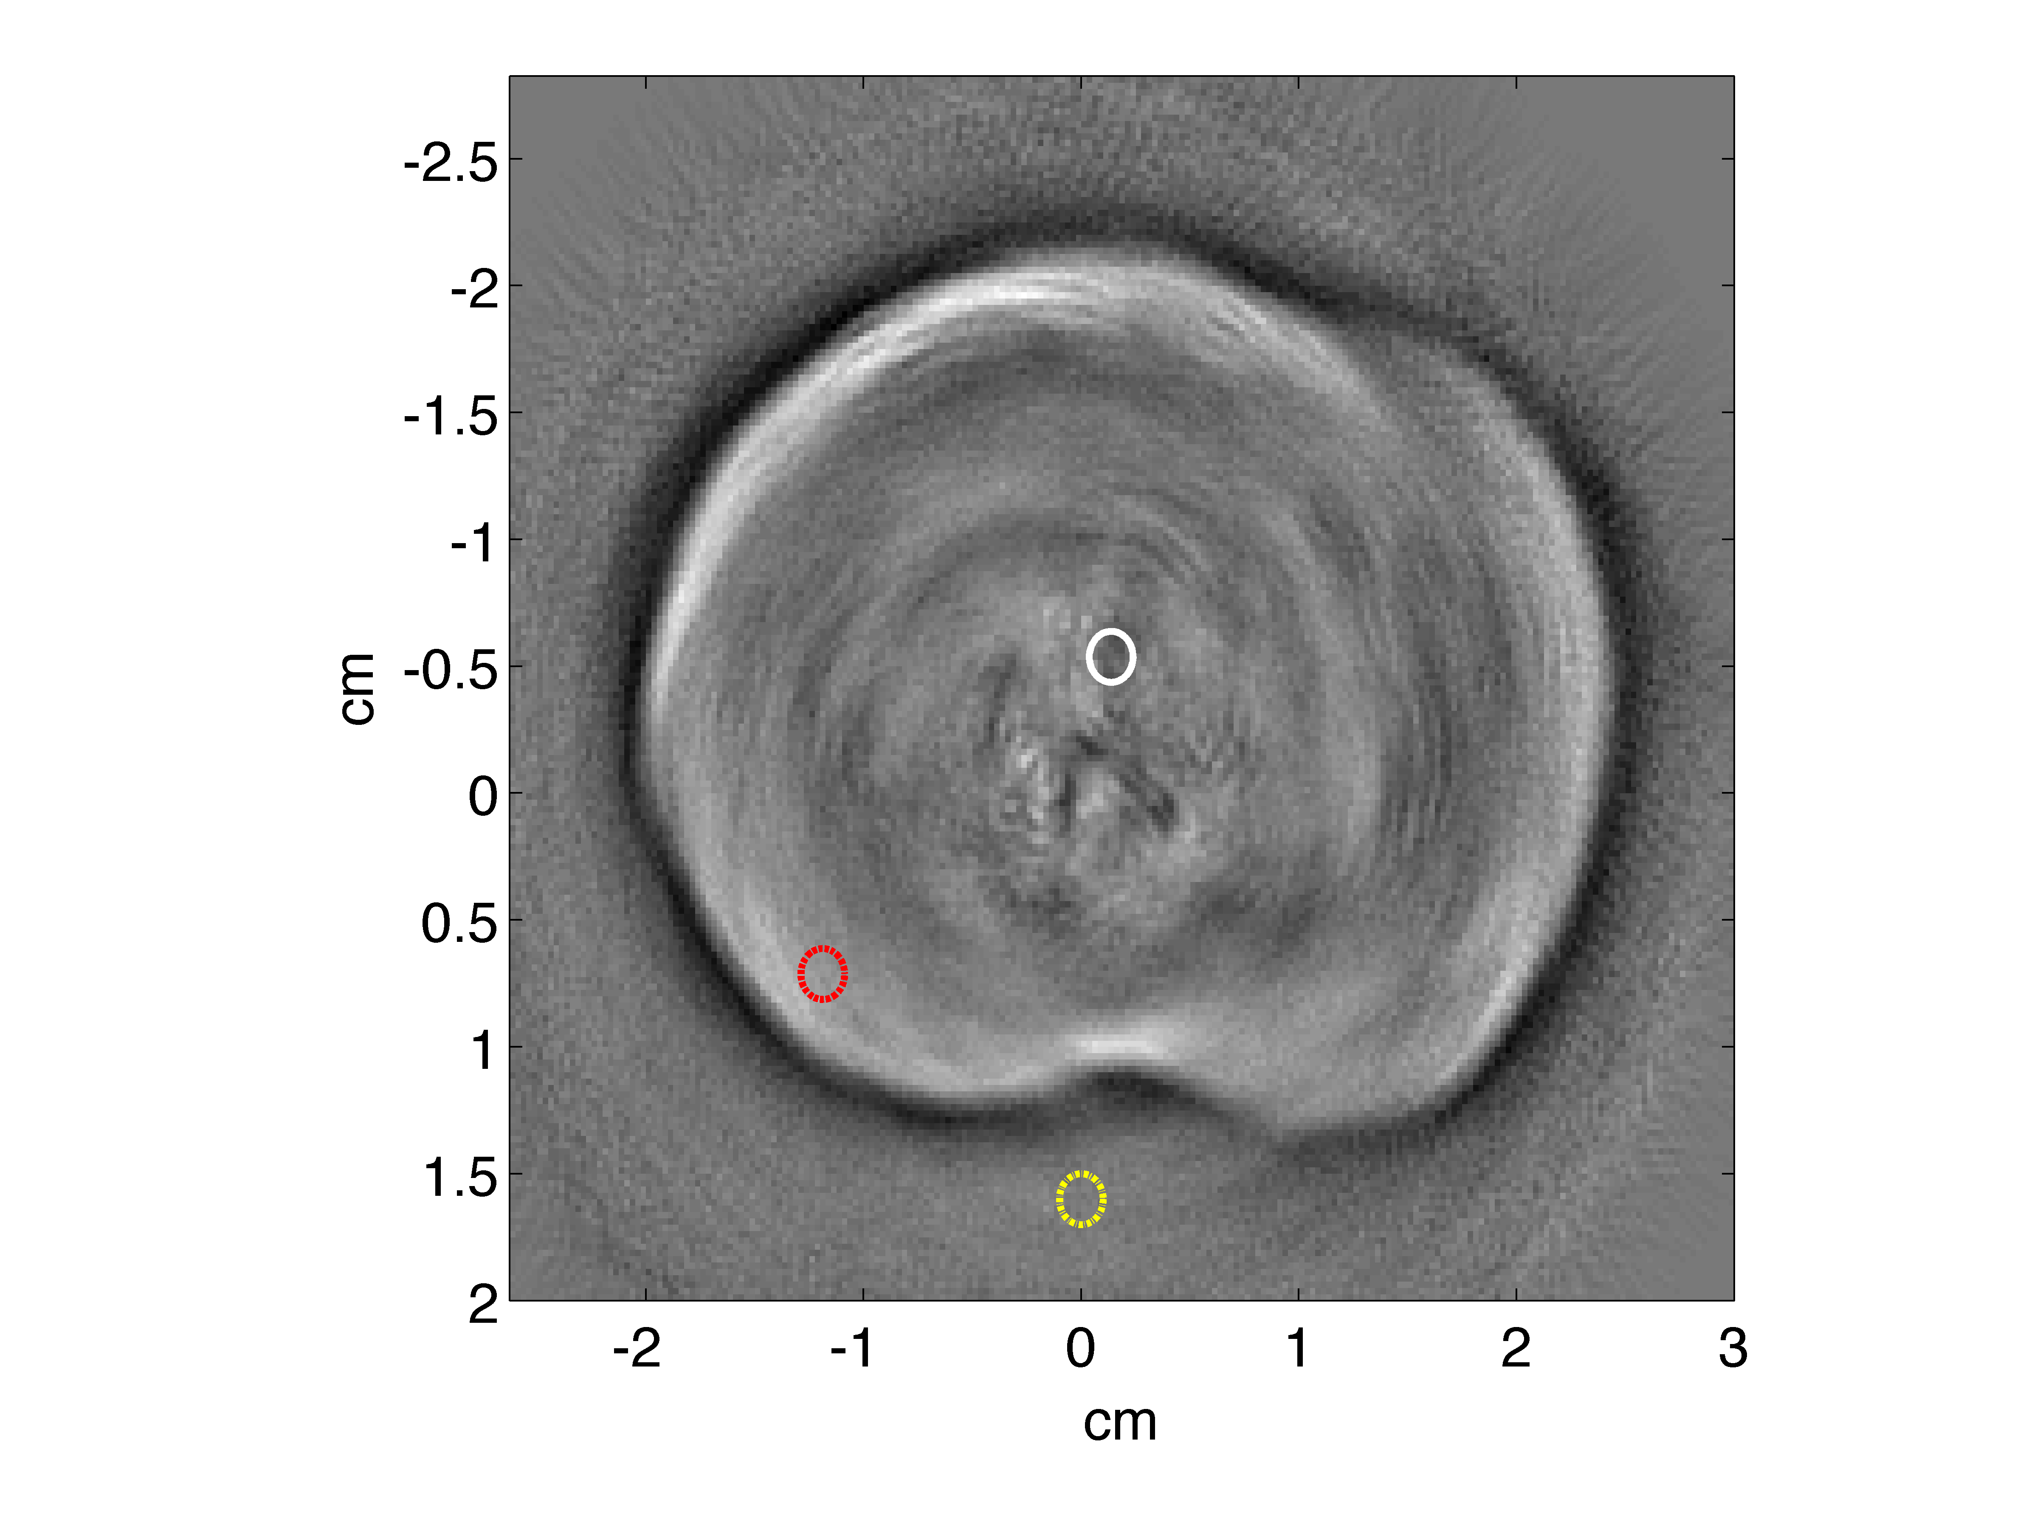
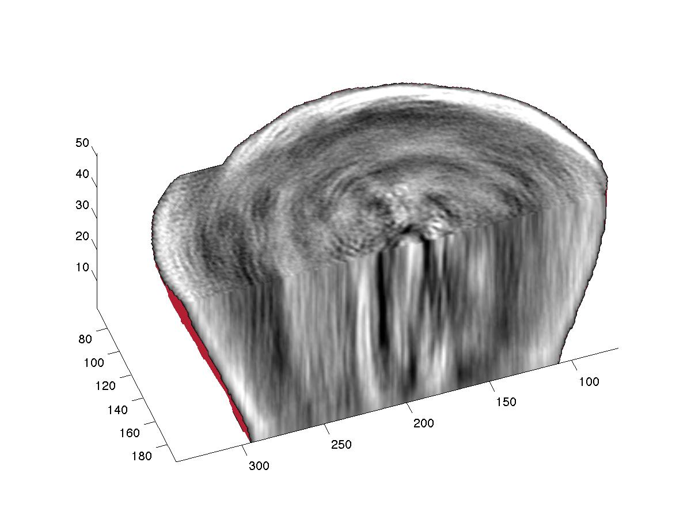
Multi-Channel Viz
base
Acquired by 96 channel transducer array + Verasonics
slice 51 of 162 total
urethra
verumontanum
apex
Visualize structures not typically seen on US, CT, or MRI.

Slide 5
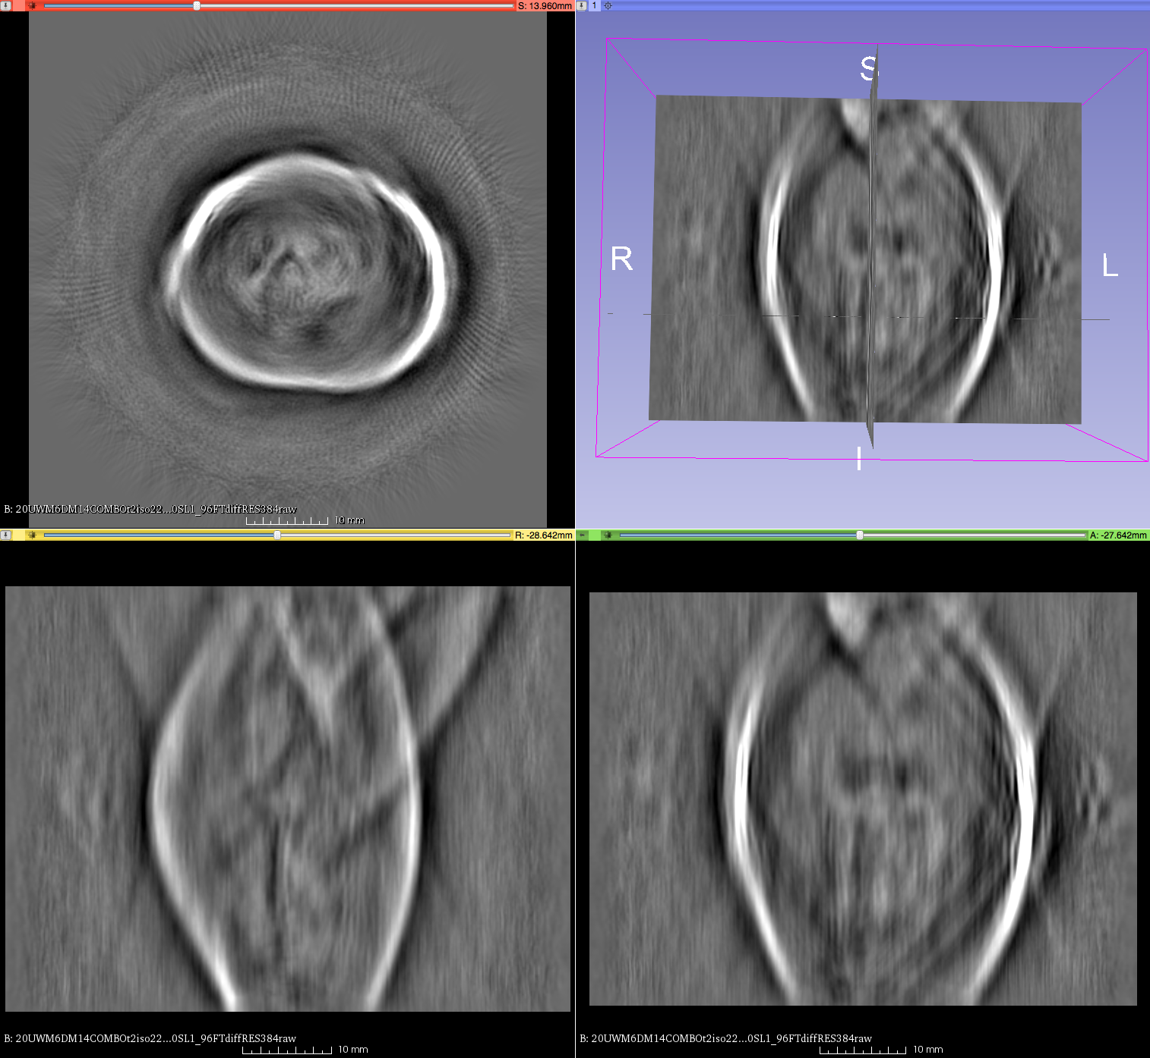
Prostate #2 of 12
viz in 3D Slicer
axial
A
R
L
veru
P
engorged vesicles
streak artifact
A
P
sagittal
coronal

Slide 6
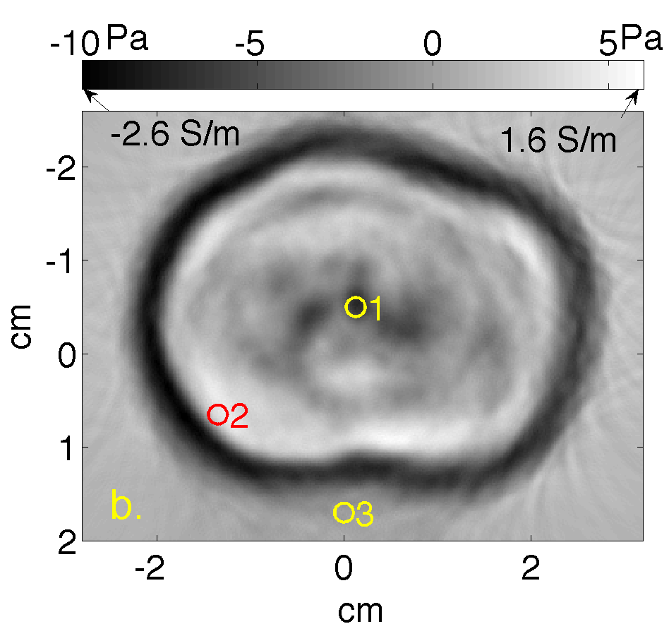
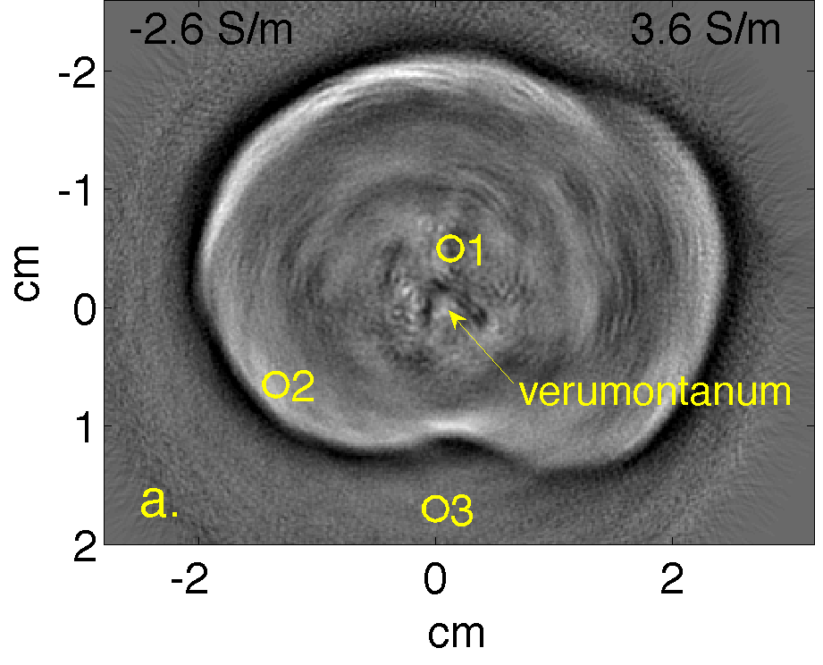
Single element vs. clinical array
combined
single element P4-1

Slide 7
qTA of saline, σ ~ 1 S/m
1. reconstruct δp in Pa from V/Pa response
2. infer σ using Γ = 0.1 and |E| = 6 kV/m
Pa
Pa
Pa
P4-1 V306 ave.

Slide 8
Quantitative TCT take-aways
Very high (100 MHz) EM-induced thermoacoustics can provide
whole organ images over 6+ cm FOV
image of electrical conductivity, ionic content + relaxation
Benchtop TCT system often detects anatomical structures.
Very low US frequencies (20 kHz) critical for “qTA” imaging.
Acknowledgements
Clinical support: MCW CTSI & Tissue Bank, H Engelke & Dr. K Jacobsohn
Verasonics hardware: UWM Instrumentation Grant
Data acquisition: YM Qadadha, I Elsharef & M Yang

Slide 9
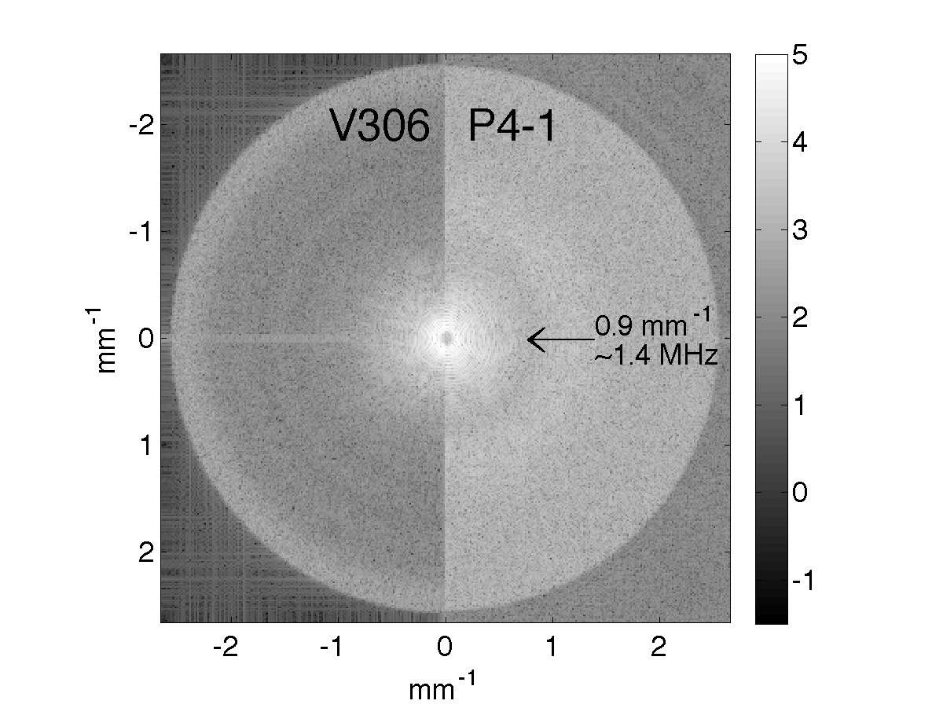
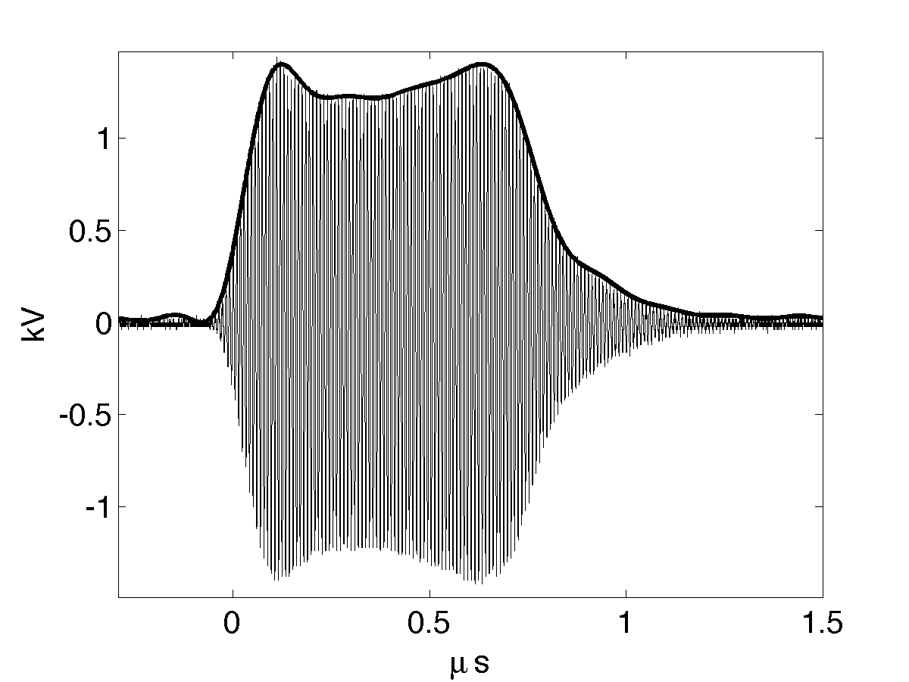
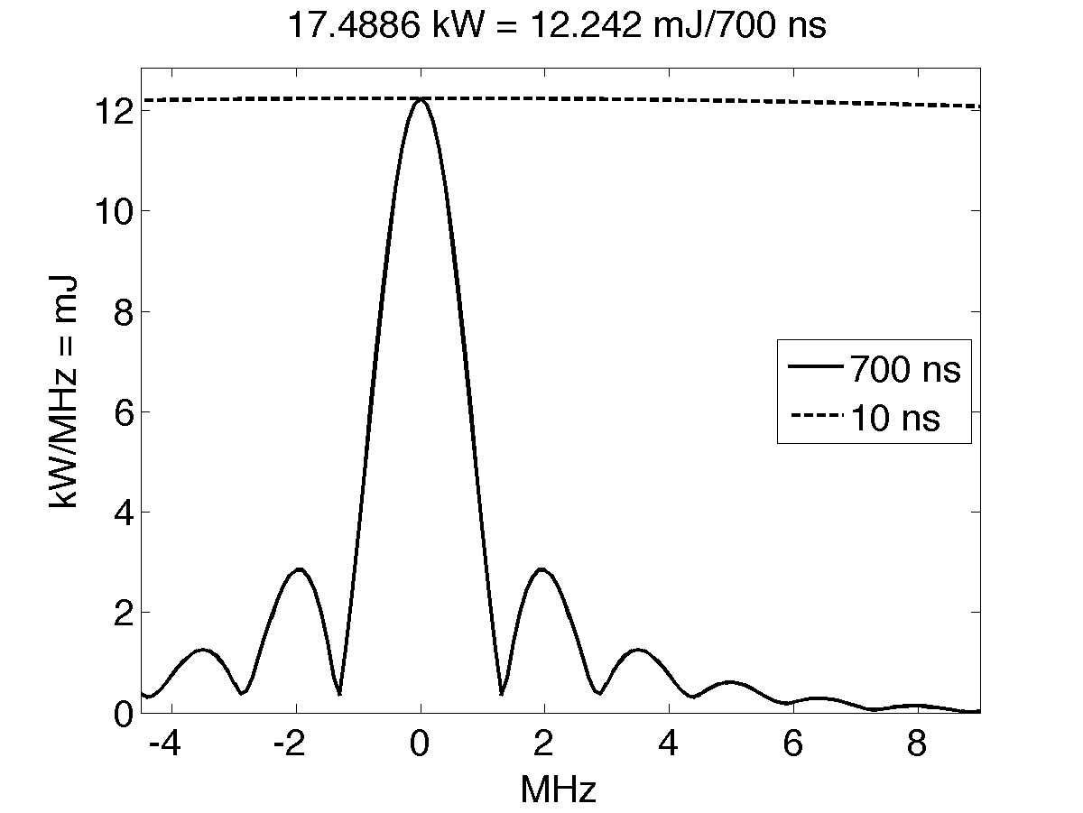
EM irradiation power spectrum vs. k-space
S$=Γ{\left|E_{o}^{}\right|}^{2}σ\left(x\right)I\left(t\right)$
p = ${\text{p}}_{δ}^{}∗h ∗I$
limits contrast
power spectrum
V_{o}² FI
- incident pulse, V(t) = V_{o} I^{1/2}(t) cos(ω_{o}t)
- I^{1/2}
limits resolution

Slide 10
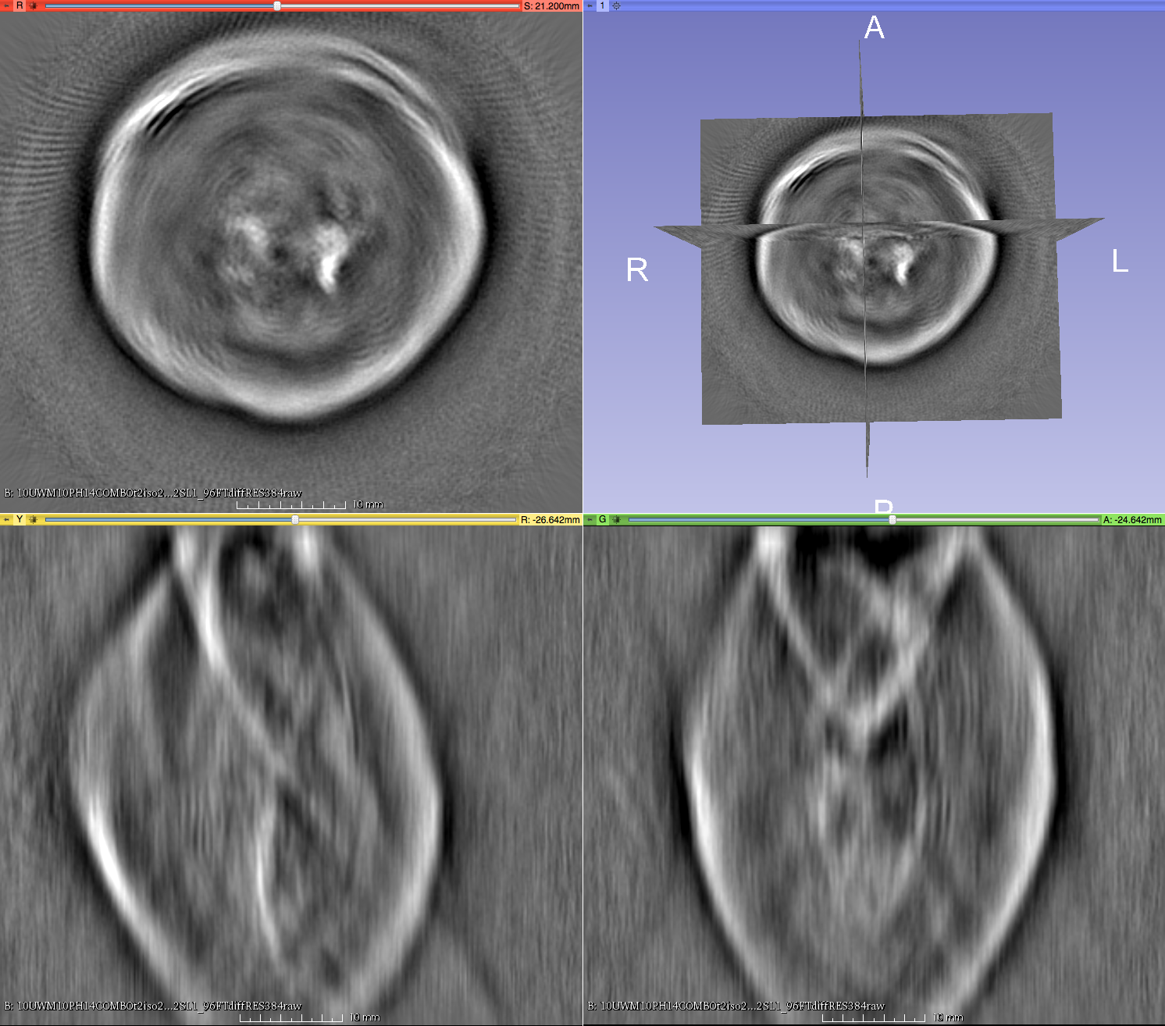
axial
A
Prostate #3 of 12
R
L
ductal structure clearly visible
P
sagittal
coronal
S
A
P
R
L
I

Slide 11
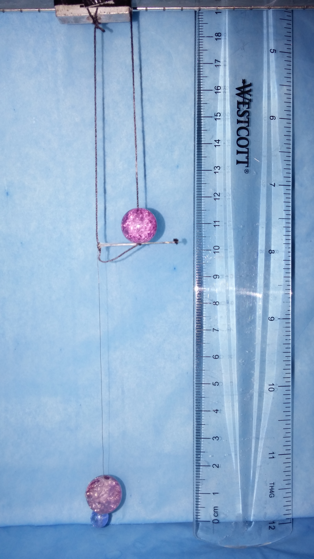
Resolution Improvement – in-plane
80 micron copper wire phantom suspended near isocenter
2.5 cm horiz. (current induced)
10 cm vertical (TA signal)
Ideal image is an 80-micron “dot.” Actual image is called the point spread function (PSF).
Expect anisotropy from polarization

Slide 12
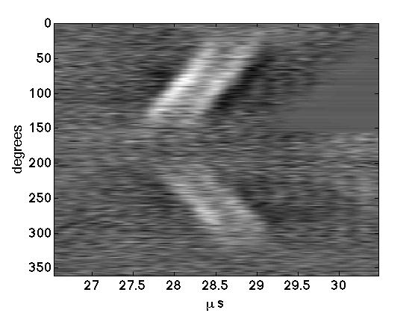
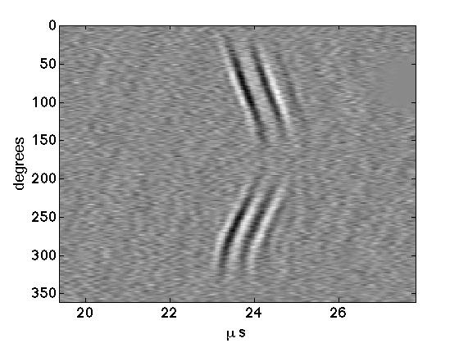
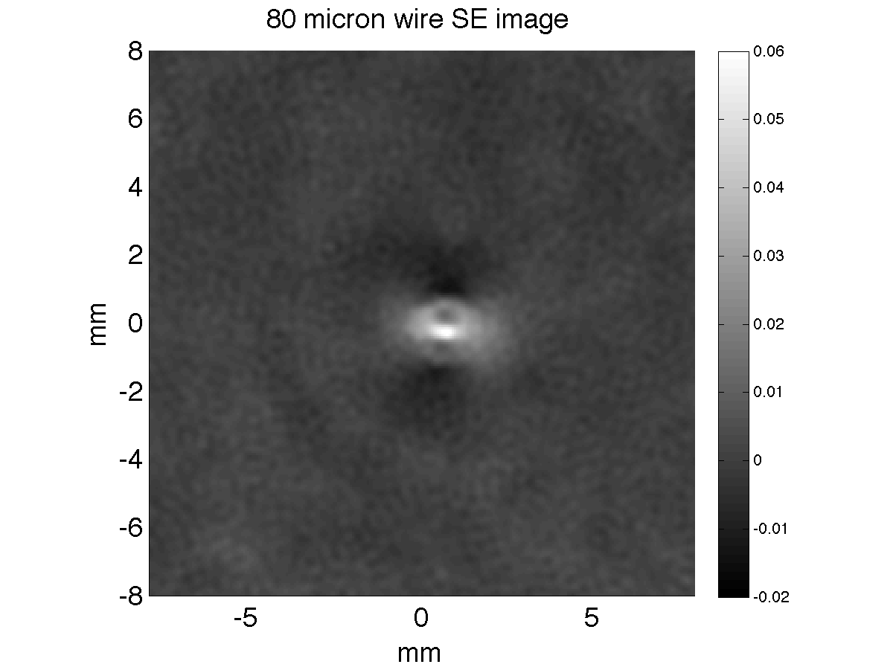
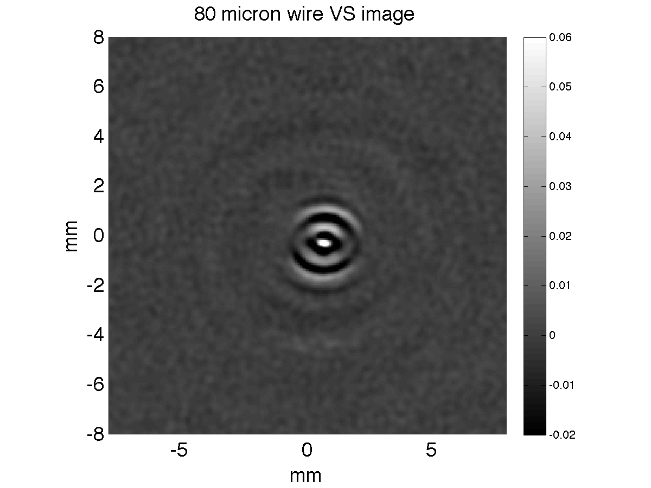
X-bar || E
X-bar || E
SE P4-1
X-bar E
X-bar E
X-bar || E
X-bar || E
“old” SE “new” P4-1

Slide 13
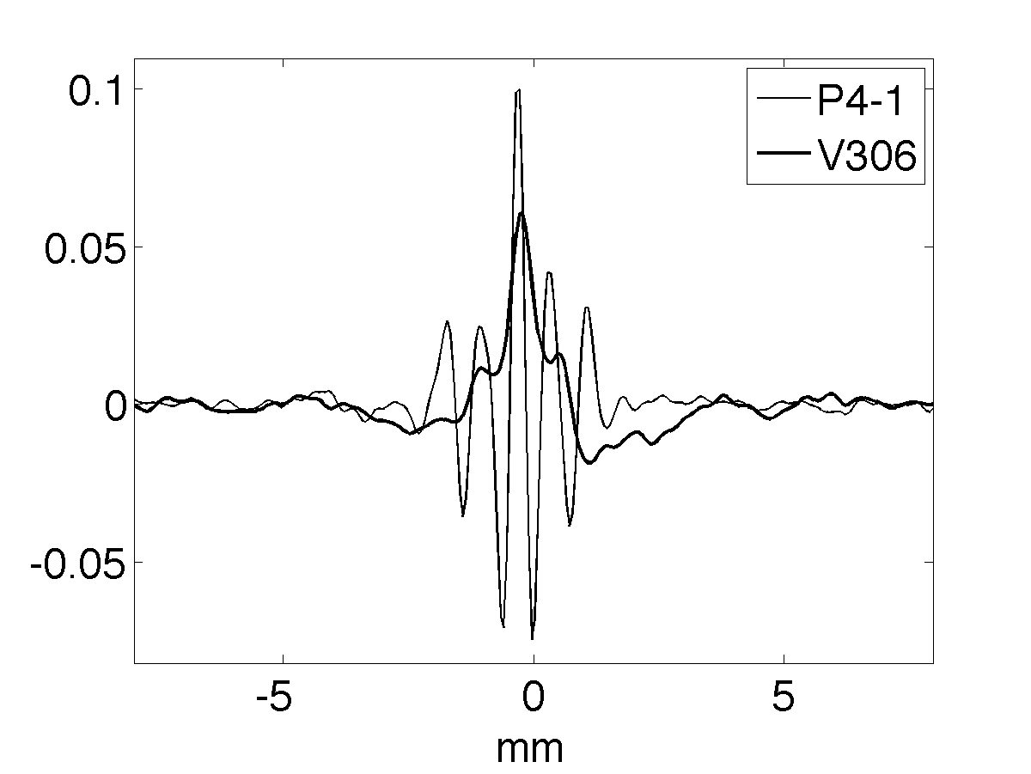
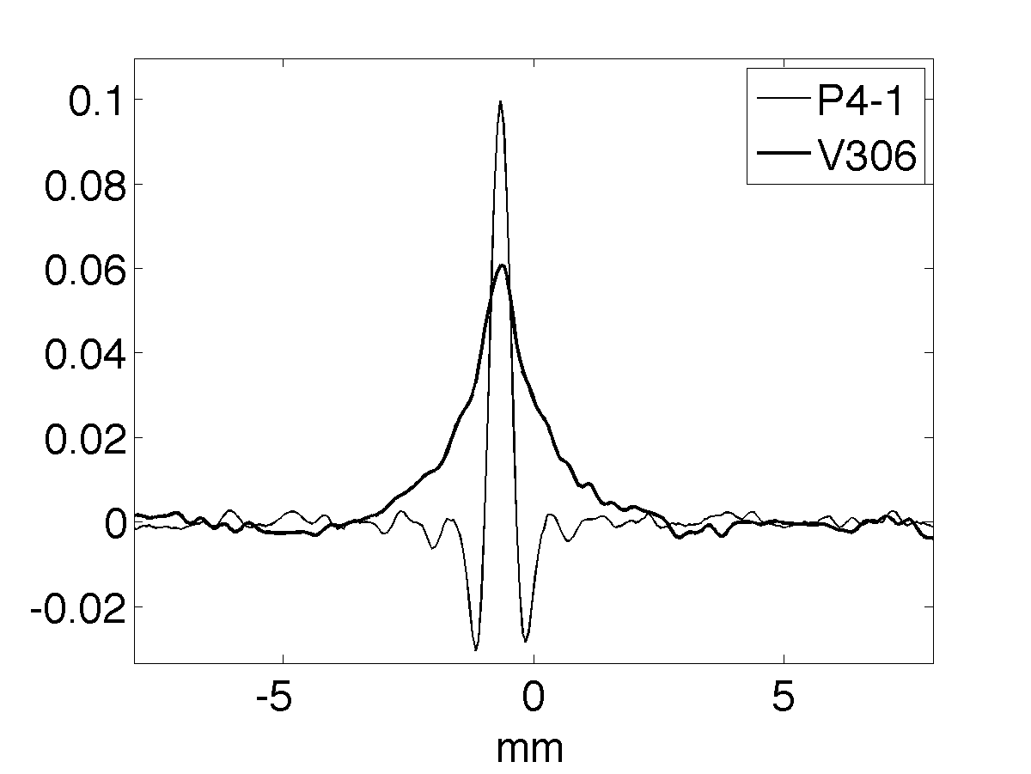
Best and worst-case resolution
parallel perpendicular

Slide 14
Backup Slides

Slide 15
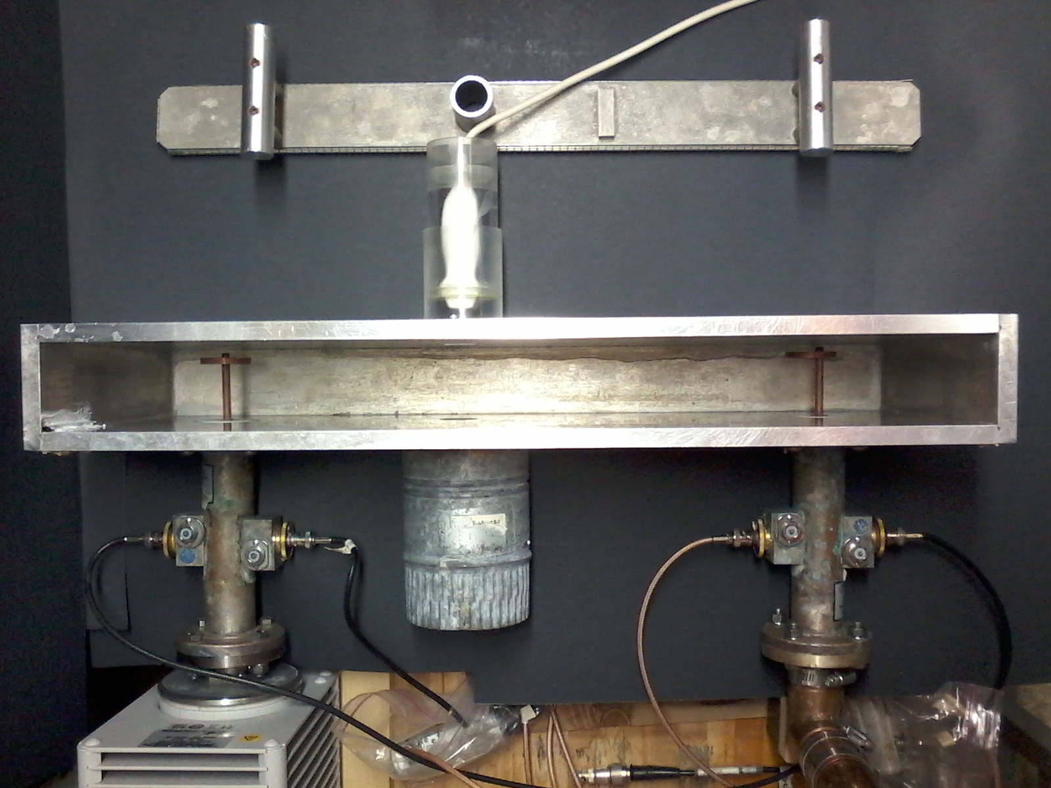
Upgrade to Clinical Array + Verasonics Box
Propagate ~25kW TE10 pulse
carrier freq 108 MHz
pulsewidth 700 ns
lid
copper EM output probe
P4-1 clinical
array, recessed
copper EM input probe
insertion direction
64 cm
6 cm
E-field polarized horizontally
single-element transducer
1 5/8” line section
rotation/ translation axis
50 dB slugs

Slide 16
k-space and image quality
- P4-1 improves resolution
- contrast/accuracy suffer
piezos high-pass
➔miss k-space center
➔pixel values wrong
log10 scale
background shading
SE P4-1 array

Slide 17
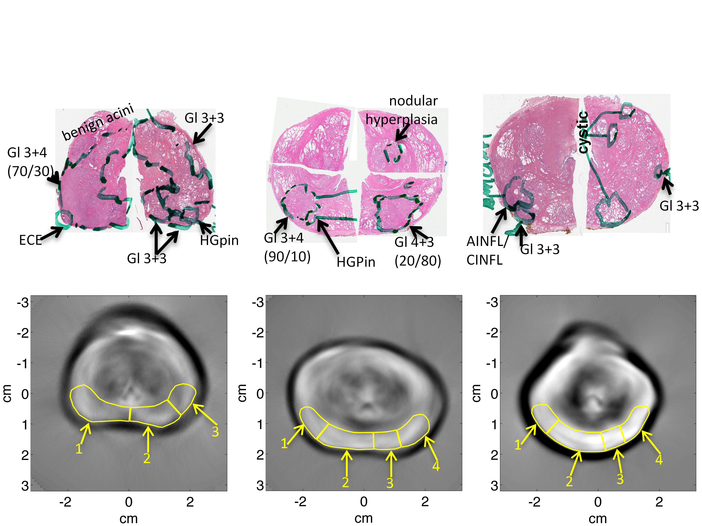
Low Frequency Results 2.25 MHz single element transducer
#2
#3
#1
display window [-0.7, +0.7] mV
verumontanum

Slide 18
TCT vs Gleason (primary) N=11 ROIs shown above

Slide 19
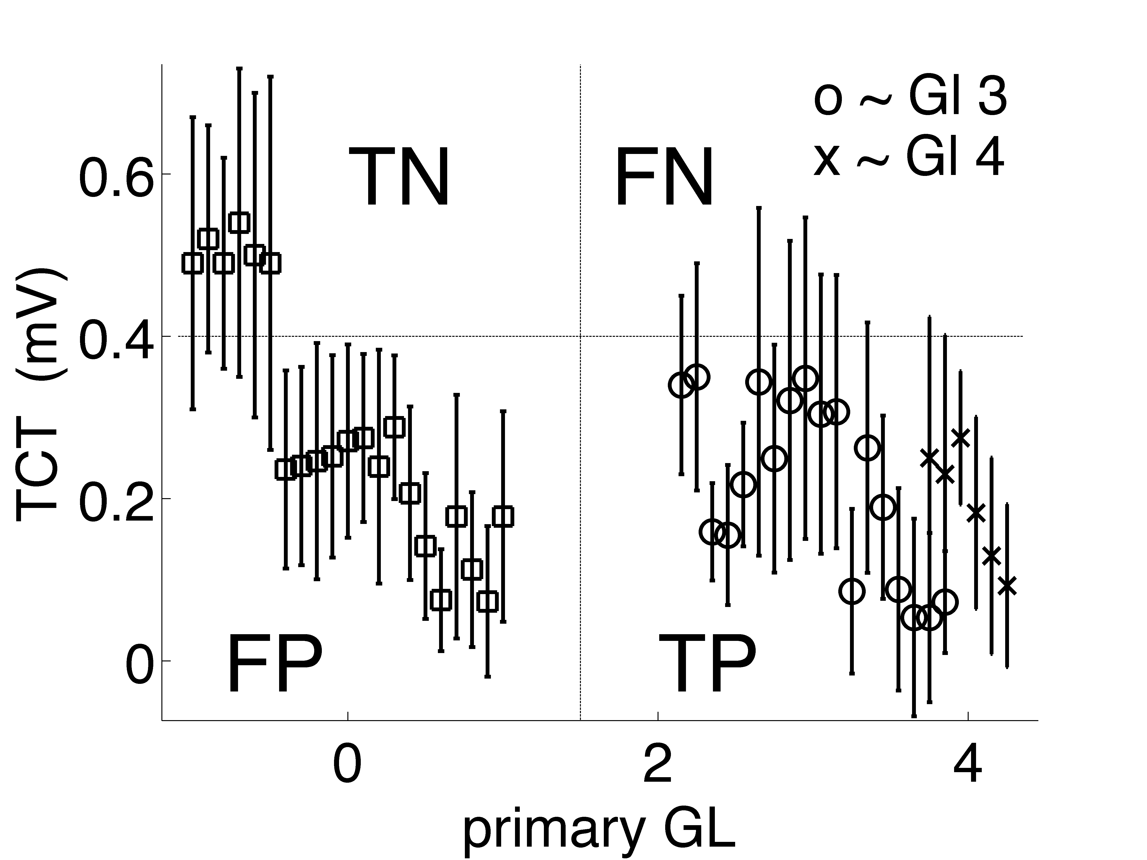
TCT vs Gleason (primary) N=45 ROIs in posterior peripheral zone

Slide 20
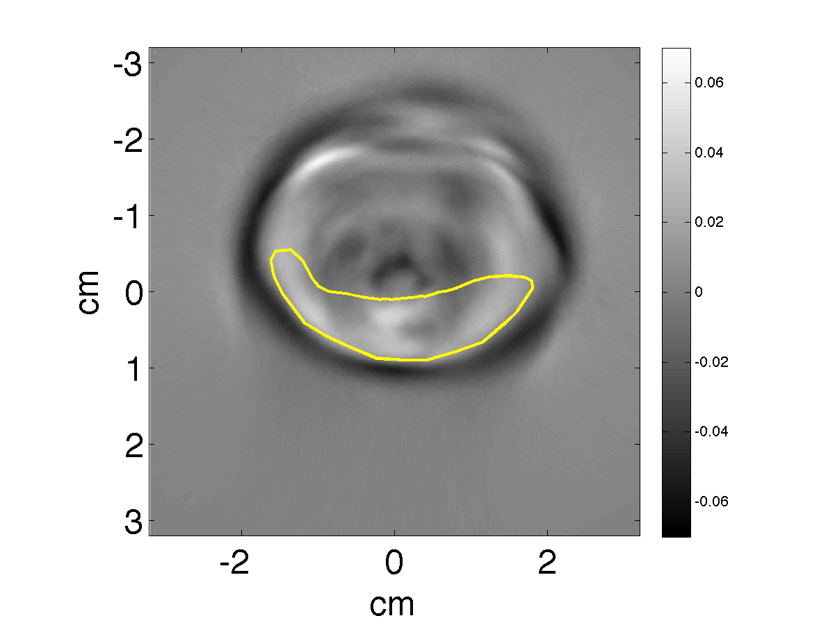
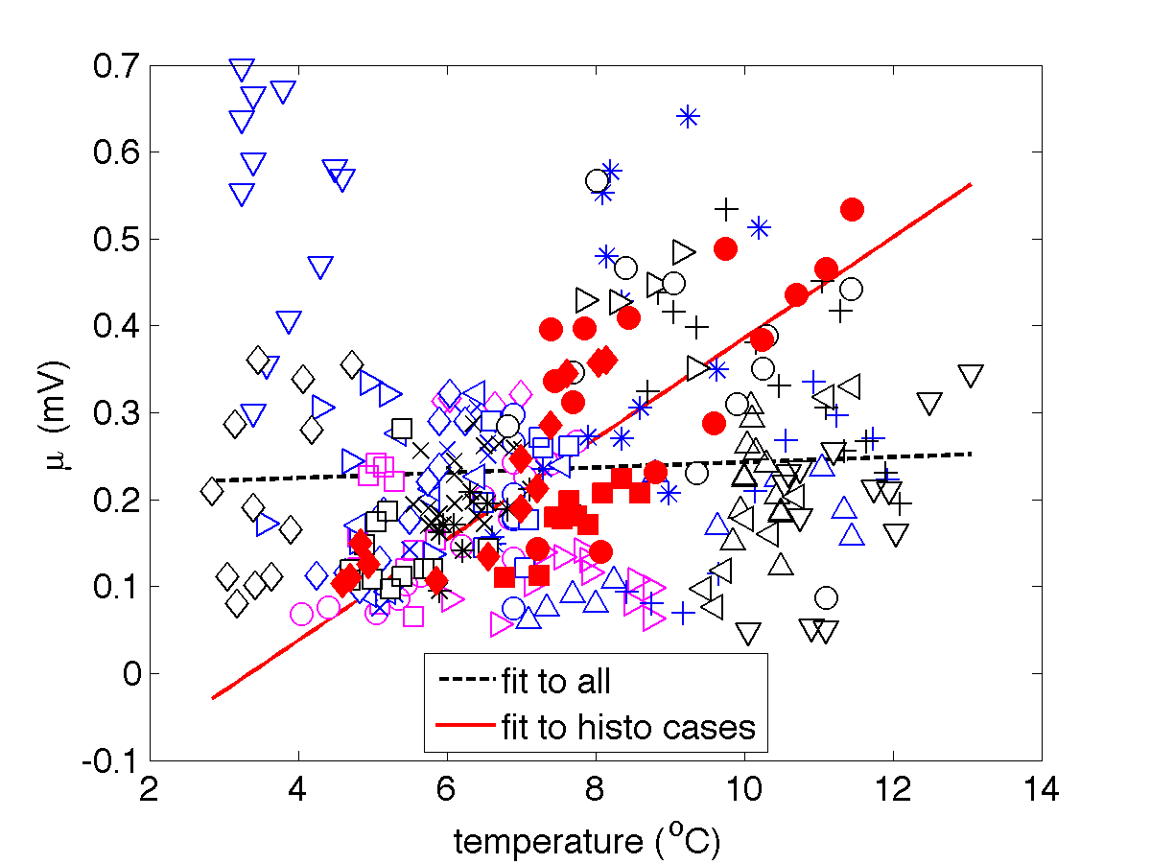
Limitations – temperature and incident power variations
ROIs posterior of each slice from 25 control specimens (hollow)
#1 #2 #3• 3 annotated specimens (solid)
average TCT vs. temp

Slide 21
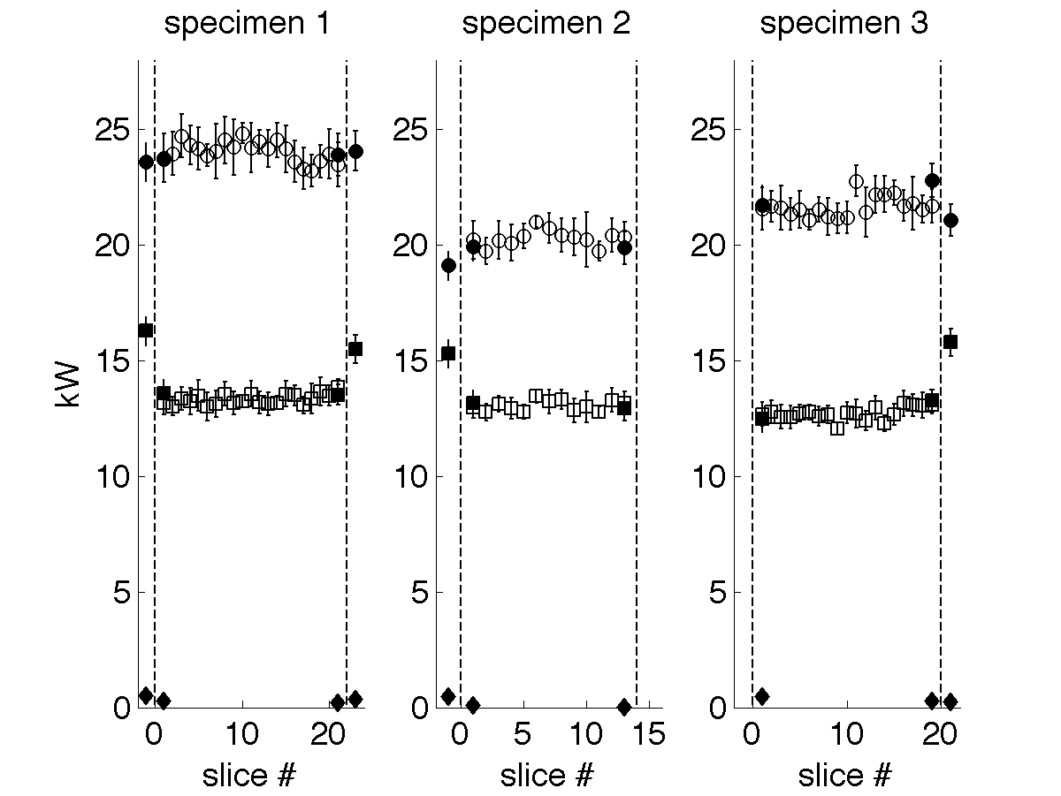
Limitations – incident power
P1_{inc}  incident
P1_{ref}  reflected
P2_{inc} ☐ transmitted
line section & 50 dB atten. slugs by Bird Electronics
unloaded (w/o prostate)
solid 4-channel data
monitor reflected power
loaded
loaded
loaded
hollow 2-channel data
w/o reflected power

Slide 22
Preliminary Conclusions
Controls for Limitations
5°C temp range likely contributed to signal difference,
BUT not enough to account for observations
EM incident power greatest for prostate #1, which produced least signal
- VHF heating yields TA contrast driven by ionic content.
- observed suppressed TA signal from diseased PZ tissue.
(for 45 ROIs from only 3 specimens 0.4 mV provides
100% sensitivity but 29% specificity.)
Acknowledgements MCW Support Team M Thomas - CTSI funded (NIH #8UL1TR000055) H Kelly, H Engelke
students: E Hanson (McGill)

Slide 23
transducer
Thermoacoustic Imaging
inverse source problem
ν_{s} t₂
ν_{s} t₁
- rapid EM heating (MRI)
- pressure jump (US)
- spherical sinogram (CT)
prostate
contrast = f(dielectric,
mechanical,
thermal)
mechanical
thermal
Ionic content of prostatic fluid negatively correlated to disease state (Kavanagh 1985).
electrical
+ homogeneous initial conditions
MRSI based on citrate suppression (Narayan & Kurhanewicz ‘92)
in vitro NMR more specific than PSA (Serkova 2008).

