Slide 1

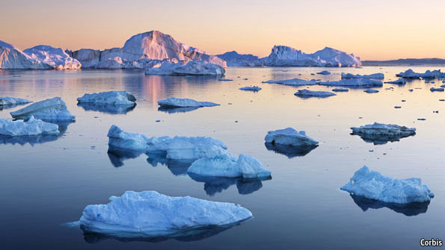
Watershed Heat Flows, Lags and Dampening under Climate Forcing
UWM Colloquim 11 May 2023
Although there is widespread agreement that future climates tend toward warming, the response of aquatic ecosystems to that warming is not well understood.
Although there is widespread agreement that future climates tend toward warming, the response of aquatic ecosystems to that warming is not well understood.
By means of updates to numerical codes that couple flow and heat transport, we have a developed a method to study the effects of anticipated climate change on temperatures and heat flows in a synthetic temperate watershed.
Although there is widespread agreement that future climates tend toward warming, the response of aquatic ecosystems to that warming is not well understood.
By means of updates to numerical codes that couple flow and heat transport, we have a developed a method to study the effects of anticipated climate change on temperatures and heat flows in a synthetic temperate watershed.
All major flow and transport pathways are considered – pivotal to prediction are the lags and dampening which occur in the unsaturated zone.
Daniel Feinstein, USGS (half retired)
Eric Morway, USGS
Randy Hunt, USGS

Slide 2
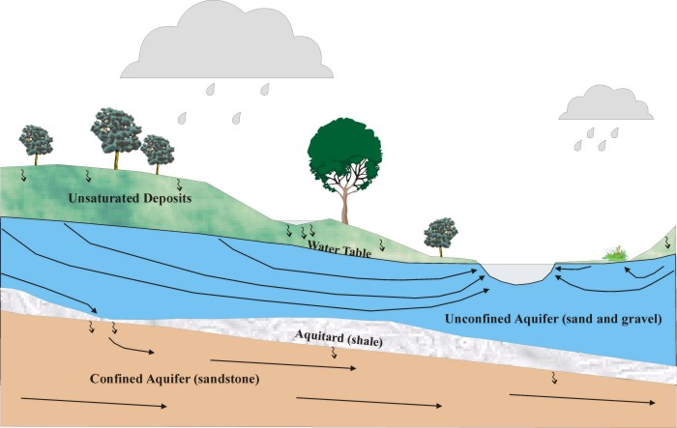
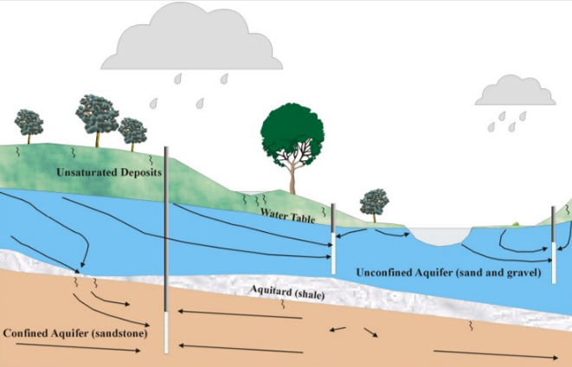
UWM Colloquim 11 May 2023
STARTING POINT for studying
the shallow subsurface:
Unconfined aquifer
Inflow from recharge
Outflow to surface-water network
STARTING POINT for studying
the shallow subsurface:
Unconfined aquifer
Inflow from recharge
Outflow to surface-water network
Outflow to shallow wells
Notes:
Core elements of any groundwater flow model of shallow subsurface. SUFFICIENT FRAMEWORK FOR MANY OBJECTIVES.
Slide two shows elements of our simple models - and they are mostly imposed rather than solved - like the recharge rate APPLIED at the WT, the streams and wetlands and pumping as EXTERNAL BCs to the model. And this is fine for many objectives. But for some problems and decision support, we want these elements to be internal to the model (slide 3).

Slide 3
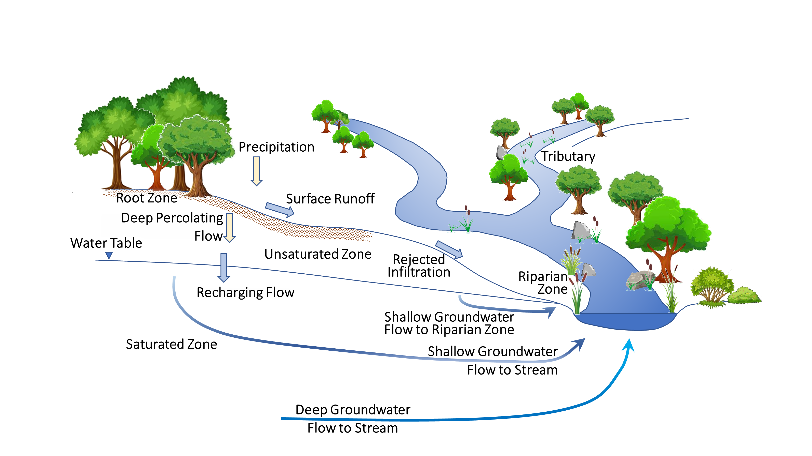
UWM Colloquim 11 May 2023
Alternative perspectives for modeling the shallow subsurface:
Interfaces and Pathways
Interfaces:
Water Table
Land Surface (infiltration, seepage)
Streambed/Lakebed
Interfaces:
Water Table
Land Surface (infiltration, seepage)
Streambed/Lakebed
Pathways:
Unsaturated Zone
Stream Channel
Riparian Zone
Rejected Infiltration
Surface Runoff
Groundwater Runoff
Flow
Line
Notes:
Grid refinement to improve simulation of interfaces ➔ unstructured models
Badger example: Without UZ, Sy acts as surrogate to get timing of water table fluctuation
That is, we want to calculate how infiltration turns to recharge thru the UZ and how groundwater flow turns to discharge at the land surface and creates wetlands. Or how pumping (not shown in slide 3) induces flow from a stream, perhaps drying up a headwater. Or even how pumping rates respond to climate change (=> Farm Process).

Slide 4

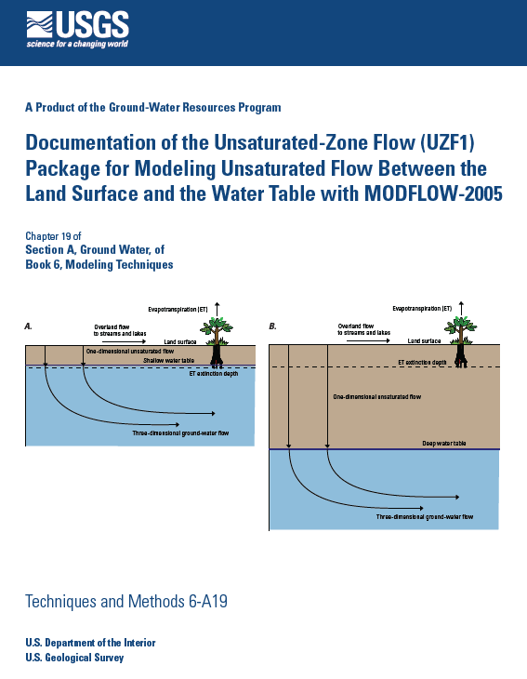
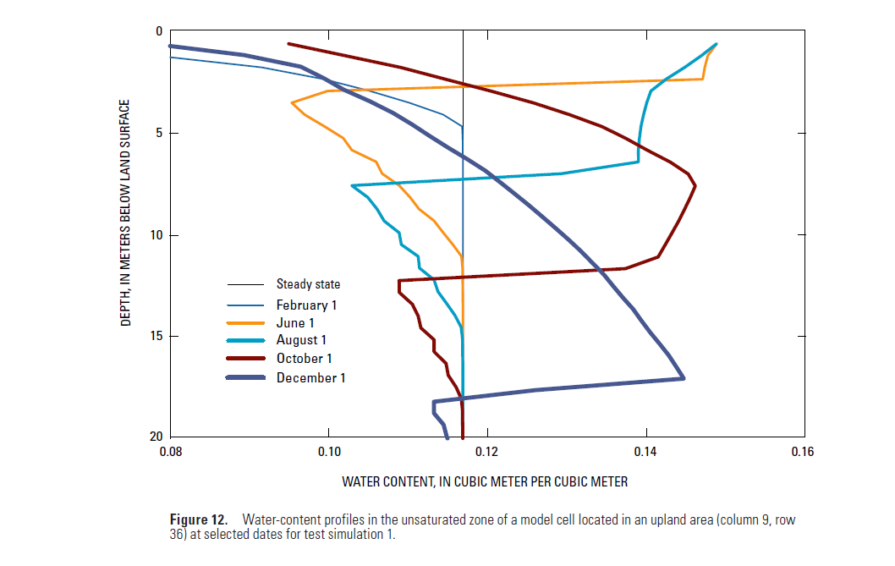
UWM Colloquim 11 May 2023
BASIC ELEMENTS
to represent heat flow through the unsaturated / groundwater / surface-water system
For unsaturated and saturated flow = MODFLOW
For transport = MT3D-USGS, modified to take into
account the unsaturated zone and heat propagation.
The unsaturated zone:
UZF in MODFLOW

Slide 5

UWM Colloquim 11 May 2023
the unsaturated zone:
UZF – MODFLOW2005
Richard Niswonger, USGS
The UZF package of MODFLOW begins with infiltration below the land surface (or root zone) and simulates transient percolation across the unsaturated zone, the recharge to the water table at the top of an unconfined aquifer, ithe gains to and losses from storage in the unsaturated zone, the evapotraspiration dfrom the unsaturated zone and the water-table aquifer, and the “groundwater” runoff due to rejected infiltration and to discharge from the aquifer to the land surface (i.e,, wetlands and fens).

Slide 6
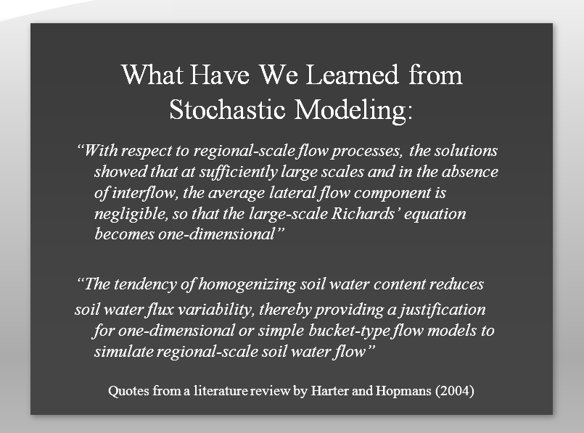
UWM Colloquim 11 May 2023
The UZF package allows ready calculation of flow from the bottom of the root zone to the water table by replacing the Richards equation with the 1D kinematic wave assumption (Niswonger and Prudic, 2009), effectively neglecting capillary effects and privileging downward gravitational flow conditioned by the relation of UZ hydraulic conductivity to transient water content.
The UZF package allows ready calculation of flow from the bottom of the root zone to the water table by replacing the Richards equation with the 1D kinematic wave assumption (Niswonger and Prudic, 2009), effectively neglecting capillary effects and privileging downward gravitational flow conditioned by the relation of UZ hydraulic conductivity to transient water content.
The kinematic wave formulation is markedly more efficient than solving the full Richards. and is suited for transient modeling at the watershed scale where capillary and preferential flow effects are secondary to the downward movement of (often overlapping) wetting fronts (Harter and Hopmans, 2004).

Slide 7
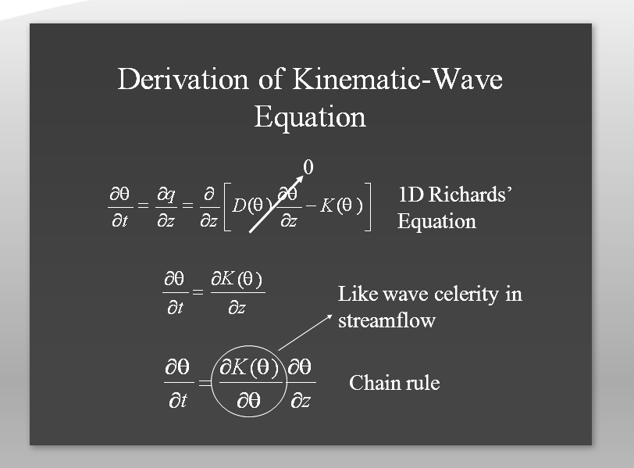
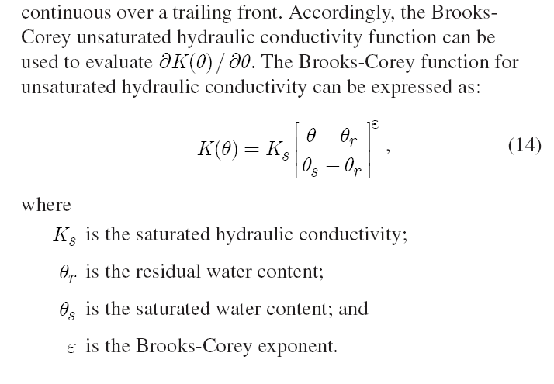
UZF documentation, 2006
The Brooks-Corey function is used to define the relation between h unsaturated hydraulic conductivity and water content.
UWM Colloquim 11 May 2023
= POROS - Sy
= POROS
Wetting and drying fronts in superposition.
The dependent variable is WATER CONTENT, (Θ)

Slide 8
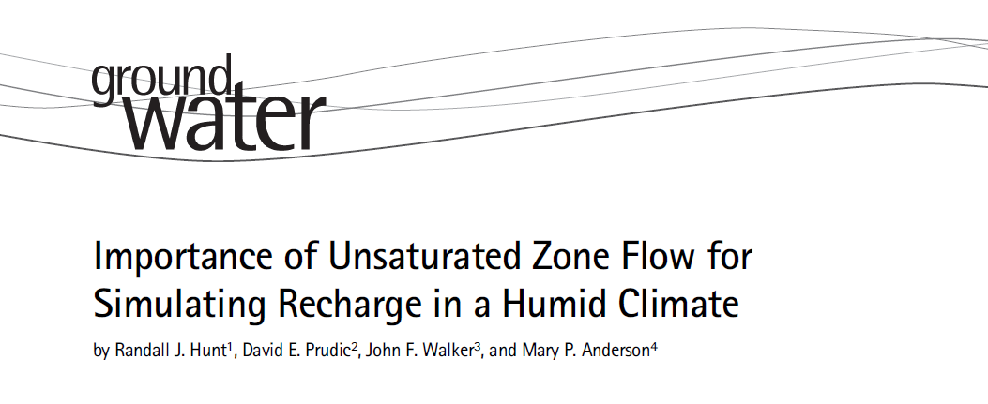
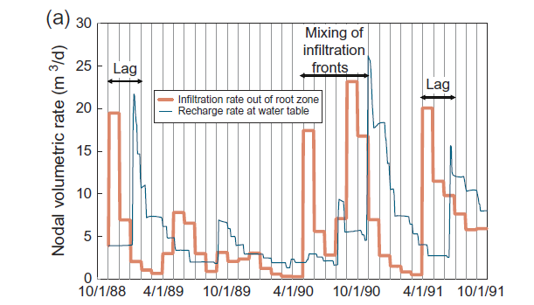
UWM Colloquim 11 May 2023
2008
Water
Focused
Work
2008
Thick Unsaturated Zone (UZ)
Unsaturated Zone acts like a Low-Pass Filter that lags and mixes recharge at the water table behind the infiltration front leaving the root zone
Timeseries of infiltration and recharge
Thicker unsaturated zone ➔ bigger lag times

Slide 9
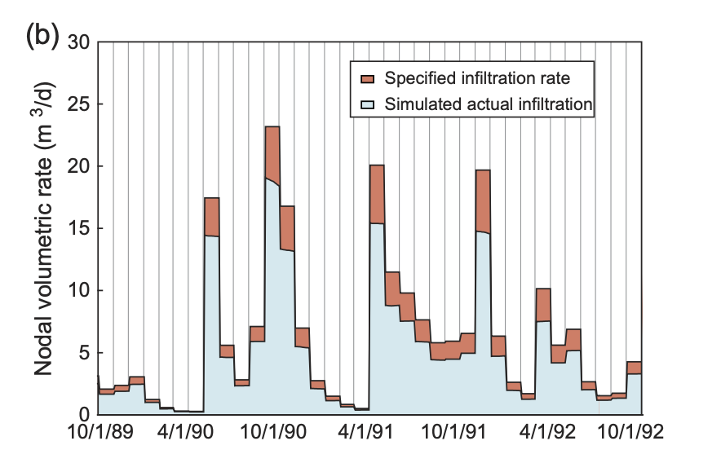
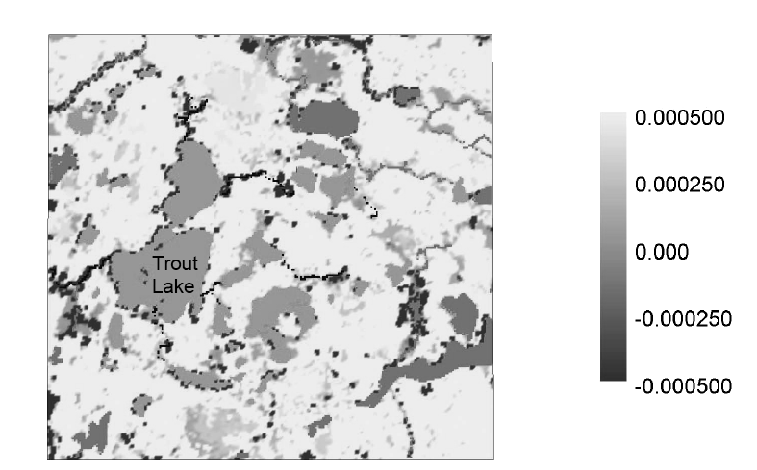
UWM Colloquim 11 May 2023
2008
Water
Focused
Work
Thin Unsaturated Zone (UZ)
Dark areas ➔ surface leakage to land surface
Thin unsaturated zone ➔ rejected infiltration

Slide 10
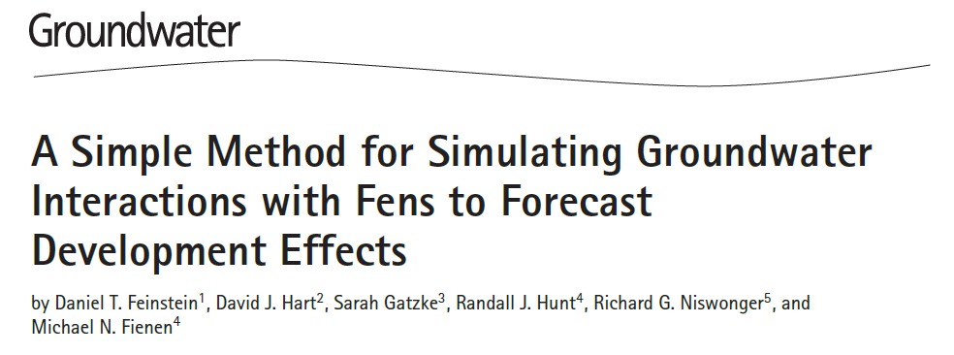
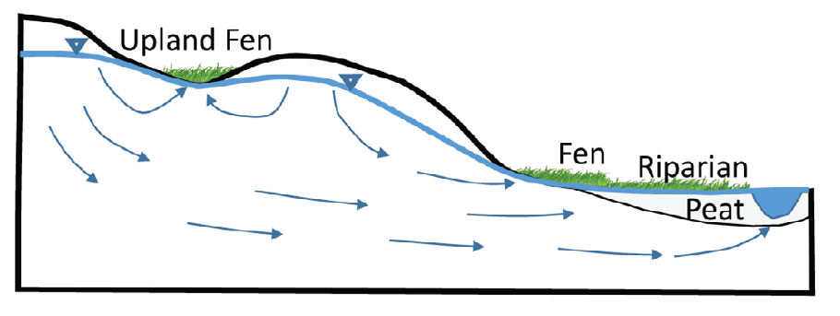
Unsaturated Zone Flow
e` girata istantanamente
Seepage Area: water table is located near the ground level.
Riparian Area: groundwater discharge alongside surface water.
Discharge assumed to flow instantaneously to the downstream water body.
UZF simulates: 1) rejected infiltration where water table near land surface +
2) seepage to land surface in low lying areas:
together they equal “GROUNDWATER RUNOFF”.
Seepage Area: water table is located near the ground level.
Riparian Area: groundwater discharge alongside surface water.
Discharge assumed to flow instantaneously to the downstream water body.
Seepage Area: water table is located near the ground level.
Riparian Area: groundwater discharge alongside surface water.
Discharge assumed to flow instantaneously to the downstream water body.
… also relevant to heat flow

Slide 11
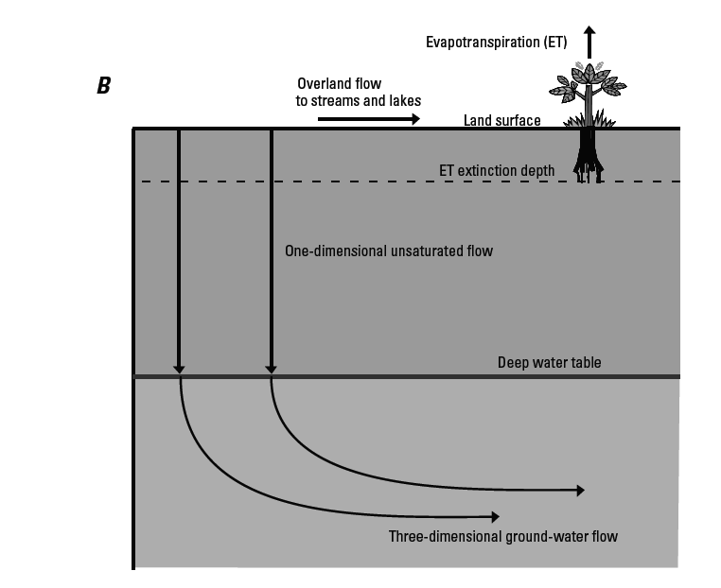
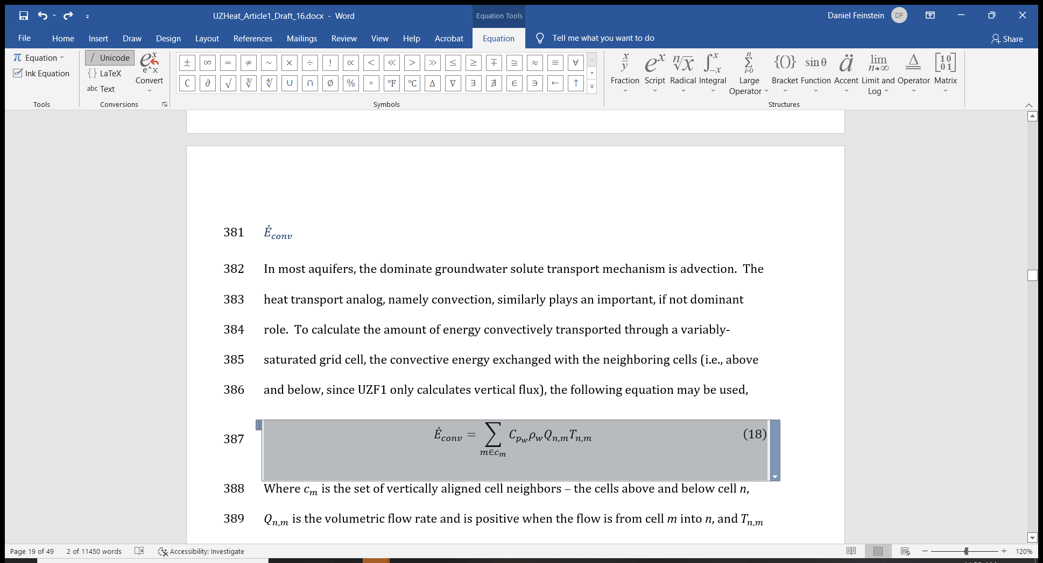
2º BASIC ELEMENT:
UWM Colloquim 11 May 2023
GOVERNING HEAT FLOW EQUATION…. PRELIMINARIES:
Definition of convection, conductance, and radiation heat flow components
Definition of “bulk”
a) Dependent variable = T (degC)
b) Energy = E (Joules)
c) Rate of flux= Watts (Joules/sec)
GOVERNING HEAT FLOW EQUATION…. PRELIMINARIES:
Definition of convection, conductance, and radiation heat flow components
GOVERNING HEAT FLOW EQUATION…. PRELIMINARIES:
Definition of convection, conductance, and radiation heat flow components
Definition of “bulk”
GOVERNING HEAT FLOW EQUATION…. PRELIMINARIES:
Definition of convection, conductance, and radiation heat flow components
Definition of “bulk”
a) Dependent variable = T (degC)
GOVERNING HEAT FLOW EQUATION…. PRELIMINARIES:
Definition of convection, conductance, and radiation heat flow components
Definition of “bulk”
a) Dependent variable = T (degC)
b) Energy = E (Joules)
Radiation
a) T analogous to water level= Head (m)
b) E analogous to water volume (m³)
c) Watts analogous to flux (m³/sec)
=> Watts/m^2 analogous to Q/m²=q
convection
Density of water
E_{cell} = Cp_{w} * ρ_{w} * Vol_{cell} * T_{cell}
Specific Heat Capacity of water
conduction
Dispersion= process that involves the deviation at the micrioscopic scale of the velocity vectors
4) ANNOTATED ADVECTION-DISPERSION equation…

Slide 12
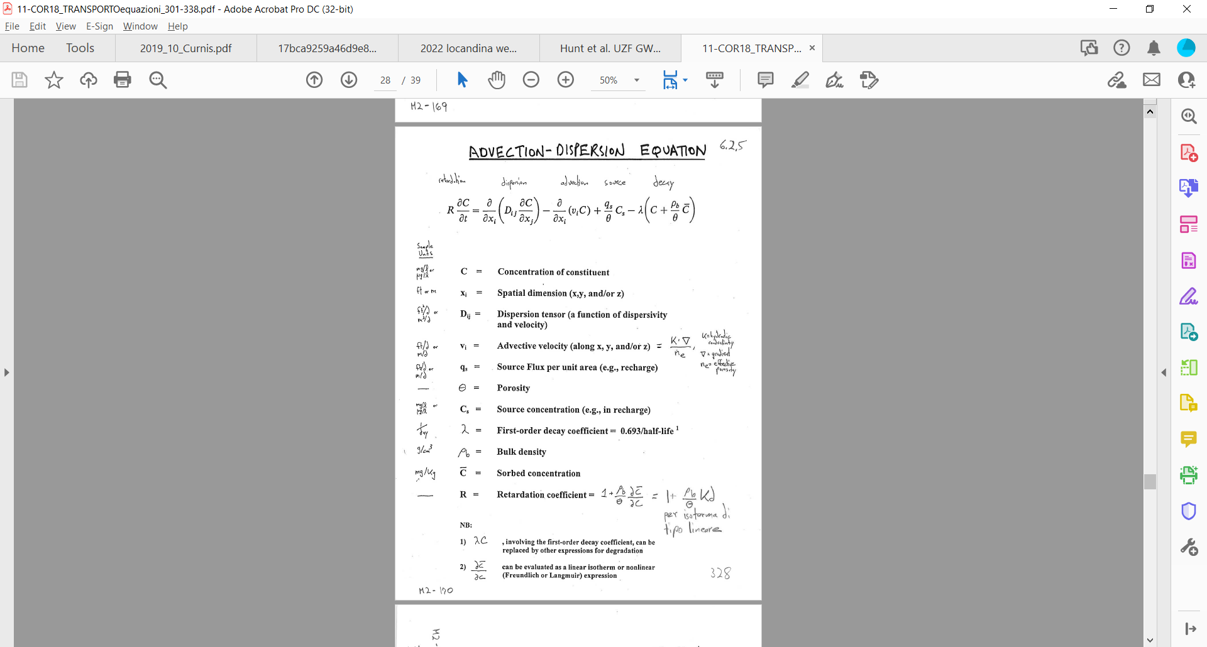
General Equation: Components of heat flow in the aquifer
convection
infiltration
+ conduction
C ➔ degT
Φ
Φ
LHS = RHS ……………………………………………………………………………..
Φ

Slide 13
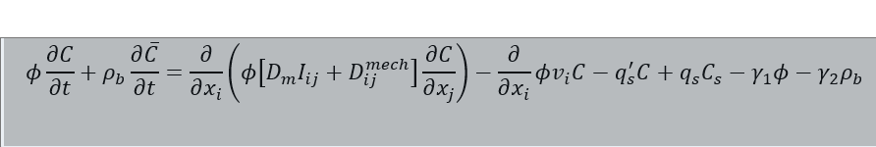
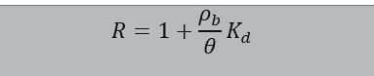
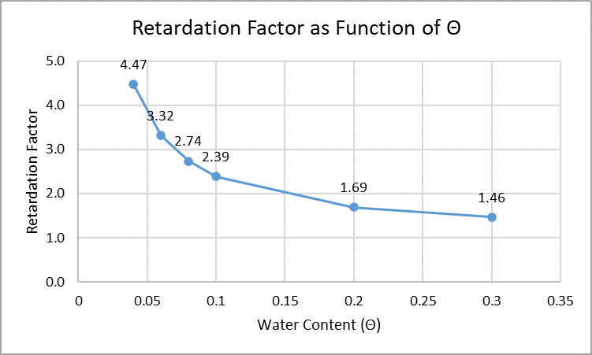
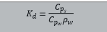
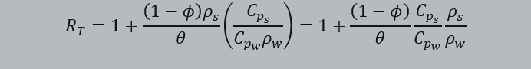
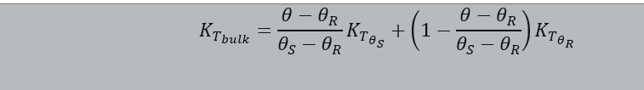
Variably-saturated transport with MT3D-USGS
General Equation...
Under Conditions of
Variable Saturation
!!!!!!
Φ= porosity
Θ = water content
Equazione di partenza
C ➔ degT
Change in stored energy
Thermal conduction
Modified from:
van Duin, R.H.A.,1963, The influence of management on the temperature wave near the surface: Wageningen, Institute for Land and Water Management Research, Technical Bulletin 29

Slide 14
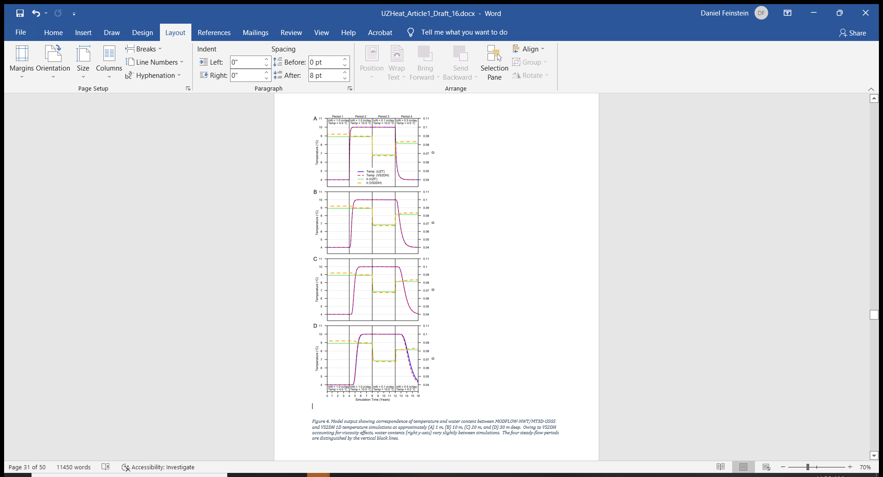
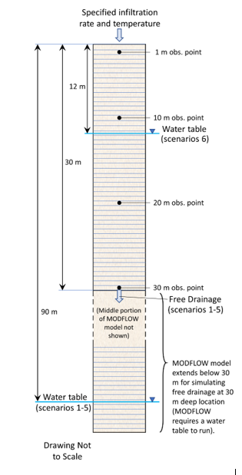
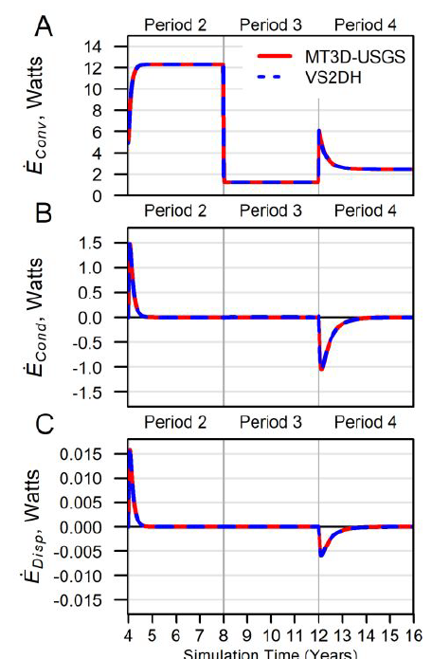
For UZ Heat Transport: MT3D-USGS
VS2DH (Richard’s eq.)
vs
MT3D-USGS (kinematic wave approximation in UZF)
Benchmarking new MT3D-USGS UZ heat transport (in review at Groundwater)

Slide 15
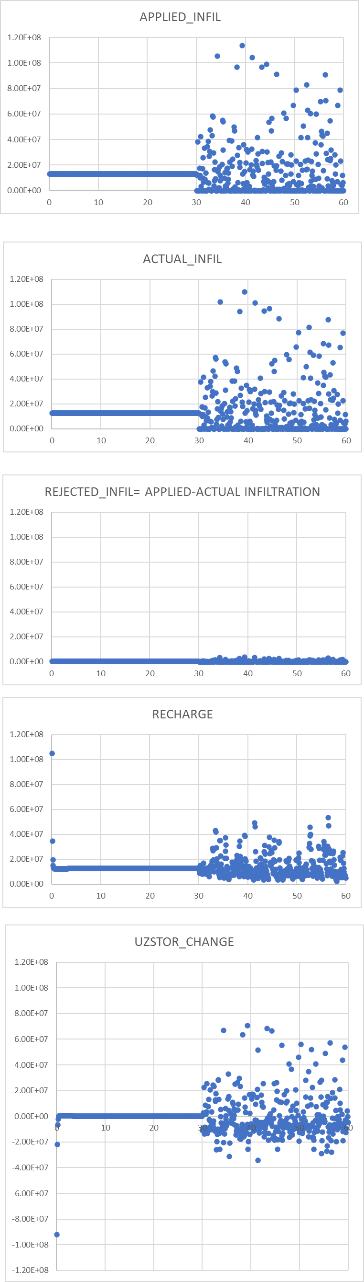
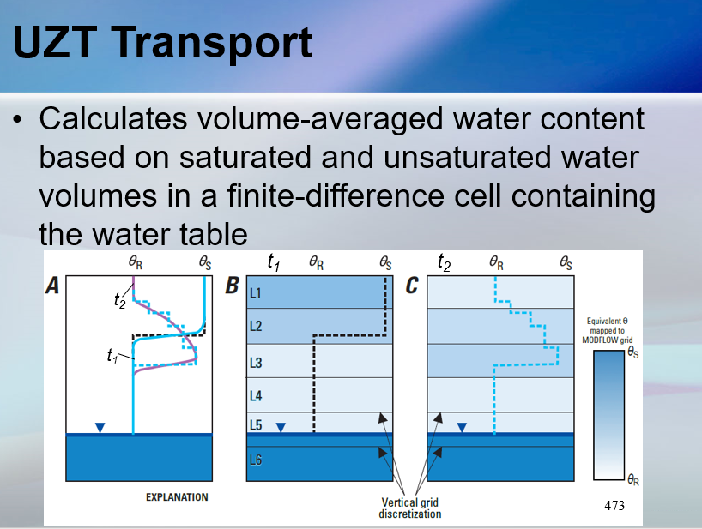
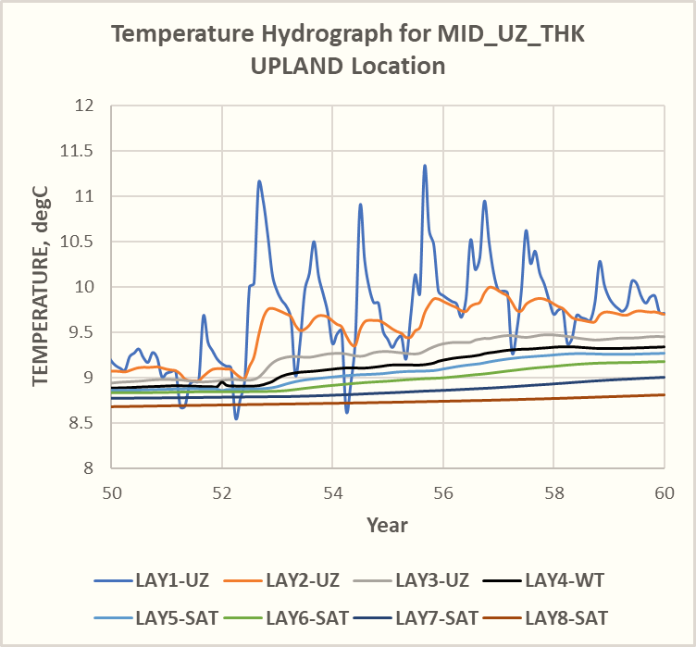
Thermal
Inertial
LAG and DAMPENING!
Putting together unsaturated flow and heat transport…

Slide 16
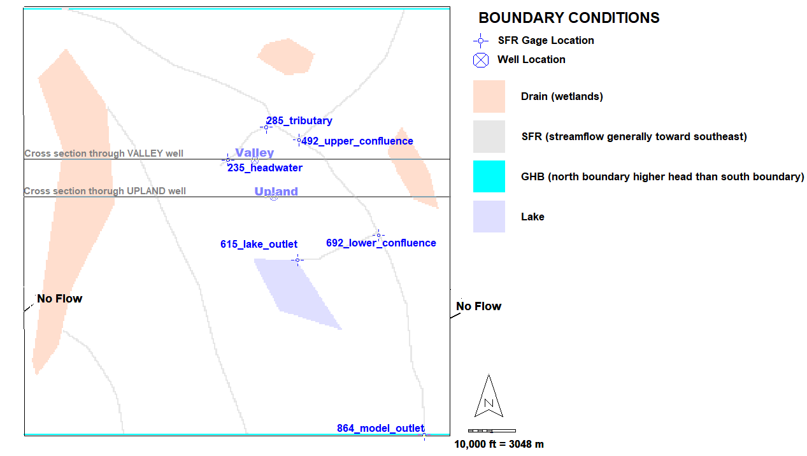
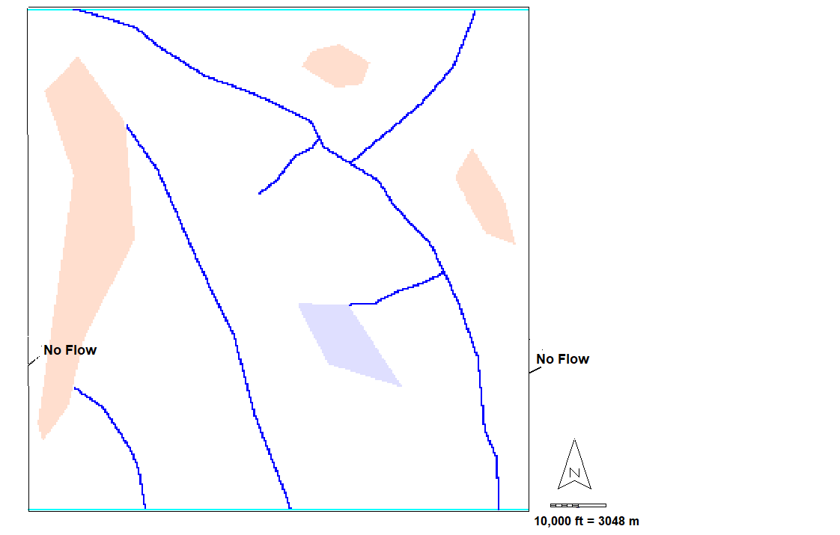
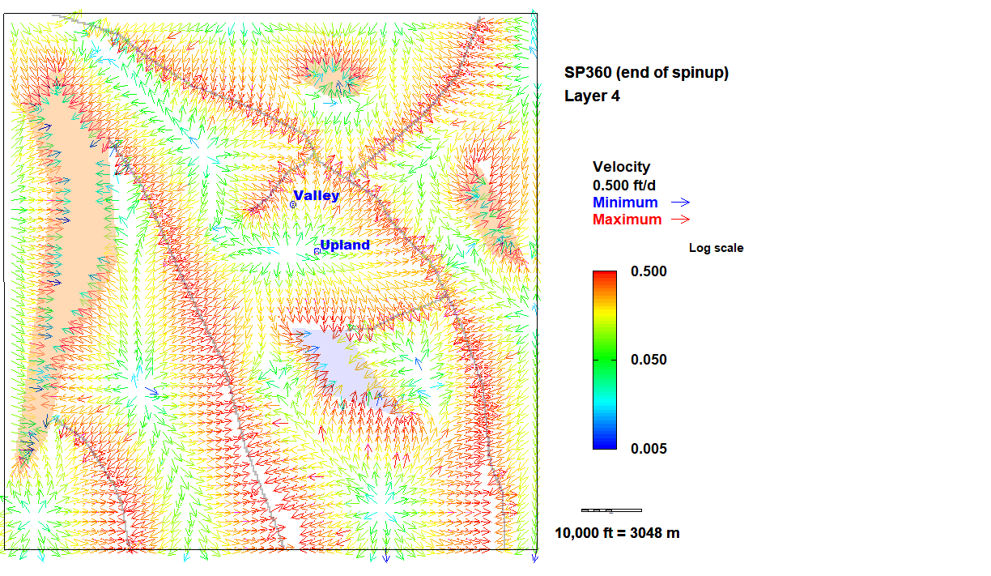
UWM Colloquim 11 May 2023
Construction and application of synthetic model
17 mi x 17 mi = 27.5 km x 27.5 km
22

Slide 17
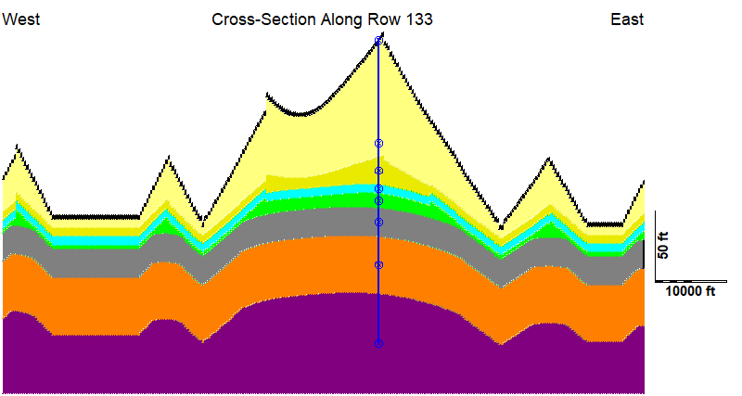
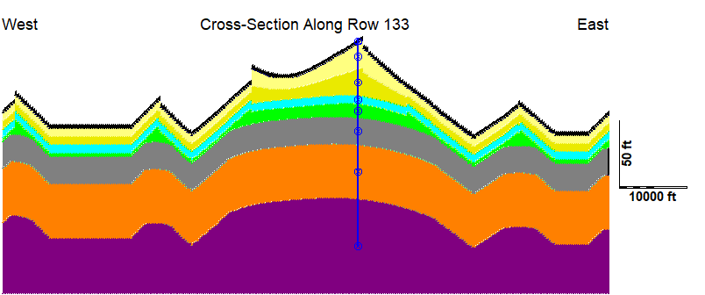
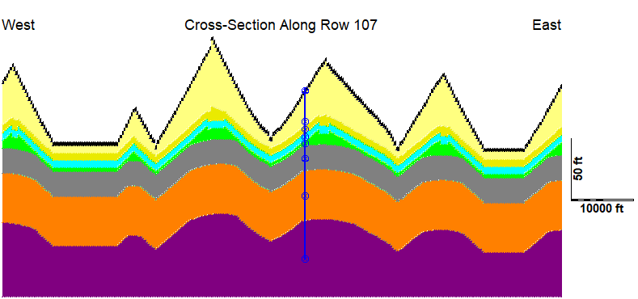
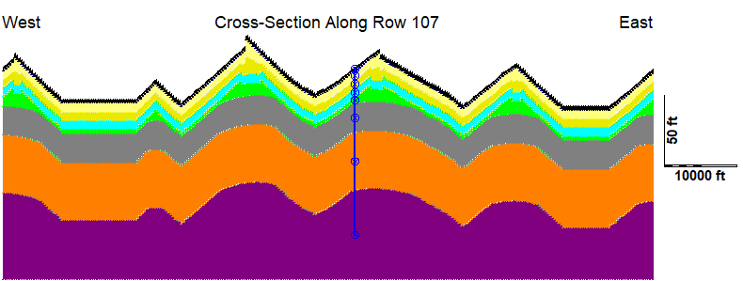
Unsaturated Zone models: NO + MID vs HI
a. LAYERING across UPLAND location for MID_UZ_THK
c. LAYERING across UPLAND location for HI_UZ_THK
Top black layer is 3-ft thick receptor layer for receiving infiltration.
b. LAYERING across VALLEY location for MID_UZ_THK
d. LAYERING across VALLEY location for HID_UZ_THK

Slide 18
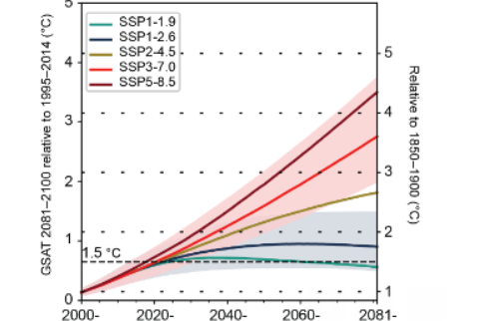
High Emission Scenario – Global Forecast
Global Climate Models (GCMs) predict warming conditions…
Mean temperature rise in set of 20 GCM model highlighted for 2022-2051 period, showing global (rather than down-scaled) scenarios for Representation Concentration Pathways
2022 2051
https://www.ipcc.ch/report/ar6/wg1/downloads/report/IPCC_AR6_WGI_TS.pdf
Cross-Section Box TS.1, Figure 1
Modified to add markers for 2022 and 2051.

Slide 19
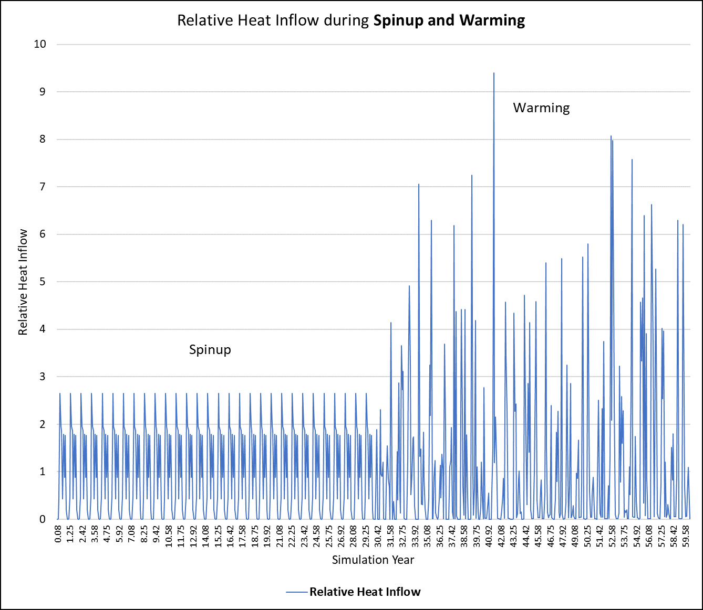
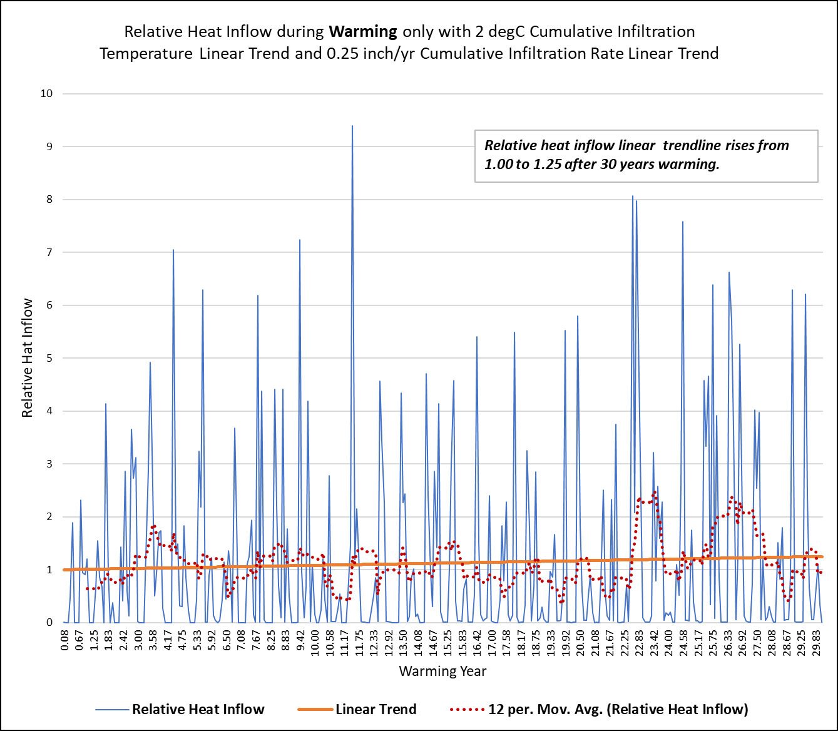
Impulse: Heat Flow downscaled
The climate forcing IN TERMS OF RELATIVE HEAT FLOW consists of the sum of three elements:
The climate forcing IN TERMS OF RELATIVE HEAT FLOW consists of the sum of three elements:
The trend due to the effect of global warming on infiltration temperatures and flow rates
The monthly periodicity of infiltration temperatures and flow rates
the superposition of random variations in infiltration temperatures and flow rates
Same HEAT forcing for NO, MID and HI model versions

Slide 20
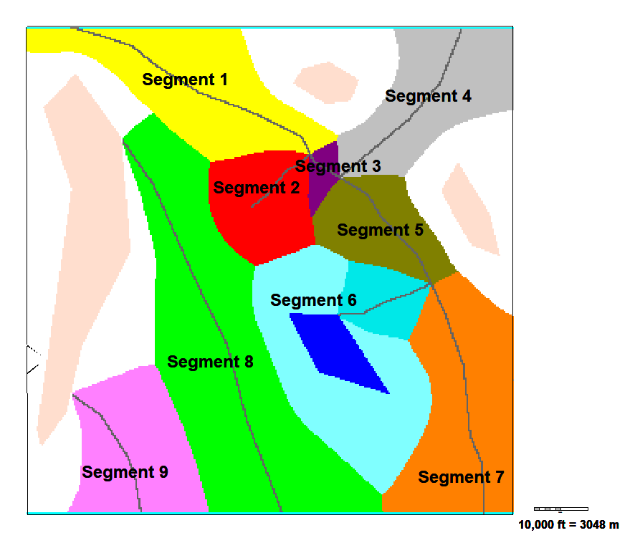
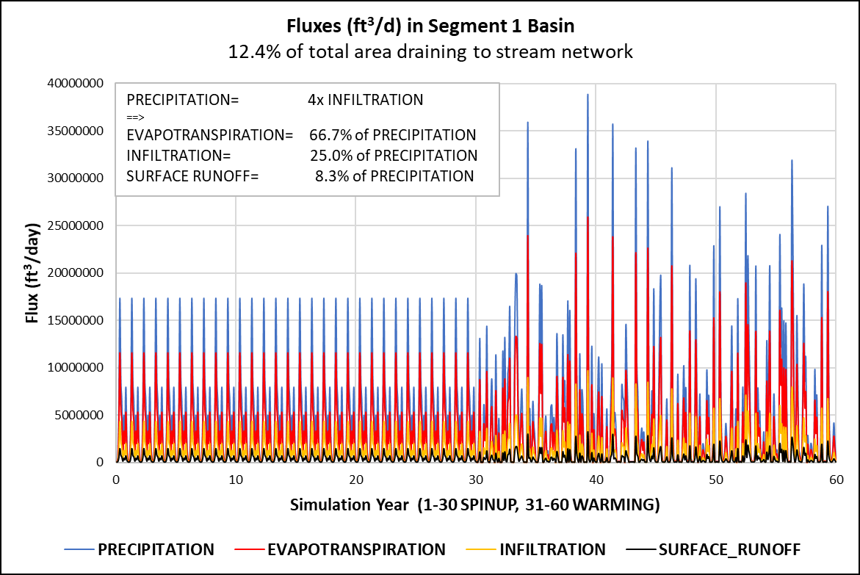
UWM Colloquim 11 May 2023
Surface Runoff Logic
Stream segment topographic basins corresponding to surface runoff areas

Slide 21
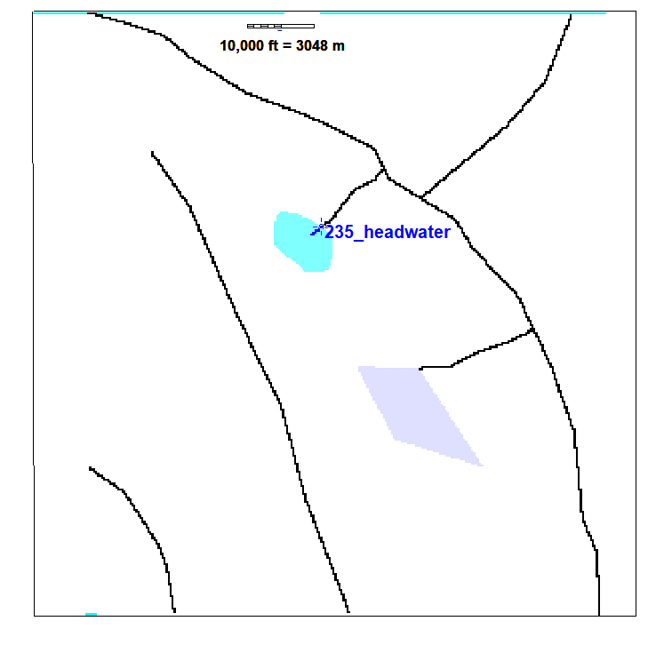
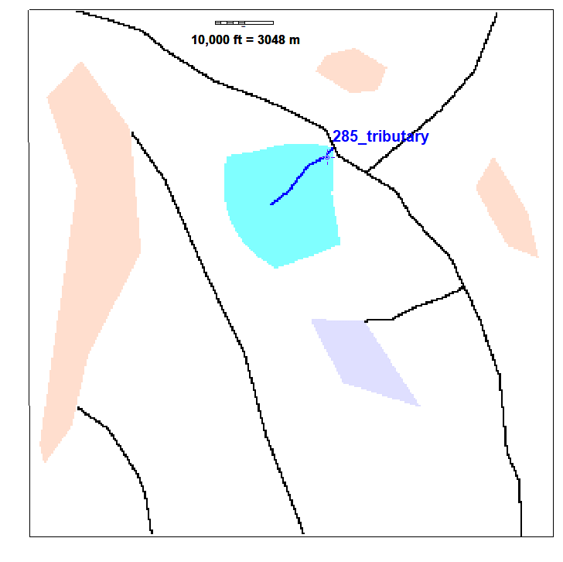
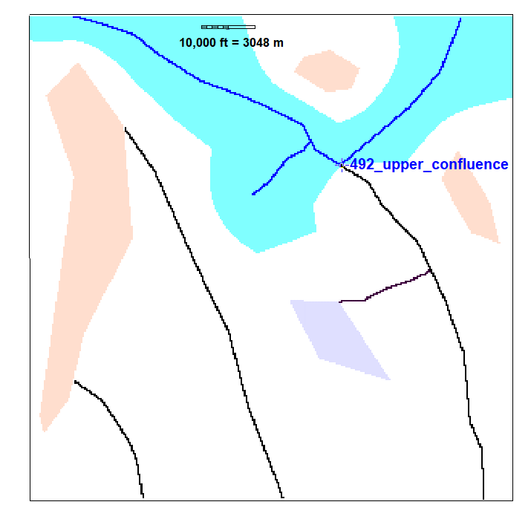
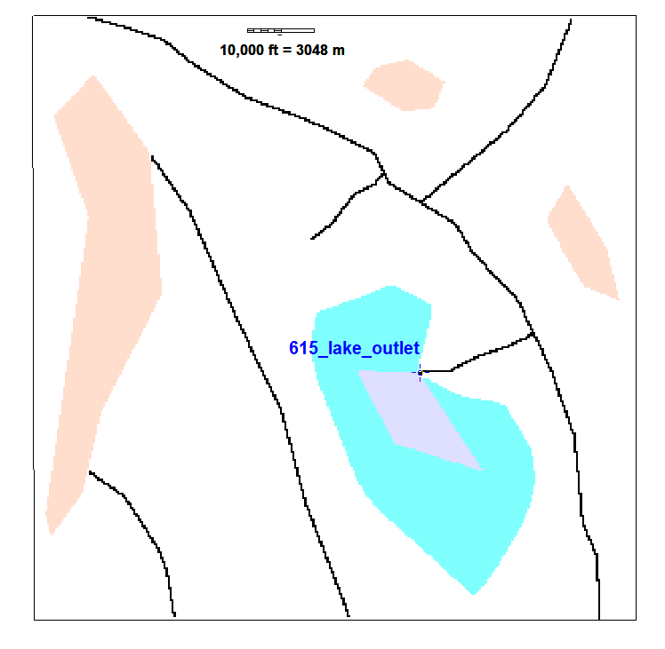
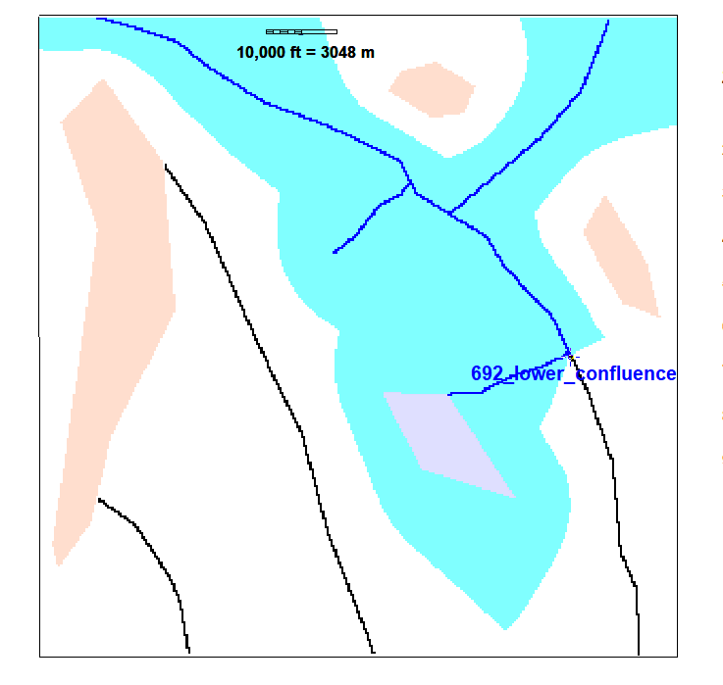
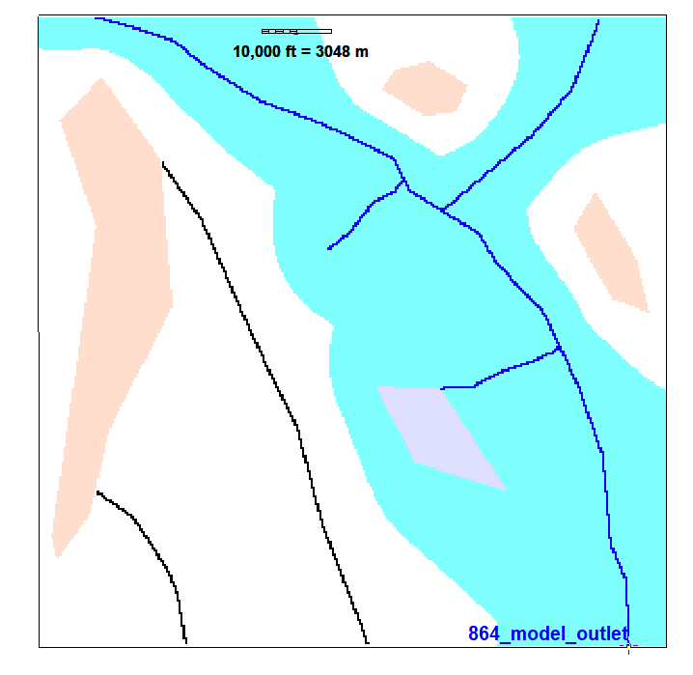
UWM Colloquim 11 May 2023
Nested topographic basins corresponding to gage contributing areas

Slide 22
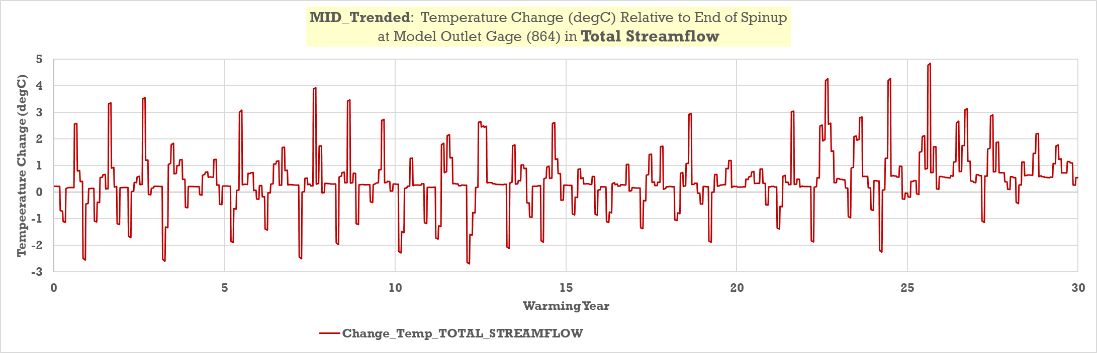
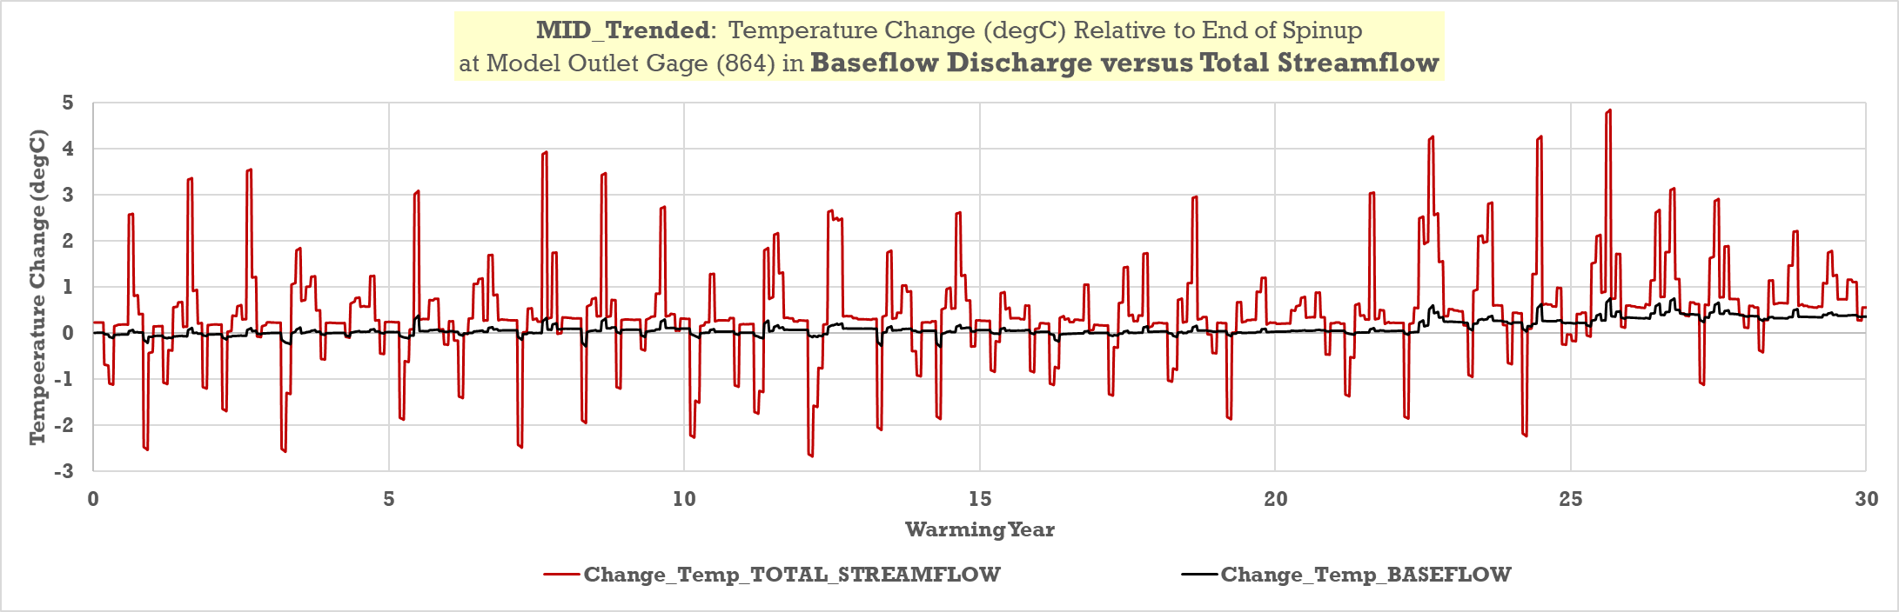
864
UWM Colloquim 11 May 2023
Trend Lineare: Aumento cumulativo di
0.88 degC
0.26 degC
Trend Lineare: Aumento cumulativo di
0.88 degC

Slide 23




A. B. .
BASEFLOW Results
TEMP: NO vs MID vs HI
C.

Slide 24

UWM Colloquim 11 May 2023
Heat-Flow Pathways through a Generic Watershed Under High-
Emission Scenario For Climate Change
PATHWAYS
RECHARGE
DIRECT DISCHARGE
PATHWAYS
RECHARGE
PATHWAYS
RECHARGE
DIRECT DISCHARGE
BASEFLOW
PATHWAYS
RECHARGE
DIRECT DISCHARGE
BASEFLOW
TOTAL STREAMFLOW
Heat Flow Pathway
Impulse
Impulse-Response:
Degree of Lag (ritardo) and Dampening (attenuazione)

Slide 25
Table 1. Heat Flux and Heat Flow: Units and Conversions
Energy Flux = Heat Flux [Joules/second, equivalent to Watts]
Convective Term = Specific Heat of Water x Water Density x Water Volumetric Flux x Water Temperature
Specific Heat of Water = 4183 joules/(kg-degC)
Density of Water = 28.32 kg/ft³ = 1000 kg/m³
Table 1. Heat Flux and Heat Flow: Units and Conversions
Energy Flux = Heat Flux [Joules/second, equivalent to Watts]
Convective Term = Specific Heat of Water x Water Density x Water Volumetric Flux x Water Temperature
Specific Heat of Water = 4183 joules/(kg-degC)
Density of Water = 28.32 kg/ft³ = 1000 kg/m³
Table 1. Heat Flux and Heat Flow: Units and Conversions
Energy Flux = Heat Flux [Joules/second, equivalent to Watts]
Convective Term = Specific Heat of Water x Water Density x Water Volumetric Flux x Water Temperature
Specific Heat of Water = 4183 joules/(kg-degC)
Density of Water = 28.32 kg/ft³ = 1000 kg/m³
Heat Flux can refer to successive thermal pahways:
Infiltration to top of UZ
Surface runoff to surface water
Recharge to water table
Groundwater runoff to surface water originating as rejected infiltration
Groundwater runoff to surface water originating as discharge to riparian land surface
Groundwater discharge directly to surface water
Accumulated baseflow from upstream in stream channel
Accumulated total streamflow from upstream in stream channel
*********************************************
Table 1. Heat Flux and Heat Flow: Units and Conversions
Energy Flux = Heat Flux [Joules/second, equivalent to Watts]
Convective Term = Specific Heat of Water x Water Density x Water Volumetric Flux x Water Temperature
Specific Heat of Water = 4183 joules/(kg-degC)
Density of Water = 28.32 kg/ft³ = 1000 kg/m³
Heat Flux can refer to successive thermal pahways:
Infiltration to top of UZ
Surface runoff to surface water
Recharge to water table
Groundwater runoff to surface water originating as rejected infiltration
Groundwater runoff to surface water originating as discharge to riparian land surface
Groundwater discharge directly to surface water
Accumulated baseflow from upstream in stream channel
Accumulated total streamflow from upstream in stream channel
*********************************************
Energy Flow = Rate of Heat Flow [Watts/m²] = Heat Flux / Area
Area [m²] can refer to a unit surface perpendicular to the direction of
heat flux or to a normalizing basin area applied to each heat pathway
Heat Flux
vs
Heat Flow
The heat flux is normalized dividing it by an area, obtaining the rate of heat flow.

Slide 26





RESPONSE OF Heat Flow (Watts/m²) and Temperature (degC) to forcing at the water table for selected locations
UPLAND
UPLAND
VALLEY
MID
HI
MID
HI

Slide 27

Mapping of Heat Flow at Watershed Scale (Watts/m²)
UWM Colloquim 11 May 2023
MID_TRENDED HI_TRENDED
15.17 years of warming, February
25.67 years of warming, August

Slide 28

Model Output: Lags and Dampening of Heat Signal
To achieve the study objective of characterizing the effect of heat pathways on lags and dampening of the heat signal, it is necessary to quantify the amplitude and phase relations between heat inflows and down-system heat flows and temperatures. The lag analysis consists of a series of impulse/response calculations at the scale of the nested contributing basins. The impulse is the heat flow (equivalent to heat flux normalized by contributing basin areas) in infiltration (or, when noted, infiltration plus surface runoff). The response corresponds to one of six pathways:
METHOD: analysis of LAGS and DAMPENING
1) Calculation of the LAG: Correlation coefficients displaced in time
PATHWAYS:
Heat Flow - RECHARGE
Δ Amplitude change in thermal flux=
Relation of the means=
1.31
Correlation calculated for successive displacments in time
Heat Flow – DIRECT DISCHARGE
impulse
Heat Flow – BASE FLOW
response
Heat Flow – STREAMFLOW
Temp - WATER TABLE
Temp - DIRECT DISCHARGE
Temp - STREAMFLOW
2) Calculation of the change in amplitude: relation between the value during the last 10 years of WARMING and the value during the last year of SPINUP….. Then to calculate the attenuation one compares the Δ Amplitude of the response along a PATHWAY and the impulse to the system (that is, the INFILTRATION)
2022

Slide 29

Analysis of LAGS via correlation at different temporal displacements
This analysis is too local – we seek a more global understanding…

Slide 30

HEAT FLOW RESPONSE along RECHARGE PATHWAY for MID_Trended and HI_Trended simulations.
Heat flow in INFILTRATION compared to heat flow in RECHARGE to Water Table for CONTRIBUTING BASINS during warming.
Heat Flow = Heat Flux normalized by basin area.
RESPONSE Along RECHARGE Pathway
MID_Trended
HI_Trended

Slide 31

UWM Colloquim 11 May 2023
Dampening results: Change in Warming along Pathways after 30 years
Dampening

Slide 32

UWM Colloquim 11 May 2023
Le simulazioni numeriche mostrano che circa il 40% del riscaldamento applicato come infiltrazione al tetto della zona insatura giunge alla falda freatica: la zona insatura (UZ) immagazzina gran parte del segnale di calore, con una tendenza all’aumento della temperatura.
Le simulazioni numeriche mostrano che circa il 40% del riscaldamento applicato come infiltrazione al tetto della zona insatura giunge alla falda freatica: la zona insatura (UZ) immagazzina gran parte del segnale di calore, con una tendenza all’aumento della temperatura.
• In seguito, la ricarica “riscaldata” scorre attraverso la zona satura; una volta che le acque sotterranee raggiungono i corsi idrici superficiali, solamente il 10% circa del segnale di riscaldamento iniziale viene restituito ai corsi d'acqua mediante fuoriuscita diretta delle acque sotterranee.
Le simulazioni numeriche mostrano che circa il 40% del riscaldamento applicato come infiltrazione al tetto della zona insatura giunge alla falda freatica: la zona insatura (UZ) immagazzina gran parte del segnale di calore, con una tendenza all’aumento della temperatura.
• In seguito, la ricarica “riscaldata” scorre attraverso la zona satura; una volta che le acque sotterranee raggiungono i corsi idrici superficiali, solamente il 10% circa del segnale di riscaldamento iniziale viene restituito ai corsi d'acqua mediante fuoriuscita diretta delle acque sotterranee.
• Tuttavia, l’aumento di temperatura simulato nei corsi idrici superficiali è di entità simile all'aumento registrato per la falda freatica, a causa del contributo di calore proveniente dal ruscellamento superficiale da precipitazioni, che non interagisce con la zona insatura e nemmeno con la zona satura, contrastando l’attenuazione indotta dal sottosuolo.
Le simulazioni numeriche mostrano che circa il 40% del riscaldamento applicato come infiltrazione al tetto della zona insatura giunge alla falda freatica: la zona insatura (UZ) immagazzina gran parte del segnale di calore, con una tendenza all’aumento della temperatura.
• In seguito, la ricarica “riscaldata” scorre attraverso la zona satura; una volta che le acque sotterranee raggiungono i corsi idrici superficiali, solamente il 10% circa del segnale di riscaldamento iniziale viene restituito ai corsi d'acqua mediante fuoriuscita diretta delle acque sotterranee.
• Tuttavia, l’aumento di temperatura simulato nei corsi idrici superficiali è di entità simile all'aumento registrato per la falda freatica, a causa del contributo di calore proveniente dal ruscellamento superficiale da precipitazioni, che non interagisce con la zona insatura e nemmeno con la zona satura, contrastando l’attenuazione indotta dal sottosuolo.
• Il metodo di modellazione per un caso ipotetico ed i risultati preliminari qui riportati forniscono un potenziale flusso di lavoro da applicare nell’ambito della modellazione dei cambiamenti climatici alla scala di un bacino esistente.
Research Paper/GROUNDWATER
Adaptation of MT3D-USGS for Simulating
Applied Unsaturated-Zone Heat Transport
Article/Water
Simulation of Heat Flow in a Synthetic Watershed: The Role of the Unsaturated Zone
37

Slide 33


UWM Colloquim 11 May 2023
Research Program – the next step:
A REAL WATERSHED!
… habitat persistence, cold-water
refugia

Slide 34

Vi ringrazio
per l’attenzione
Foto dell’aurora boreale (Anna Grava ,2022)
Foto stock

