Slide 1
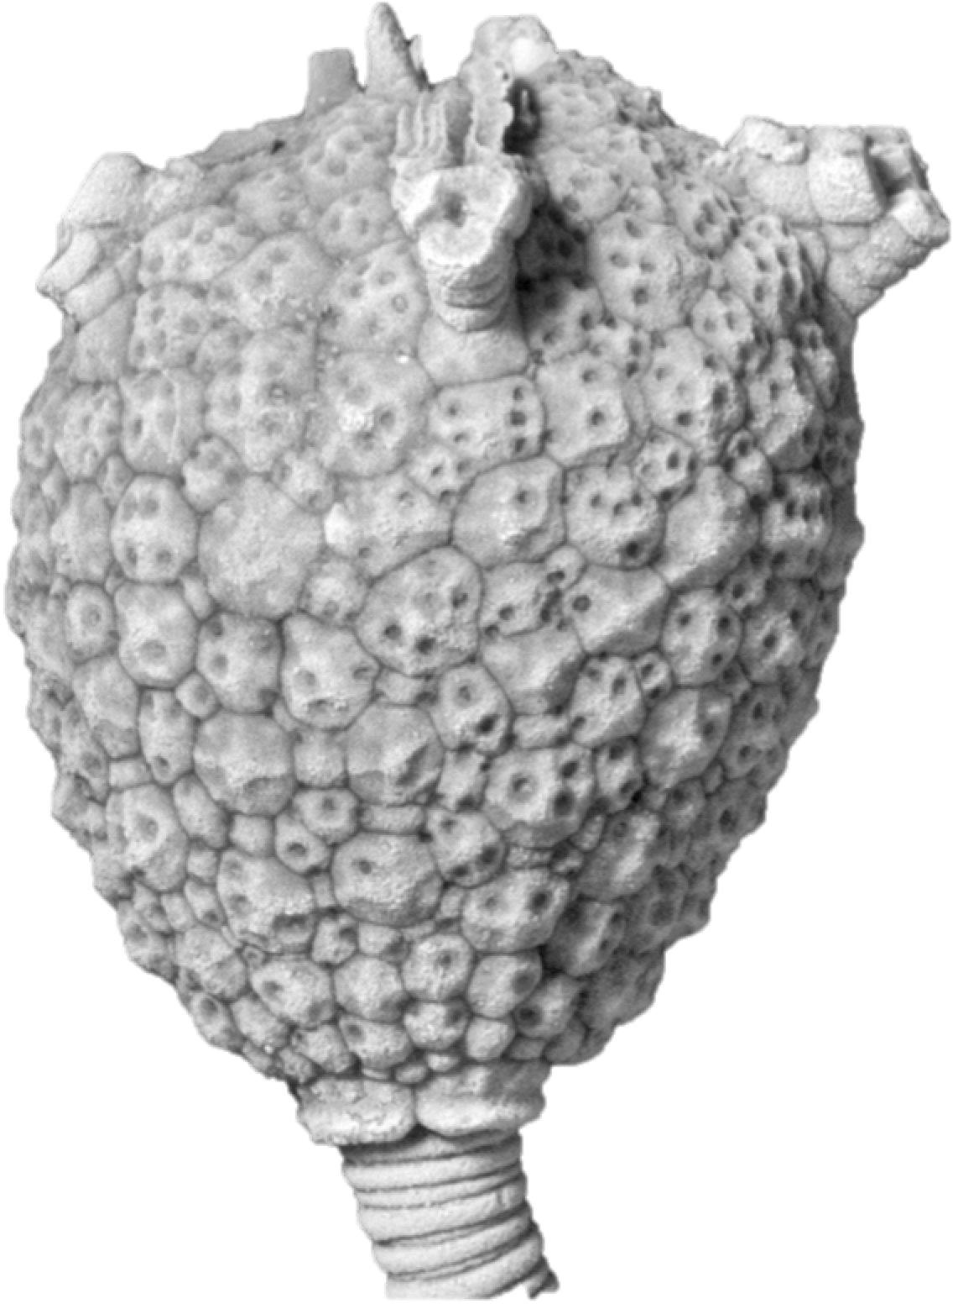
Unraveling the evolutionary relationships of ancient echinoderms
Sarah L. Sheffield
University of South Florida

Slide 2
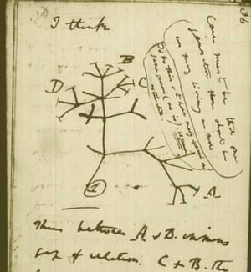
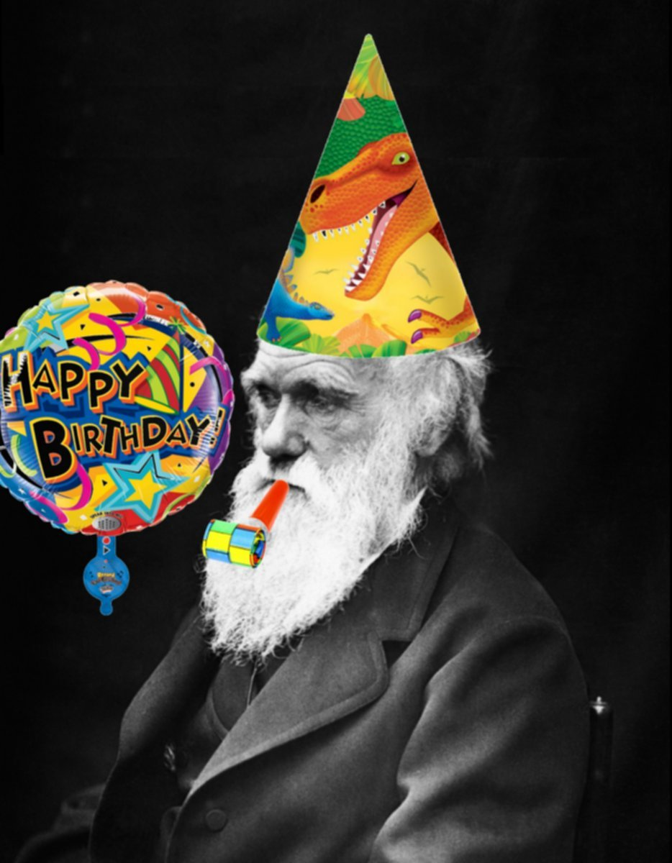

Happy Darwin Day! Feb. 12
The first phylogenetic tree
Charles Darwin
University of Tennessee

Slide 3
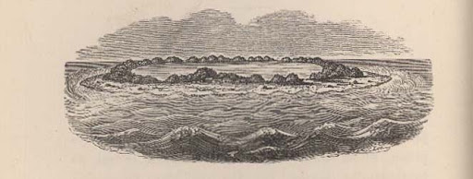
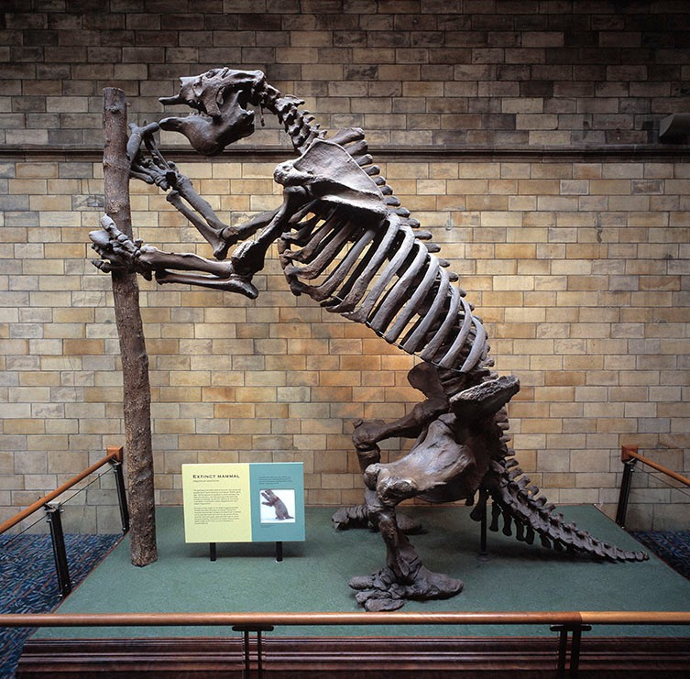
Darwin as a geologist
The Voyage of the Beagle
Natural History Museum of London

Slide 4
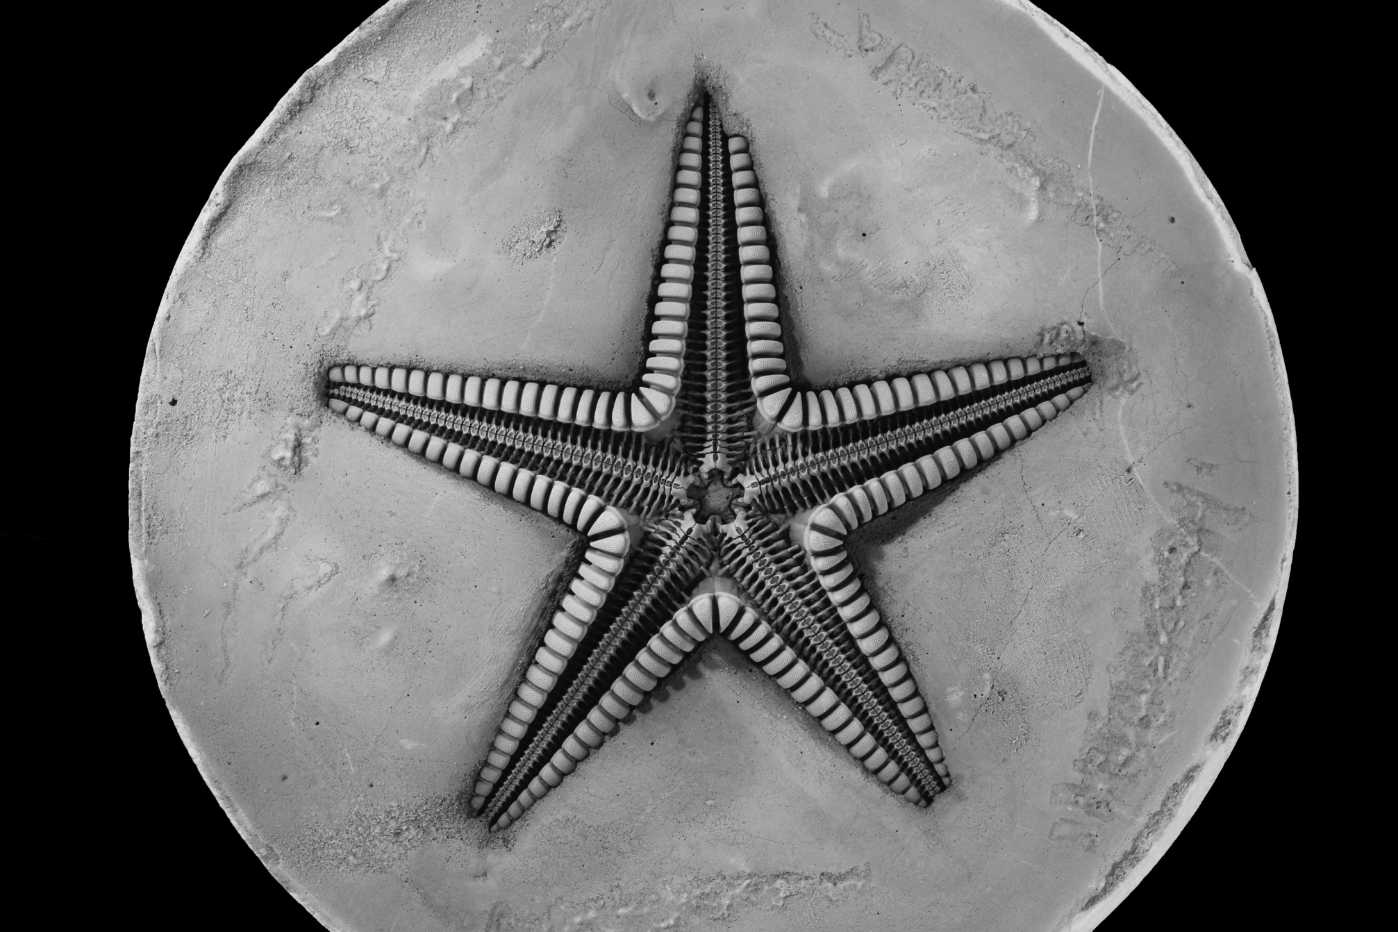
Research Aims
Understand homologous skeletal elements across echinoderm groups
Determine phylogenetic relationships of major groups of echinoderms
Use phylogenetic hypothesis to uncover evolutionary patterns e.g., biogeographic trends

Slide 5

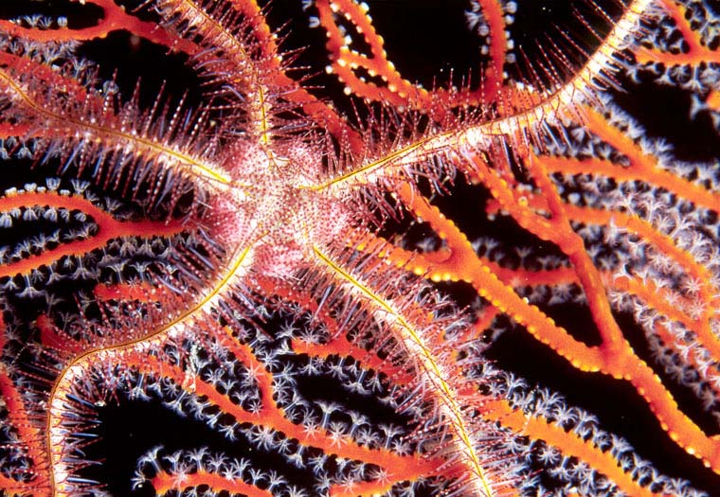
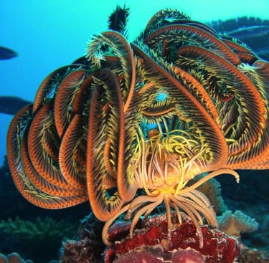
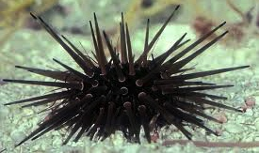
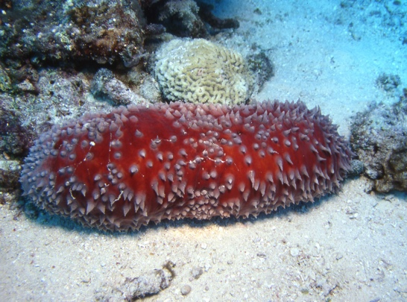
Echinodermata
Sea Star
Brittle Star
Defined by:
  “5-ishness”
  High Mg Calcite skeletons
  Water Vascular System
Crinoid
http://www.liveanimalslist.com/fish/starfish.php
Ryan Photography
Sea Urchin
Sea Cucumber
http://www.fic.nih.gov/Grants/PhotoContest/Pages/fiji-crinoids.aspx
http://www.nhm.ac.uk/our-science/data/echinoid-directory/intro/defence1.html
Ryan Photography
Ryan Photography

Slide 6

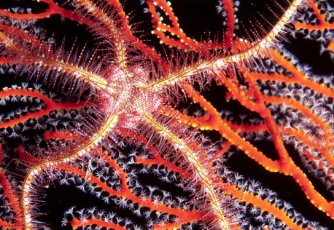
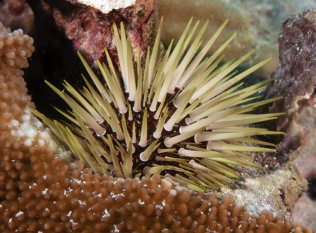
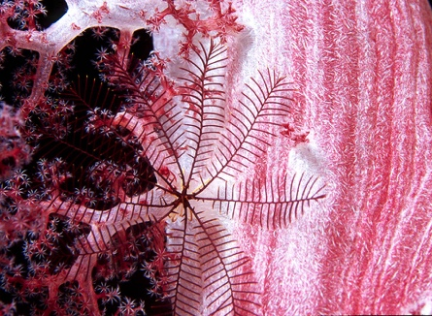
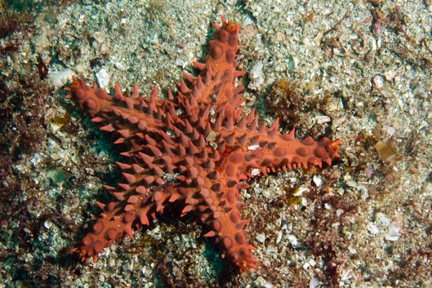
Phylogenetics of Echinodermata:
Holothurians
Crinoids?
Ophiuroids
Echinoids
Asteroids
Crinoids?
Ryan Photography

Slide 7
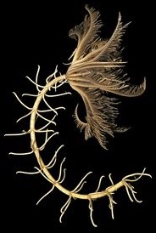
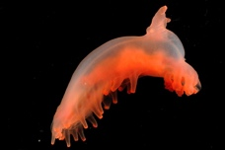

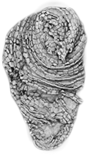
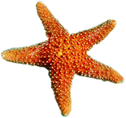
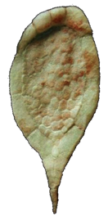
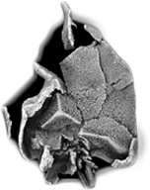
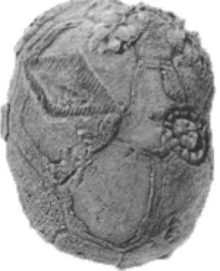
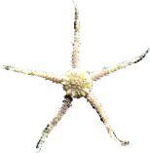
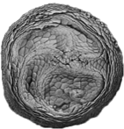
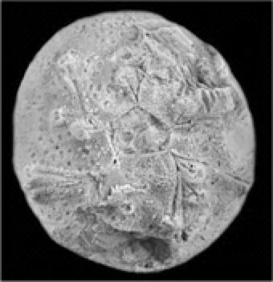
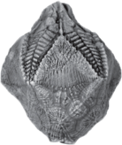
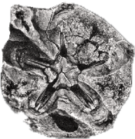
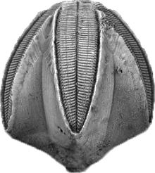
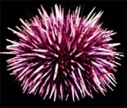
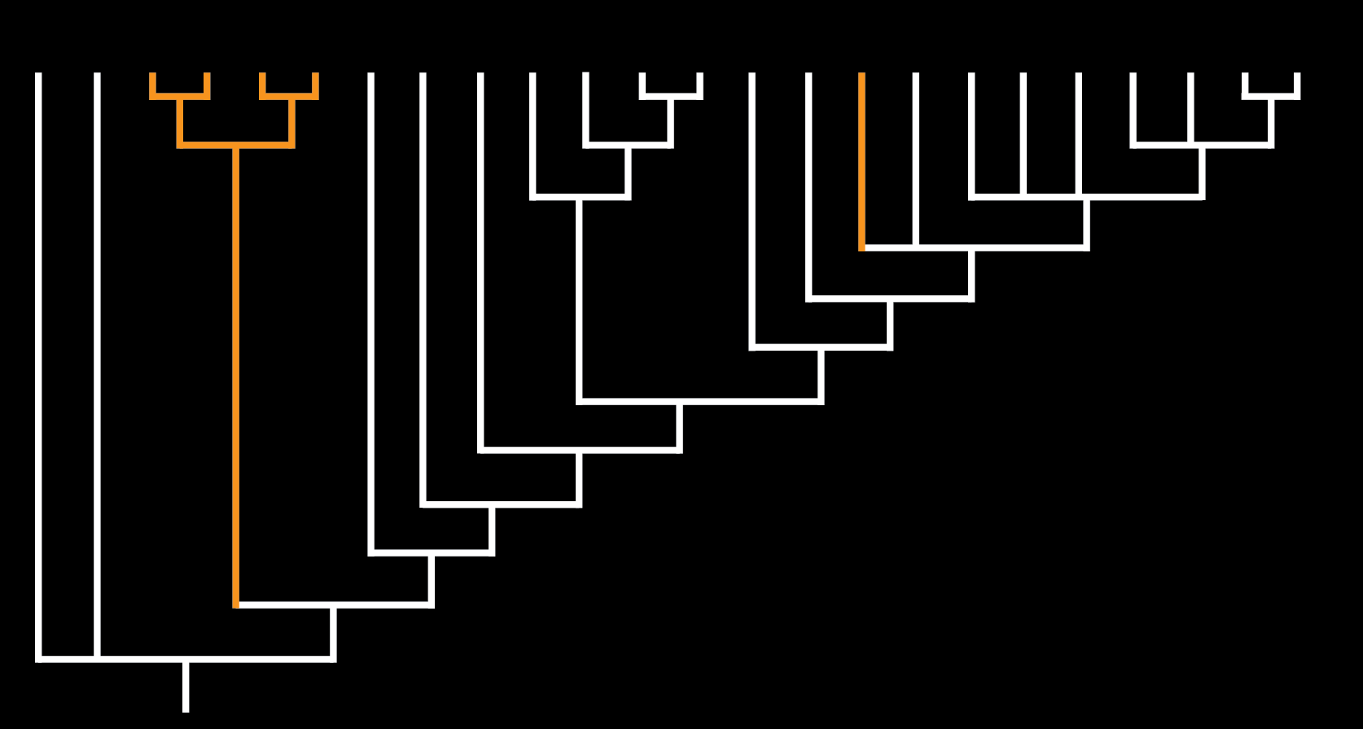
Echinodermata
Modern
Extinct
Sumrall & Wray, 2007

Slide 8
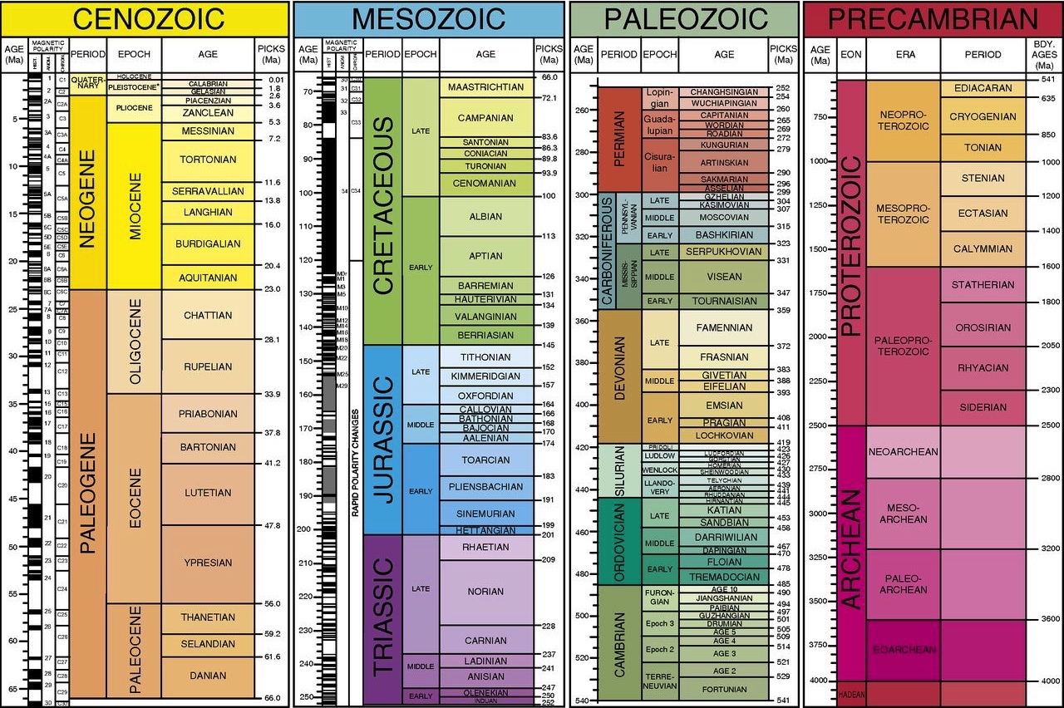

Slide 10
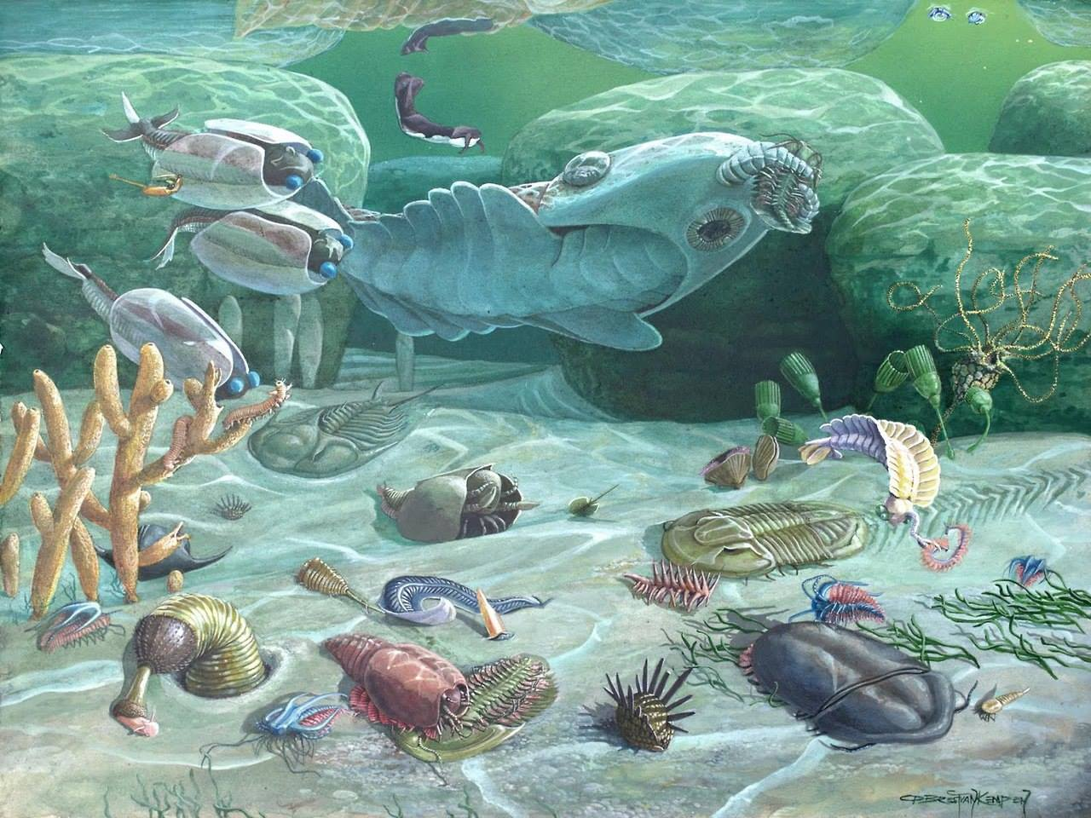
The Cambrian Explosion: significant high-level diversity

Slide 11
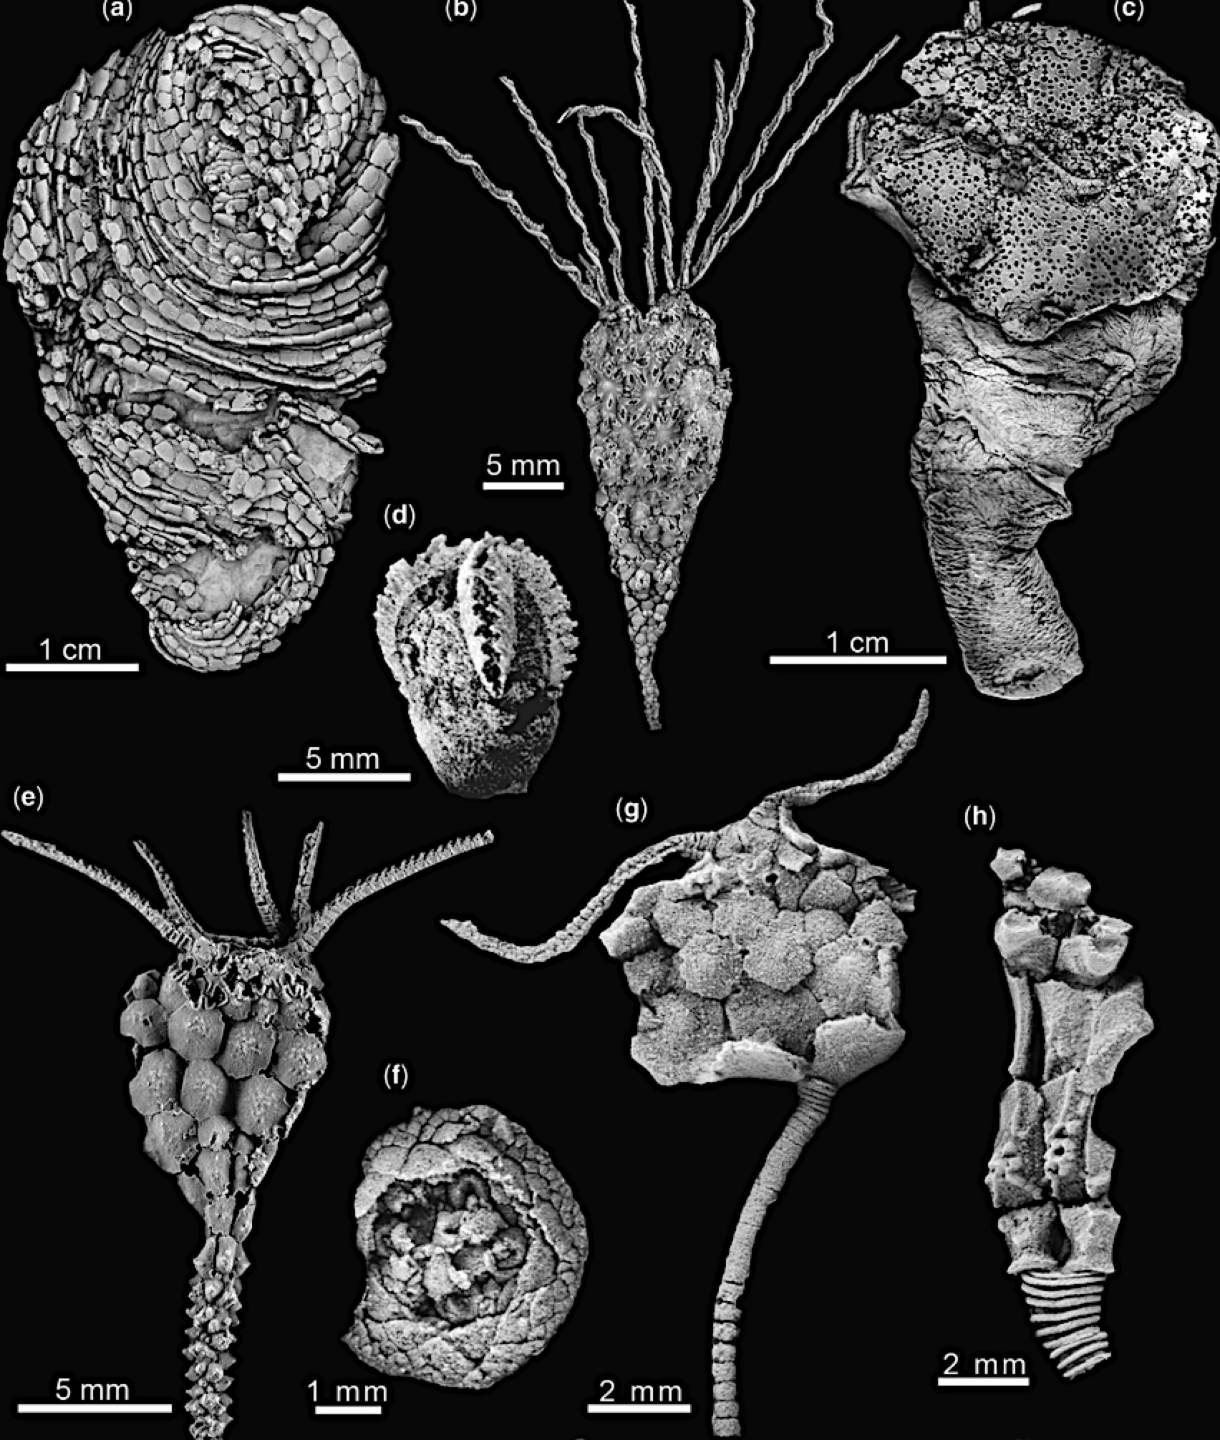
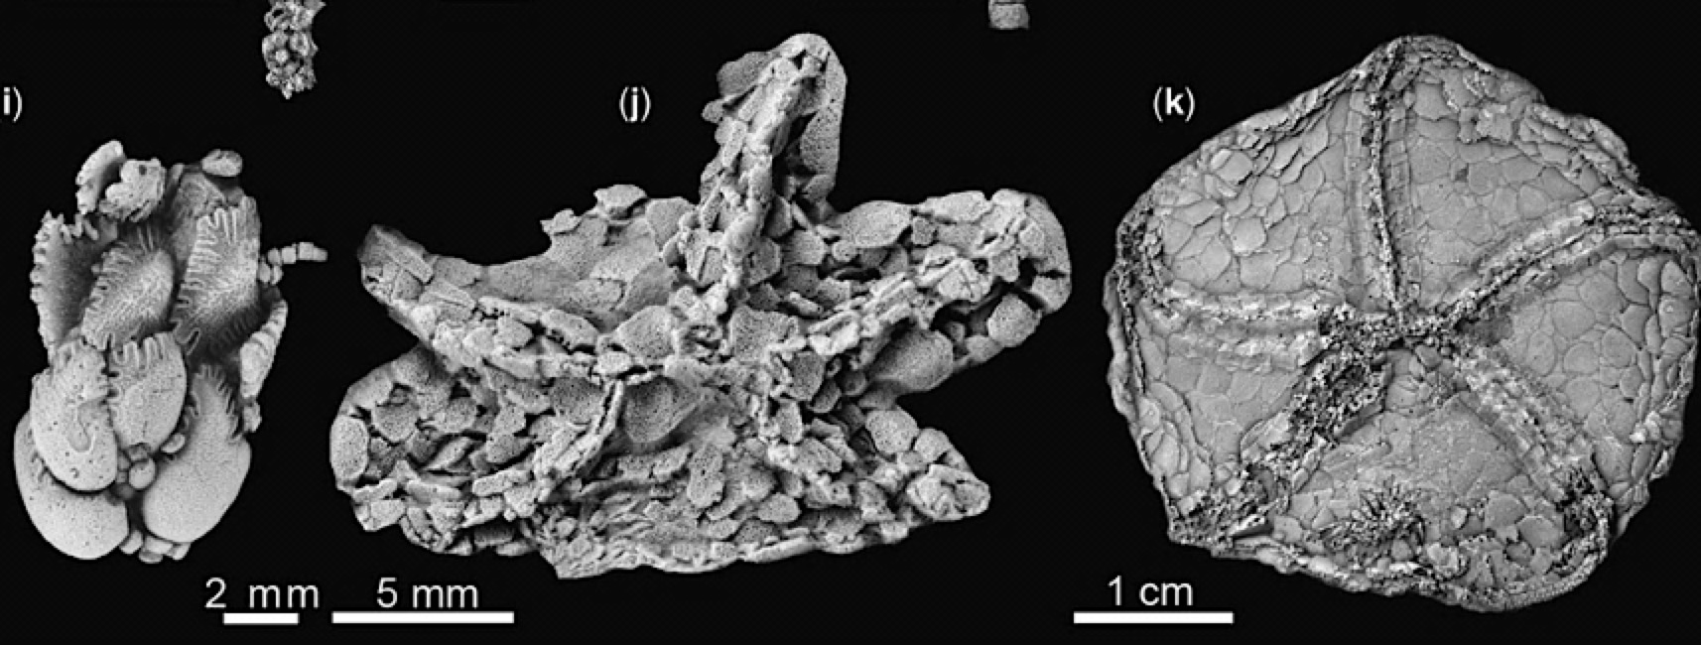
Very little species or substrate diversity
Unfortunately, Cambrian echinoderm fossils are rare
Zamora et al., 2013

Slide 12
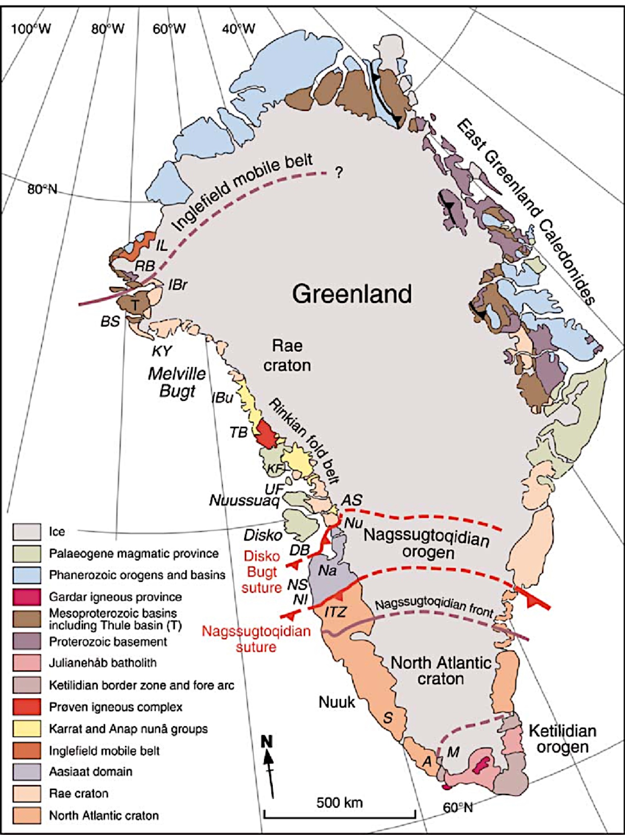
Globally, very few exposures of Upper Cambrian rocks
Fewer than 10 localities globally hold complete echinoderm fossils from late Cambrian
Problem: we lose information about transition from Cambrian- Ordovician
St. Ong et al., 2009

Slide 13
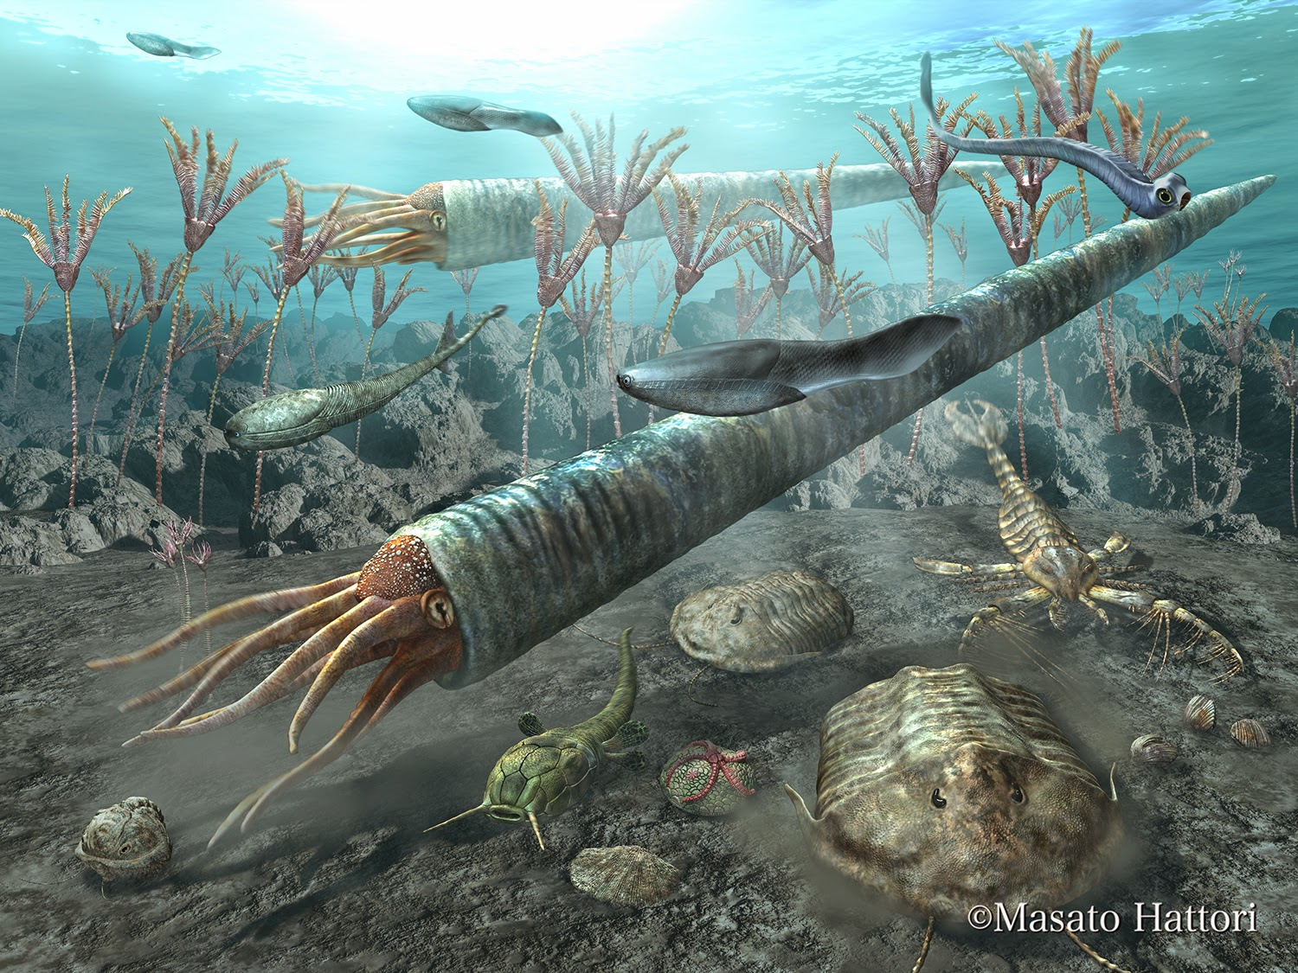
The Great Ordovician Biodiversification Event

Slide 14
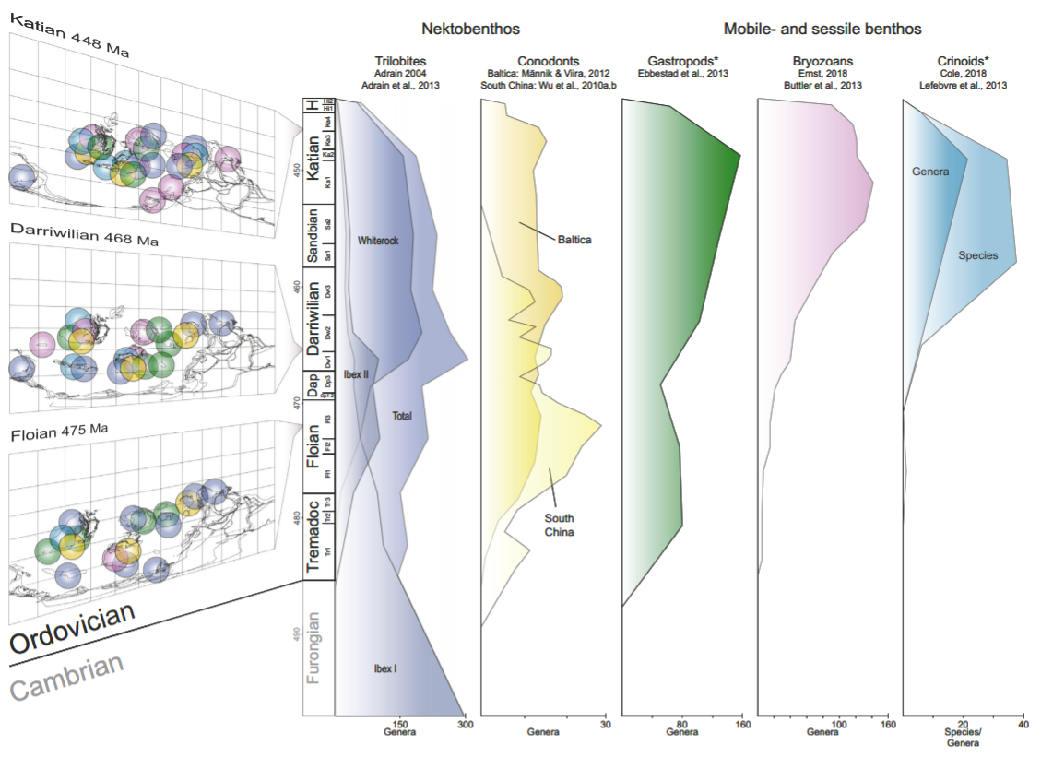
The Great Ordovician Biodiversification Event
Stigall et al. (2019)

Slide 15
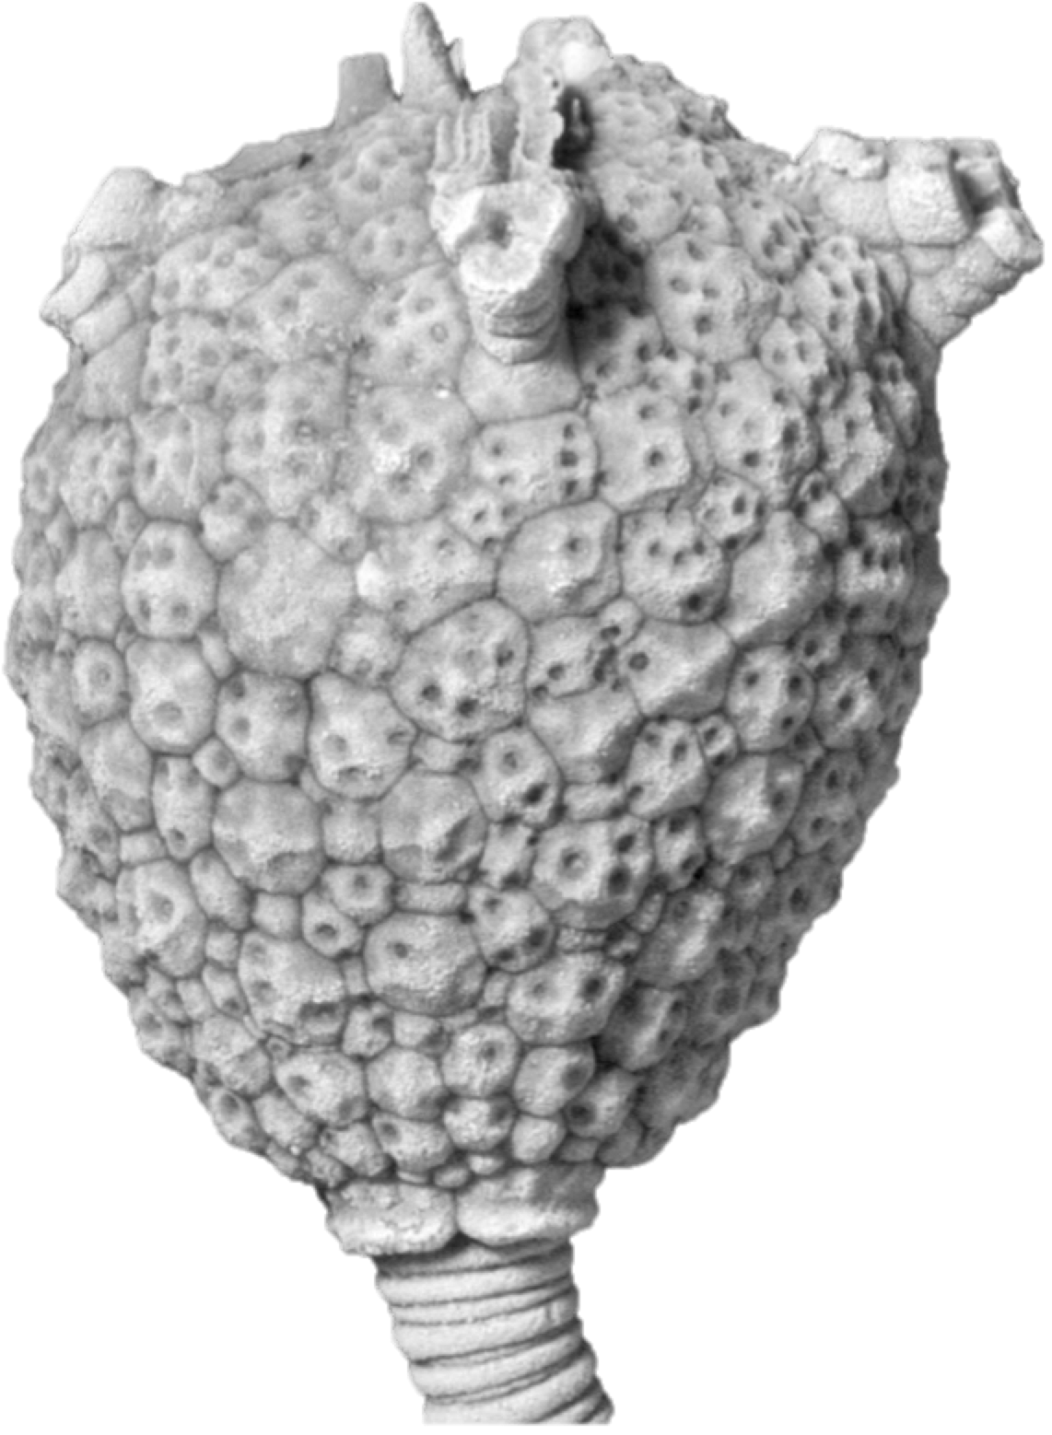
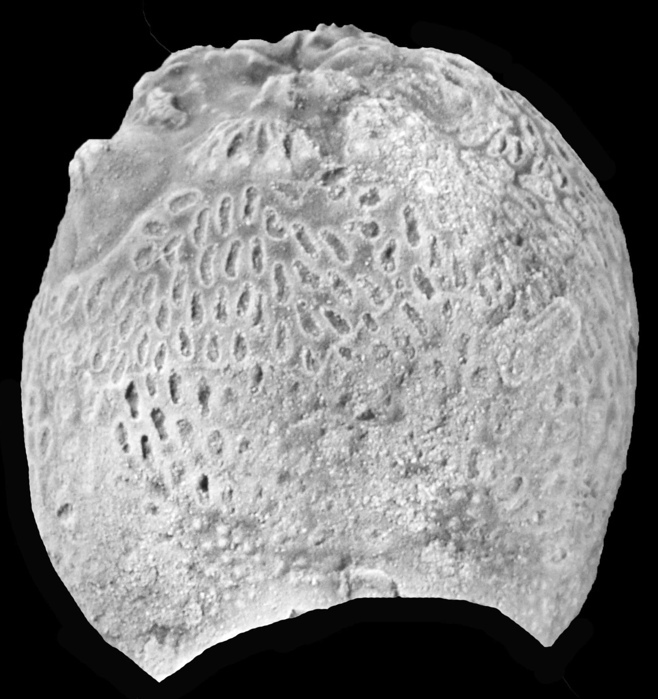
Ordovician Echinoderm Innovations
Species-rich diversity and substrate-type diversity
Eumorphocystis
Haplosphaeronis
Estonocystis
1 cm

Slide 16
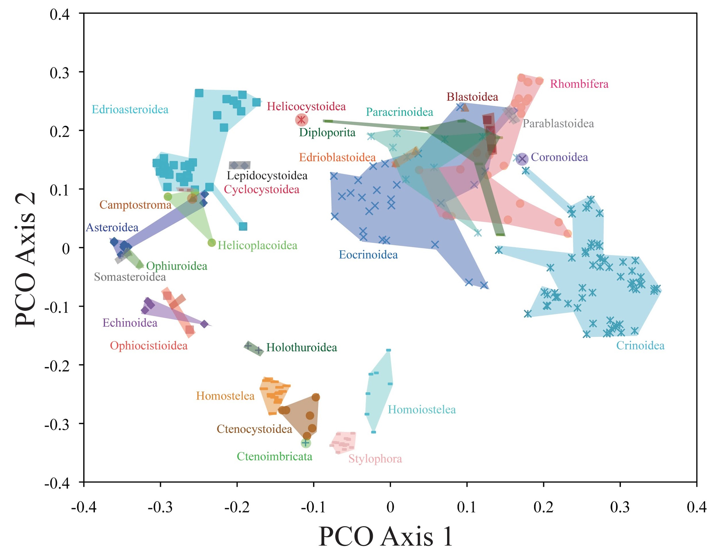

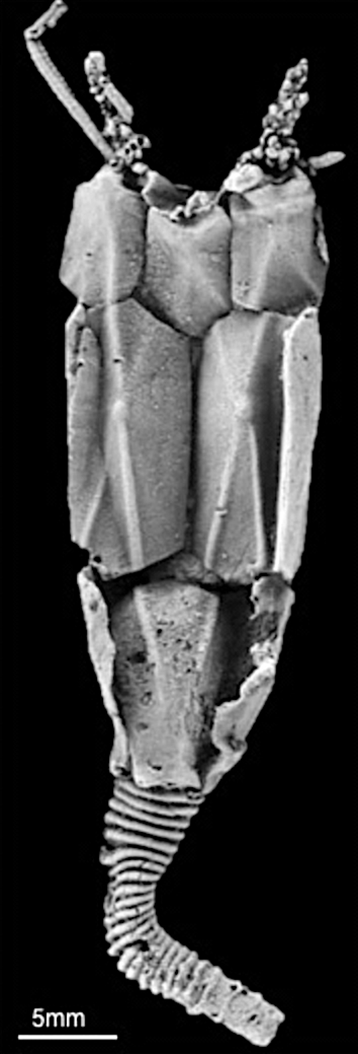

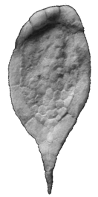
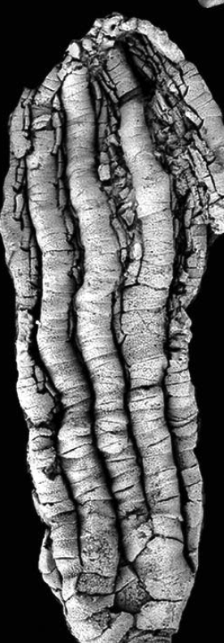
High Disparity and Diversity
The further distance, the more different these echinoderms are
Deline, 2015
Deline, 2015

Slide 17
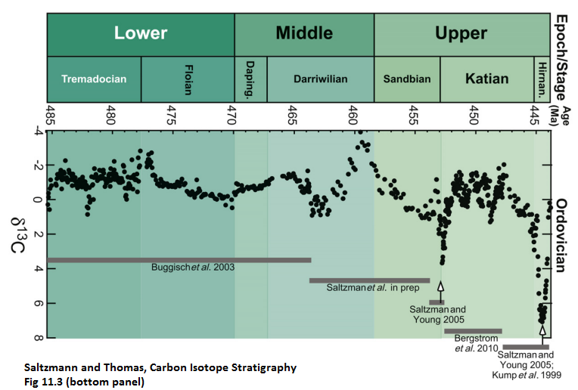
Climate change driven diversity?

Slide 18
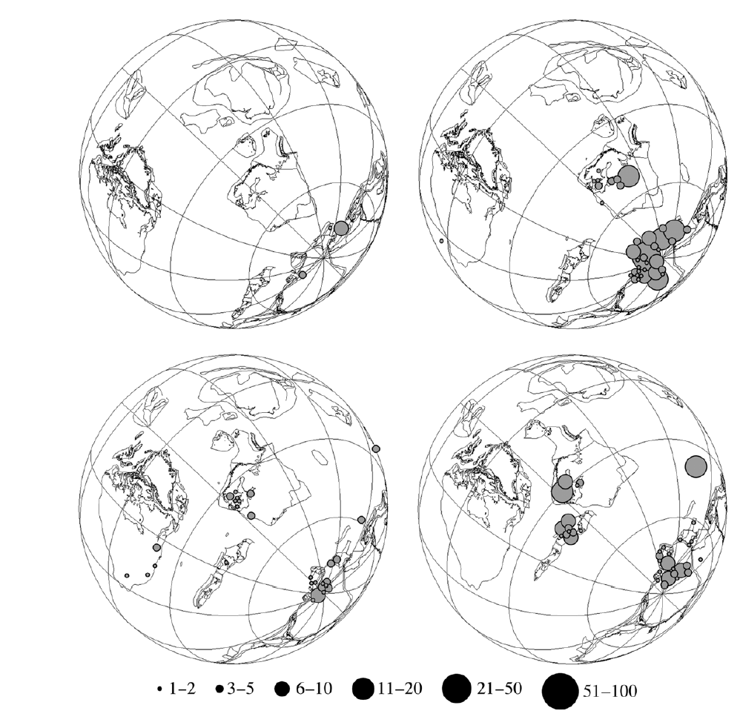
Future Implications
480ma
470ma
460ma
450ma
Circles indicate number of echinoderm taxa
Lefebvre et al., 2013

Slide 19
Evolutionary Groups
-Many traditional groups of echinoderms are not monophyletic
Asteroblastida
Glyptosphaeritida
Sphaeronitida

Slide 20






Evolutionary Groups
-Many traditional groups of echinoderms are not monophyletic
Asteroblastida
Sphaeronitida

Slide 21
Evolutionary Groups
-Many traditional groups of echinoderms are not monophyletic
Asteroblastida
Sphaeronitida
We cannot quantify any evolutionary trends of echinoderms or understand these trends in a global climatic context.

Slide 22
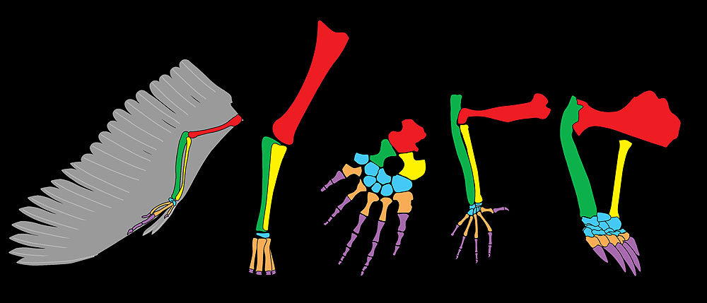
Homology
C. Sumrall

Slide 23
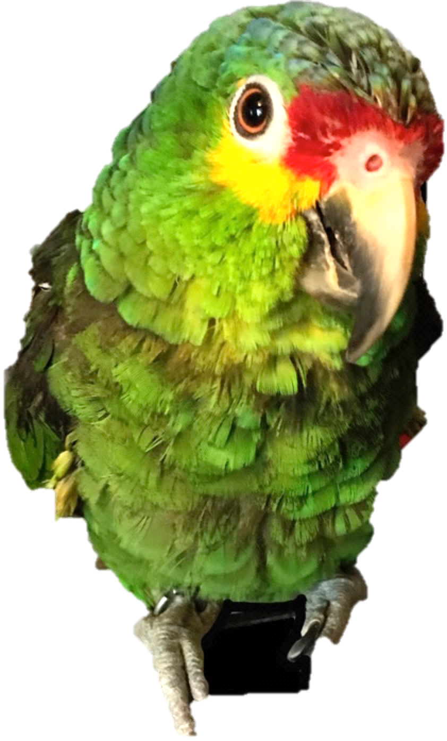
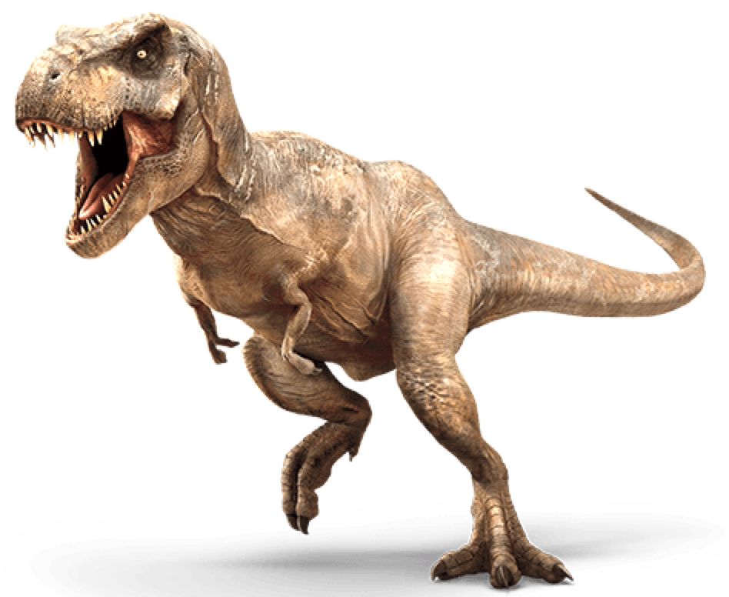
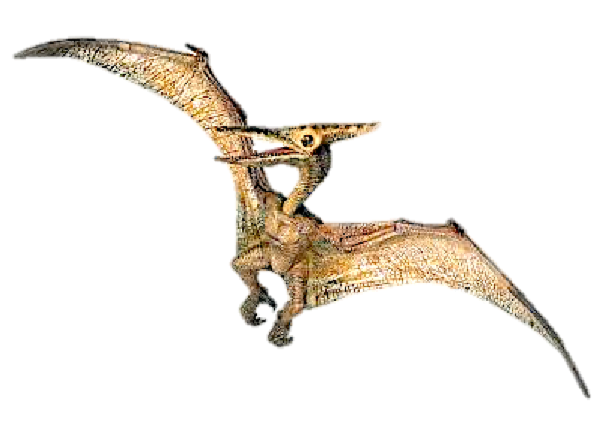
Homoplasy
Presence of wings
*parrot not to scale

Slide 24
Homoplasy
Presence of wings
*parrot not to scale

Slide 25
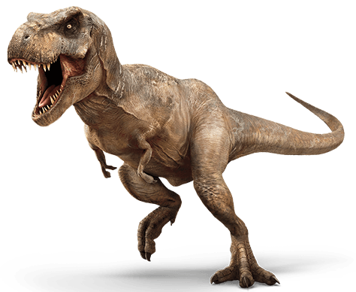
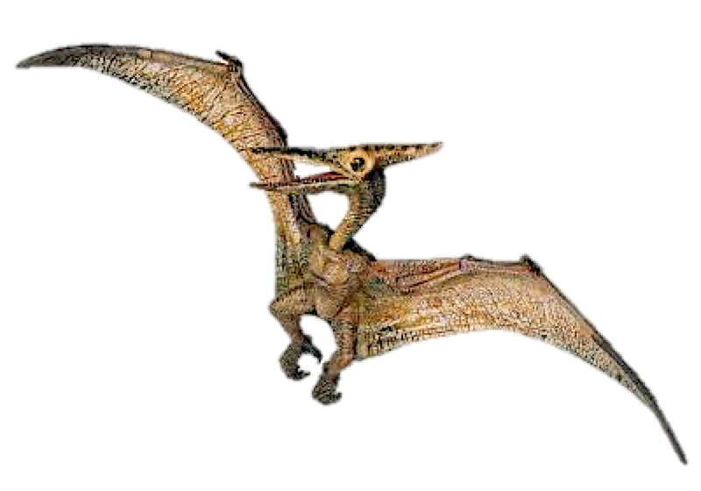
The correct tree
Presence of wings
Presence of wings
*parrot not to scale

Slide 26

Understanding Echinoderm Homologies
Modified from Kammer et al., 2013

Slide 27


Datasets
-Constructed via museum collections and field work
Prague, Czech Republic
Sardinia, Italy

Slide 28

Echinodermata
Modern
Extinct
Sumrall & Wray, 2007

Slide 29

Blastozoans
Echinoderms with brachiole plates for feeding and specialized respiratory structures
  Groups of blastozoans are largely defined by respiratory structures
    However, morphologies are highly disparate and convergence is likely
Exothecal (external) structures
1 cm

Slide 30

Blastozoans
Echinoderms with brachiole plates for feeding and specialized respiratory structures
  Groups of blastozoans are largely defined by respiratory structures
    However, morphologies are highly disparate and convergence is likely
1 cm
Endothecal (internal) structures

Slide 31


Diploporitans
Blastozoans with a diplopore (=double pore) respiratory structure
1cm
Haplosphaeronis sp . GIT 540-3

Slide 32


Diploporitans
Blastozoans with a diplopore (=double pore) respiratory structure
  not all diplopores are
  constructed the same
1cm
Paulicystis sparsus SUI 48164

Slide 33

Diploporitans
Blastozoans with a diplopore (=double pore) respiratory structure
  some diploporitans lack
  diplopores
1cm
Amphoracystis irregularis NM-L13063

Slide 34

Diploporitans
Blastozoans with a diplopore (=double pore) respiratory structure
  non-diploporitan echinoderms
  have diplopores
Thresherodiscus ramosus UMMP 73816

Slide 35

Further morphological diversity within Diploporita
1cm
1cm
1cm
Asteroblastida
Glyptosphaeritida
Sphaeronitida
Gomphocystites
Paulicystis
Eumorphocystis

Slide 36

The phylogeny of the Diploporita
1cm
Sheffield and Sumrall, 2017

Slide 37
The phylogeny of the Diploporita
C. Darwin

Slide 38
Polyphyletic Assemblage: Diploporita
An NP hard problem
N=29; characters= 69; Parsimony, ML
Steps= 129
CI= 0.654
Possible arrangements: ~8.69x10³⁶
Sheffield and Sumrall, 2019

Slide 39

Polyphyletic Assemblage: Diploporita
N=29; characters= 69; Parsimony, ML
Steps= 129
CI= 0.654
Possible arrangements: ~8.69x10³⁶
Sheffield and Sumrall, 2019

Slide 40




Polyphyletic Assemblage: Diploporita
Sphaeronitida
Glyptosphaeritida
Asteroblastida
Non-diploporitans
N=29; characters= 69; Parsimony, ML
Steps= 129
CI= 0.654
Possible arrangements: ~8.69x10³⁶
Sheffield and Sumrall, 2019

Slide 41


Polyphyletic Assemblage: Diploporita
Eumorphocystis shares a common ancestor with crinoids, not with diploporitans
Sphaeronitida
Glyptosphaeritida
Asteroblastida
Non-diploporitans
N=29; characters= 69; Parsimony, ML
Steps= 129
CI= 0.654
Possible arrangements: ~8.69x10³⁶
Sheffield and Sumrall, 2019

Slide 42

Eumorphocystis
Protocrinoid
Sheffield and Sumrall, 2018

Slide 43

Eumorphocystis
Protocrinoid
Sheffield and Sumrall, 2018

Slide 44

Polyphyletic Assemblage: Diploporita
Sphaeronitida
Glyptosphaeritida
Asteroblastida
Non-diploporitans
N=29; characters= 69; Parsimony, ML
Steps= 129
CI= 0.654
Possible arrangements: ~8.69x10³⁶
Sheffield and Sumrall, 2019

Slide 45


Polyphyletic Assemblage: Diploporita
Sphaeronitida
Glyptosphaeritida
Asteroblastida
Non-diploporitans
N=29; characters= 69; Parsimony, ML
Steps= 129
CI= 0.654
Possible arrangements: ~8.69x10³⁶
Sheffield and Sumrall, 2019

Slide 46
Testing for Monophyly
N=29; characters= 69; Parsimony
Steps= 143 (compared with 129)
CI= 0.608
Templeton: p=0.04
Sheffield and Sumrall, 2019

Slide 47
Evolution of Diplopore Respiratory Structures?
Gain (3)=
Loss (1)=
Sheffield and Sumrall, 2019

Slide 48
How did diploporans evolve across the Great Ordovician Biodiversification Event?

Slide 49
3 and 4-fold increase in family/genus level diversity
Stigall et al. (2019)

Slide 50
3 and 4-fold increase in family/genus level diversity
Stigall et al. (2019)

Slide 51

Increasing atmospheric oxygen?
Decreasing global temperatures?
Increased weathering and thus increased nutrient delivery to the marine realm?
Stigall et al., 2019

Slide 52

Few studies of diploporan diversity, biogeography
Treated Diploporita as monophyletic

Slide 53

Few studies of diploporan diversity, biogeography
Nardin and Lefebvre, 2010
Treated Diploporita as monophyletic

Slide 54
Diploporita is not monophyletic
N=29; characters= 69; Parsimony, ML
Sheffield and Sumrall, 2019

Slide 55

Investigated evolutionary patterns of diploporan echinoderms within a phylogenetic context
Paleobiogeography
Speciation types
R package ‘BioGeoBEARS’
reconstruct ancestral ranges within the phylogeny
reconstruct dispersal directions among defined basins
1 cm
Haplosphaeronis sp. GIT 540-3

Slide 56

8 defined basins, defined by thermal, physical barriers
Lam, Sheffield, and Matzke, 2020

Slide 57

Time-calibrated Phylogenetic Hypothesis
Species’ ranges from Paleobiology Database and literature
Used Sheffield & Sumrall (2019) character matrix to Bayesian tip-dating methods in BEAST2
Lam, Sheffield, and Matzke, 2020

Slide 58

BioGeoBEARS (R)
Incorporates three historical biogeography base models:
-Dispersal-extinction-cladogenesis (DEC)
-Dispersal-vicariance-analysis (DIVALIKE)
-BayAreaLIKE
+j parameter for founder-event speciation (i.e., jump dispersal)
Matzke, 2013

Slide 59

Model selection
Best-fit model chosen based on Akaike Information Criterion (AIC), difference between best-fit model and other models(ΔAIC), and Akaike weight (ω_{i})
+J parameter improved all model fits: indicates that jump dispersal likely critical in explaining blastozoan evolution
d= rate of dispersal; e= rate of extinction; j= relative weight of jump dispersal
Lam, Sheffield, and Matzke, 2020

Slide 60

Reconstructed area relationships
Dispersal: descendant occupies new areas than that of its ancestor
Vicariance: descendant species occupies a subset of areas from that of its ancestor

Slide 61


Biostochastic mapping (BSM)
Estimates the number, percentage, and direction of dispersal events, which are dominant in our models
Table on top indicates number of dispersal events between basins; figure at bottom visualizes such events
Dupin et al., 2017

Slide 62

Biostochastic mapping (BSM)
Time-sliced the BSM analysis
Early - Middle Ordovician (Tremadocian-Dapingian stages)
Middle Ordovician (Darriwilian Stage; GOBE)
Late Ordovician (Sandbian-Hirnantian stages)
First study to take a time slice BSM approach

Slide 63


Time 1: Tremadocian-Dapingian stages
Most dispersal from
Baltica to Southern Laurentia
Western Midcontinent to Southern Appalachian Basin
A lot of exchange between Gondwana and Laurentia
Left rows: ancestral areas. Top columns: areas dispersed into
Lam, Sheffield, and Matzke, 2020

Slide 64


Time 2: Darriwilian Stage GOBE
Most dispersal from
Baltica to Cincinnati Basin
Western Midcontinent to Southern Appalachian Basin
More restricted dispersal events compared to T1
Lam, Sheffield, and Matzke, 2020

Slide 65


Time 3: Sandbian to Hirnantian stages
Most dispersal from
Baltica to Cincinnati Basin
Western Midcontinent to other Laurentian basins
Lam, Sheffield, and Matzke, 2020

Slide 66

Can we use these models to uncover areas of possible fossil bearing locations?
1cm
1cm
Holocystites scutellus
Holocystites salmoensis
Lam, Sheffield, and Matzke, 2020

Slide 67

Abiotic drivers?
Lam, Sheffield, and Matzke, 2020

Slide 68

Lam, Sheffield, and Matzke, 2020

Slide 69
Speciation rates difficult to tie to specific abiotic drivers
Lam, Sheffield, and Matzke, 2020

Slide 70


Surface ocean circulation models of Early and Middle Ordovician
Early Ordovician
Middle Ordovician
Pohl et al. (2016)

Slide 71

Where can we go from here?
Tholocystis

Slide 72

Geographic Biases
We are here*
*Wisconsin used to have way better weather
Zamora, 2010

Slide 73
Sinocystis: Single fossil find from Cambrian-age deposits of China completely revolutionized understanding of rhombiferan echinoderm evolution
Zamora et al., 2016

Slide 74

Do
Global sampling will allow for better comparison of blastozoans to other invertebrate groups to better determine abiotic drivers
Lam et al. 2018

Slide 75
Respiratory structures responding to climatic changes?
Gain (3)=
Loss (1)=
Sheffield and Sumrall, 2019

Slide 76
Summary
Echinoderm respiratory structures are convergent and not homologous; not appropriate group-defining features.
Large-scale evolutionary trends cannot be assessed without understanding evolutionary relationships; these require global sampling
Comparison of speciation patterns across invertebrate groups could elucidate abiotic drivers for critical transitions in Earth history

Slide 77

Acknowledgments
Funding provided by: NSF, Knoxville Gem and Mineral Society, Dry Dredgers, The Paleontological Society, Geological Society of America, Schuchert and Dunbar Grants-in-Aid Program, Paleontological Research Institute, Association of Applied Paleontological Sciences.
Collaborators: Tiffany Adrain, SUI; Paul Mayer, FMNH; Lukáš Laibel, NM; Ursula Toom, GIT; Bushra Husseini, AMNH; Susan Butts, YPM; Kendall Hauer, MUMG; Kathy Hollis, USNM; Jonas Hagström, NRM; Colin Sumrall, UTK; Samuel Zamora, UZ; Jen Bauer, UF; Maggie Limbeck, UTK; Adriane Lam, BU; Nick Matzke, UA.

Slide 78
Summary
Echinoderm respiratory structures are convergent and not homologous; not appropriate group-defining features.
Large-scale evolutionary trends cannot be assessed without understanding evolutionary relationships; these require global sampling
Comparison of speciation patterns across invertebrate groups could elucidate abiotic drivers for critical transitions in Earth history

