Slide 1
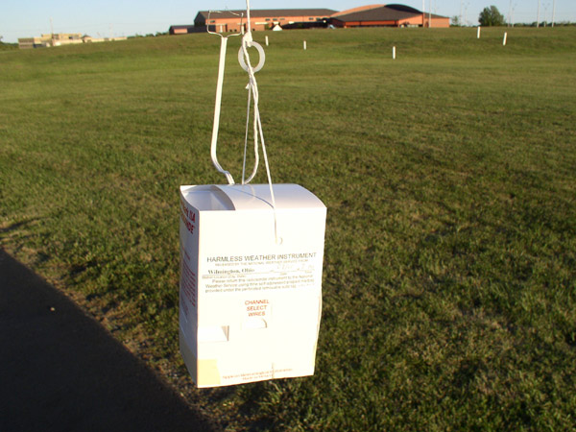
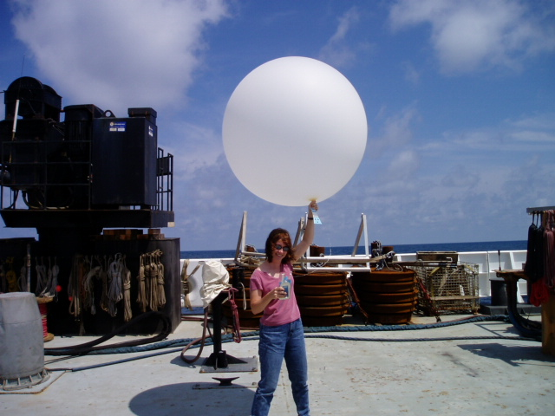
Real-time, global radiosonde data:
http://weather.uwyo.edu/upperair/sounding.html

Slide 2
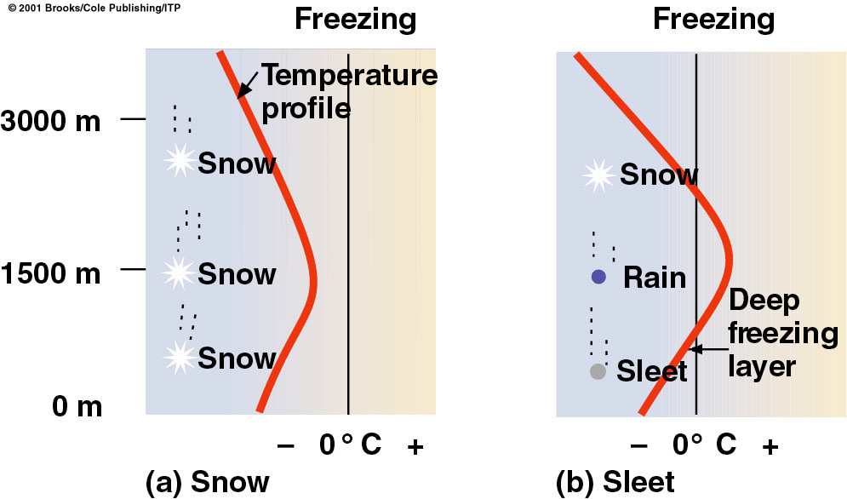
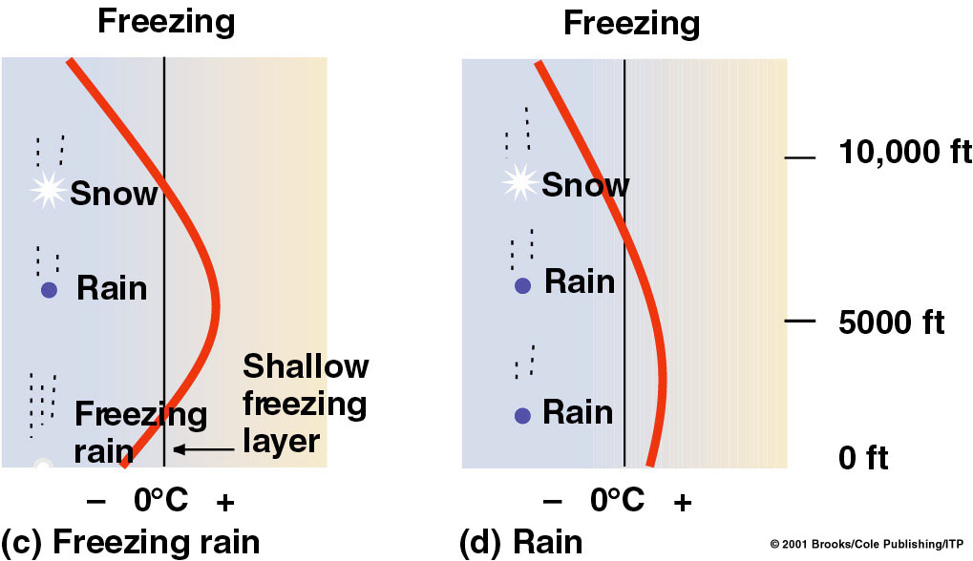

Slide 5
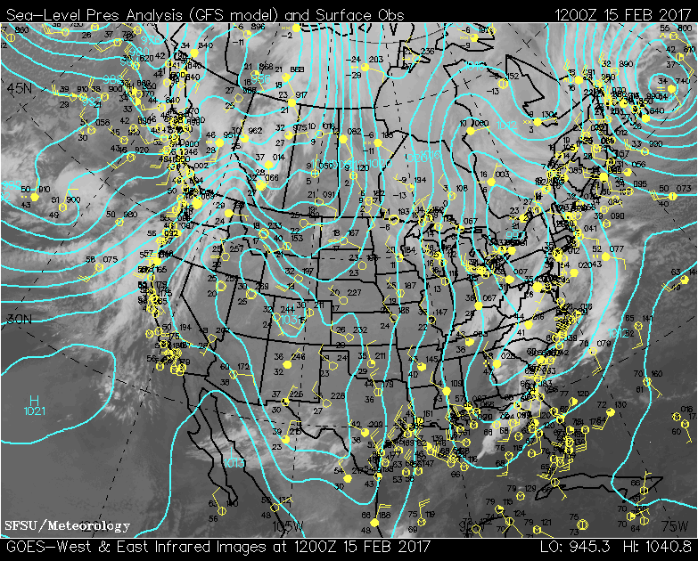

Slide 8
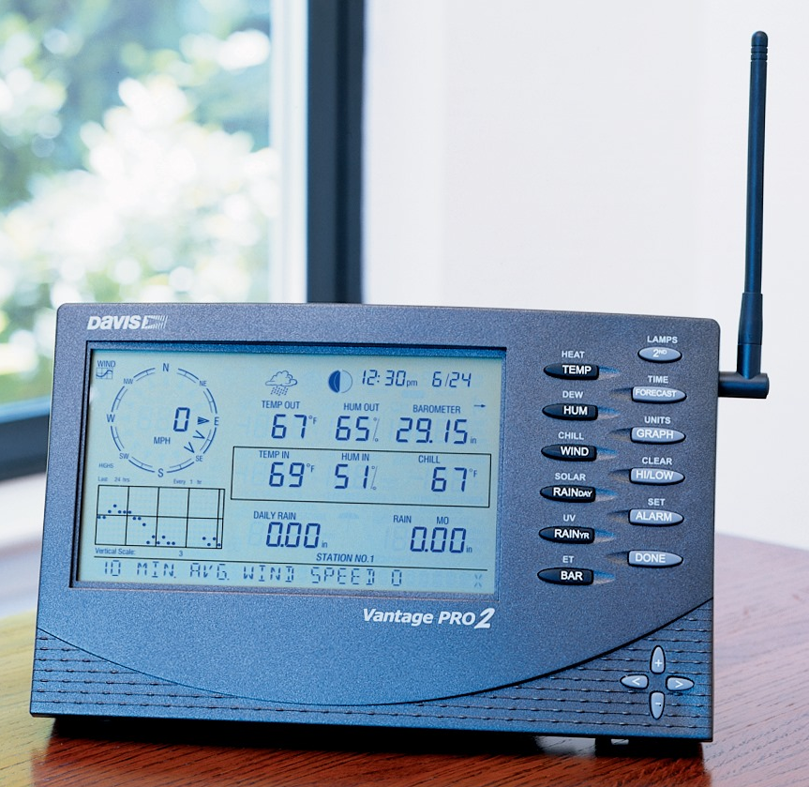

Slide 9
from Atmospheric Thermodynamics (Bohren & Albrecht)

Slide 12
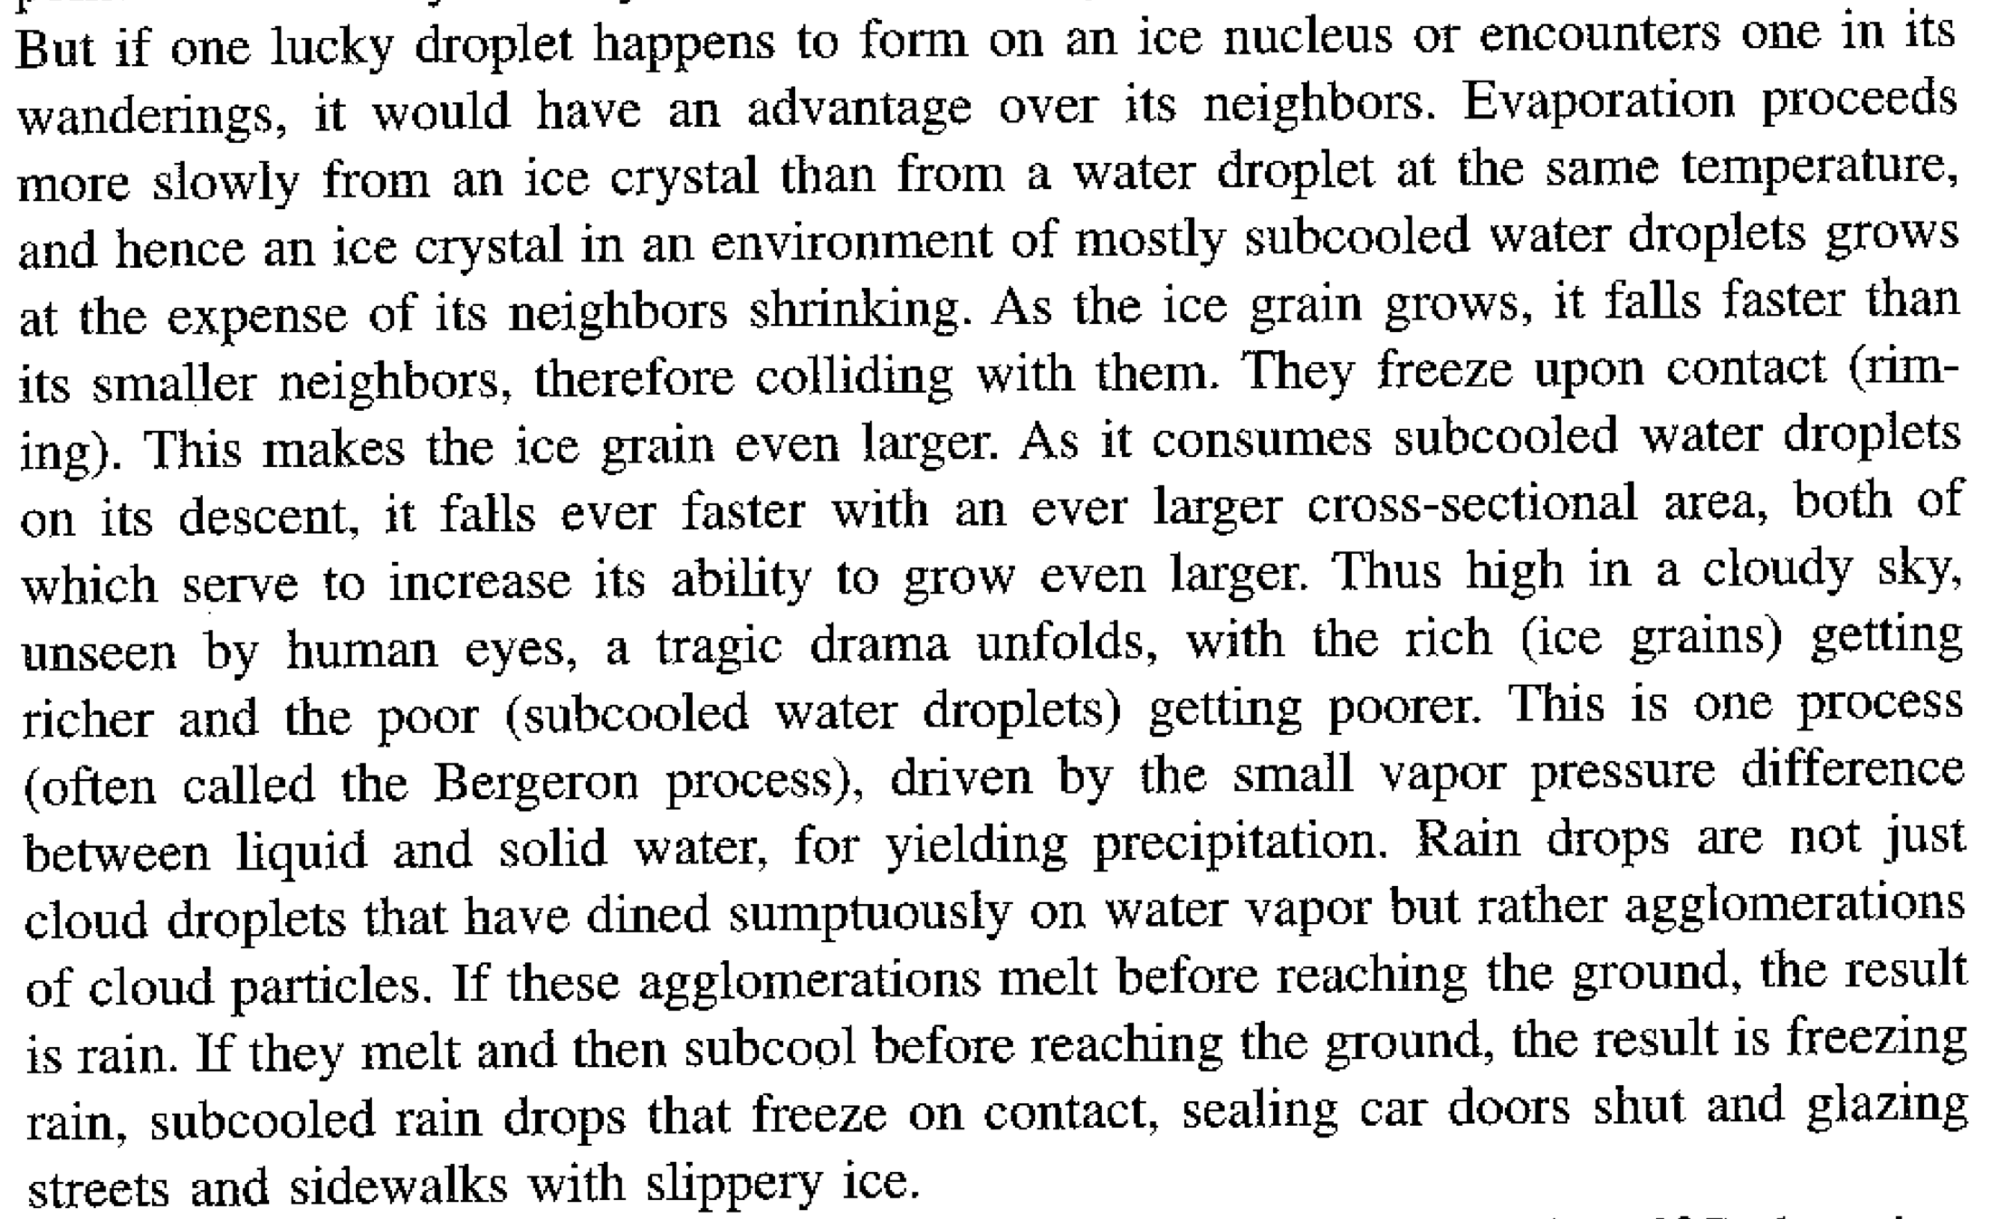

Slide 13
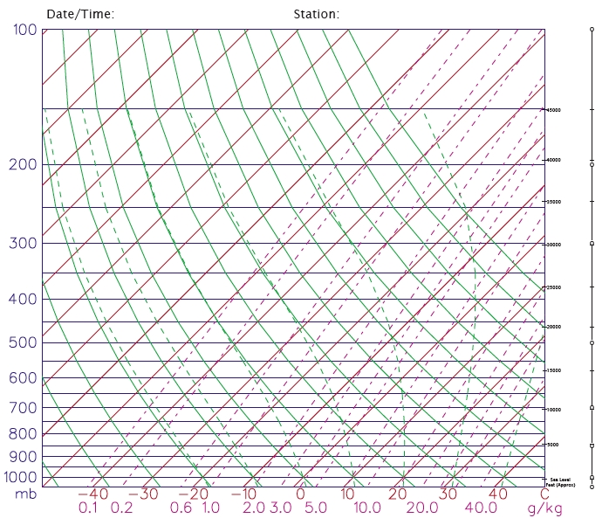

Slide 14
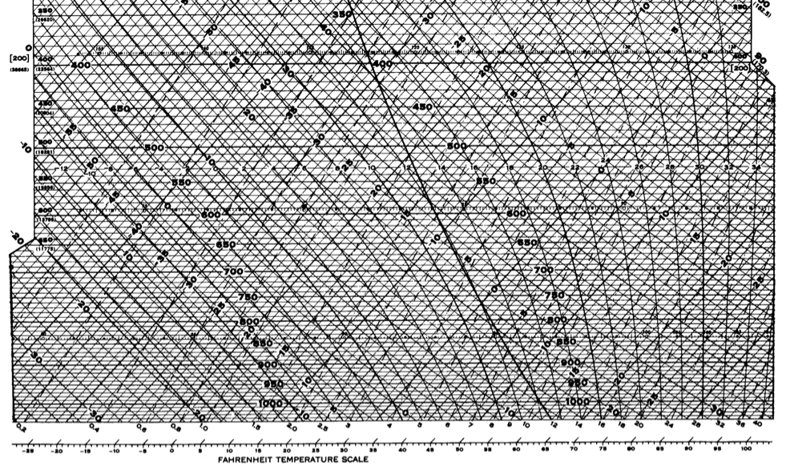

Slide 15
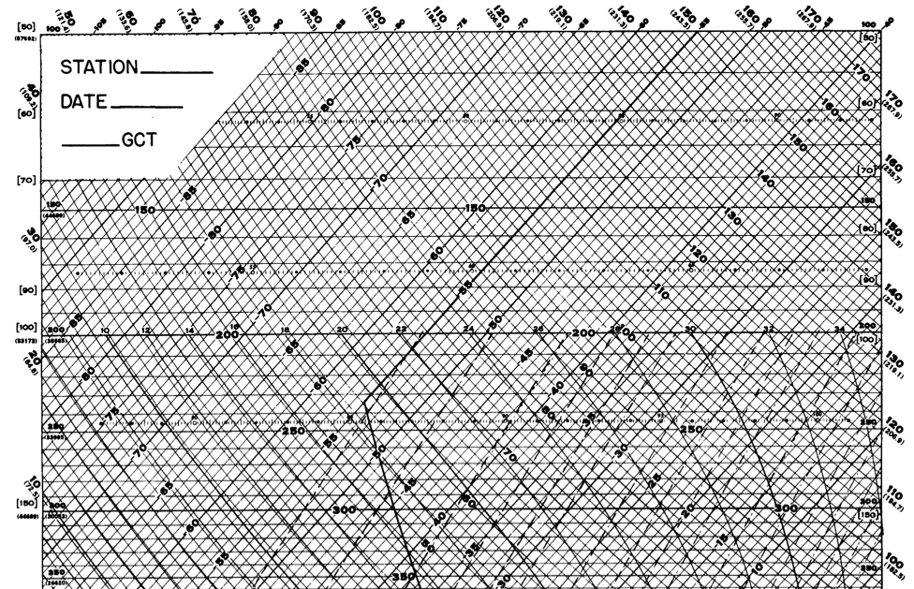

Slide 16
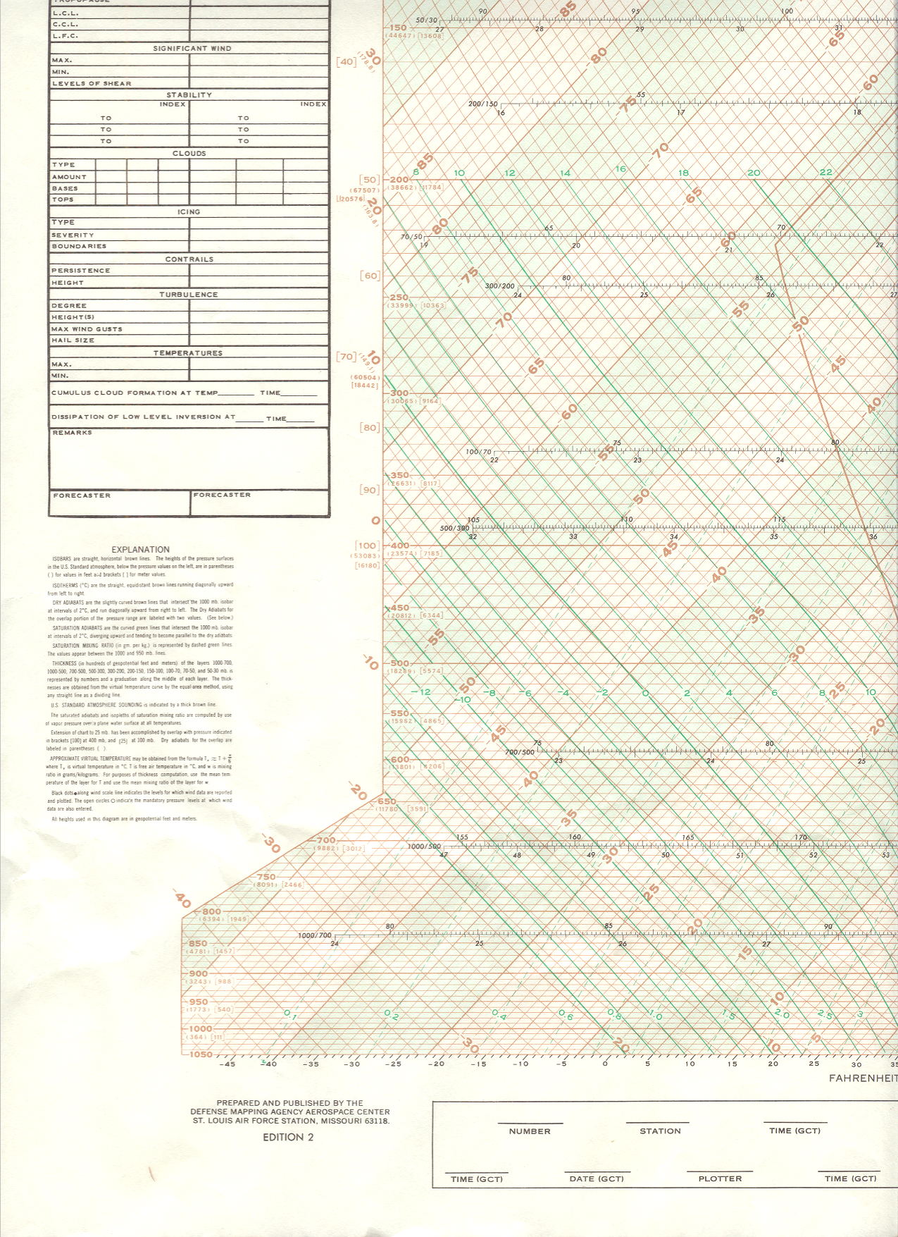
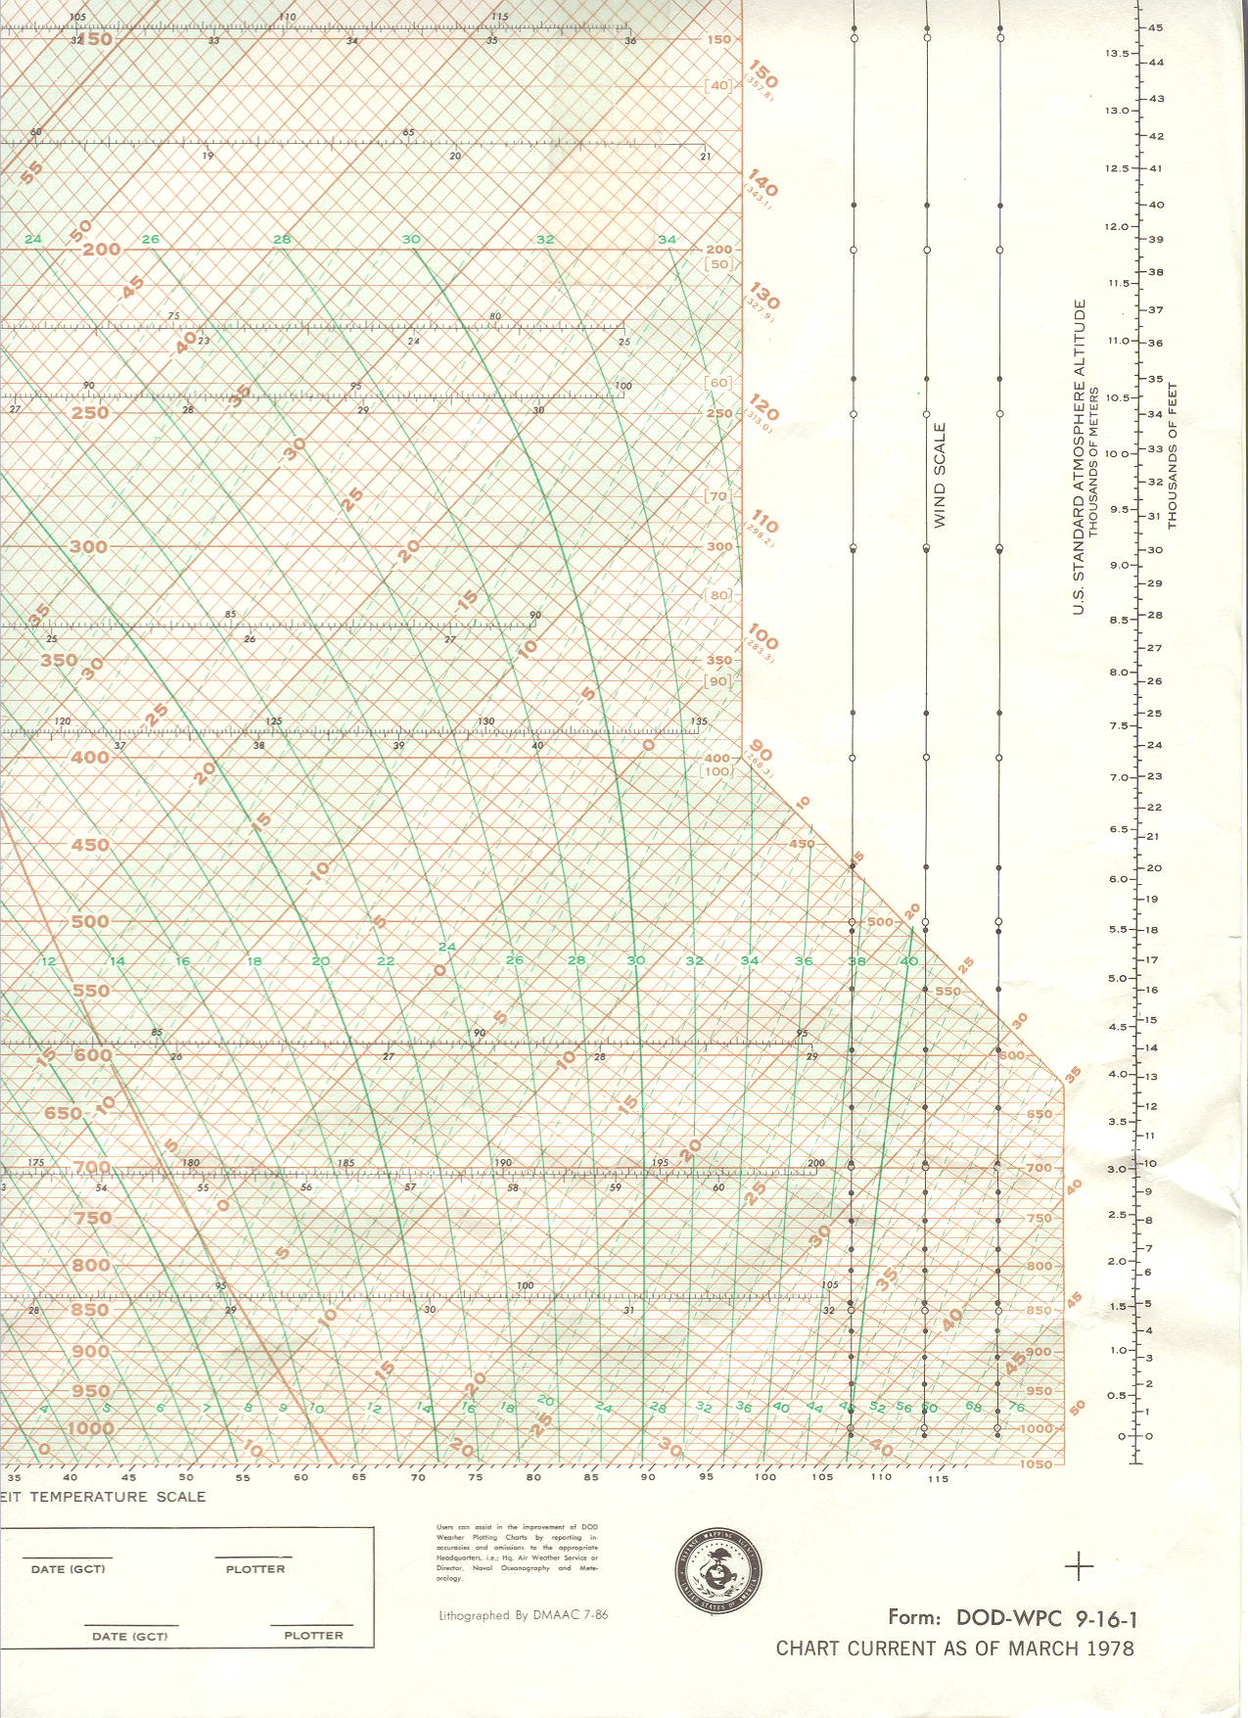

Slide 17
An air parcel has a temperature of -43ºC at 400 mb. What is its potential temperature?

Slide 18
An air parcel has a temperature of -43ºC at 400 mb. What temperature will it have if it descends adiabatically to 600 mb?

Slide 19
An air parcel has a temperature of 15ºC and a dew point temperature of 2ºC at 1000 mb. If the air parcel is lifted adiabatically, at what pressure level will it become saturated?

Slide 20
An air parcel has a temperature of 15ºC and a dew point temperature of 2ºC at 1000 mb. If the air parcel is lifted adiabatically, at what pressure level will it become saturated? If the air parcel is lifted another 200 mb, what is the final temperature and how much liquid water has condensed?

Slide 21
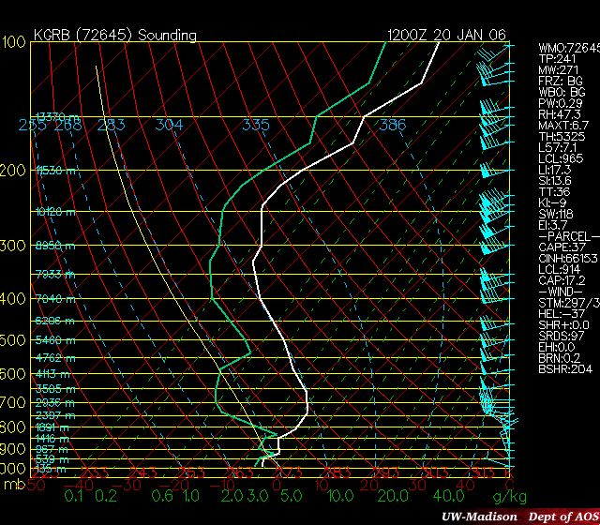

Slide 22
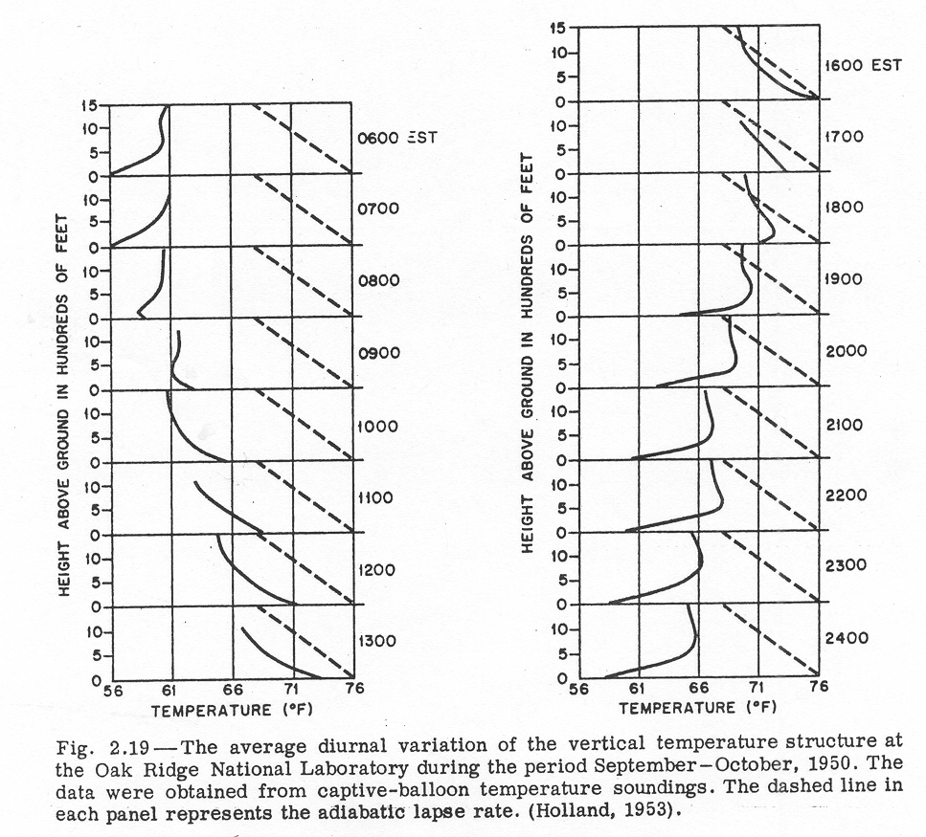
Diurnal variation of stability
Notes:
Go thru a day, and show how stability changes and why.

Slide 23
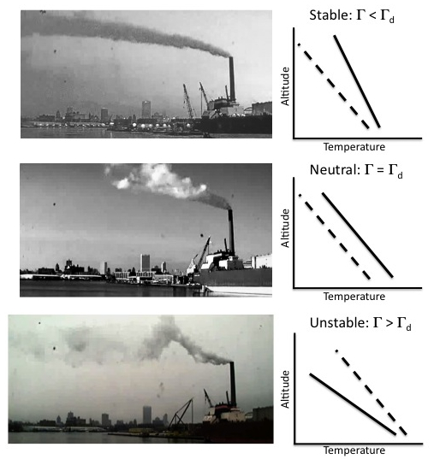
Smoke plumes in Milwaukee

Slide 24
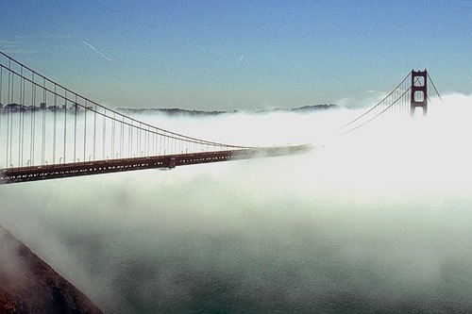
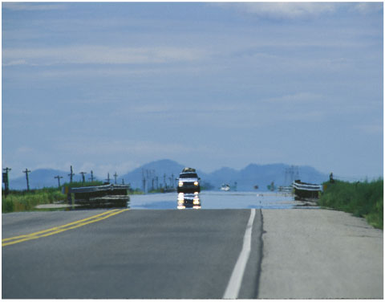
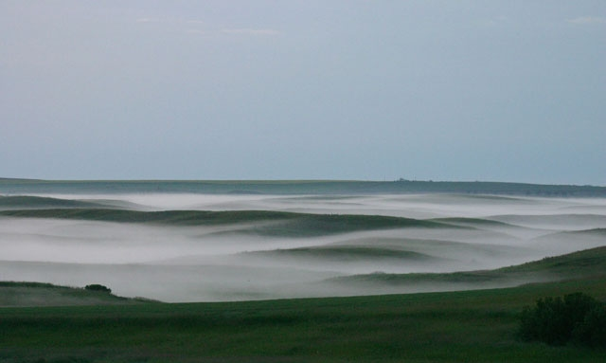
Stable conditions: Vertical motions suppressed

Slide 25
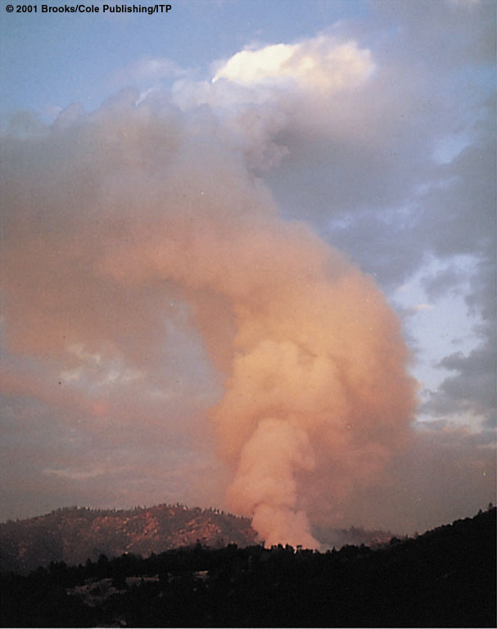
Unstable conditions: Vertical motions enhanced

Slide 26
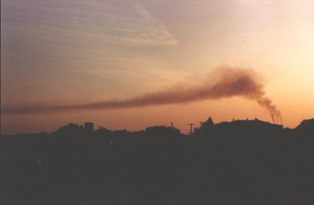
Guess the stability!

Slide 27
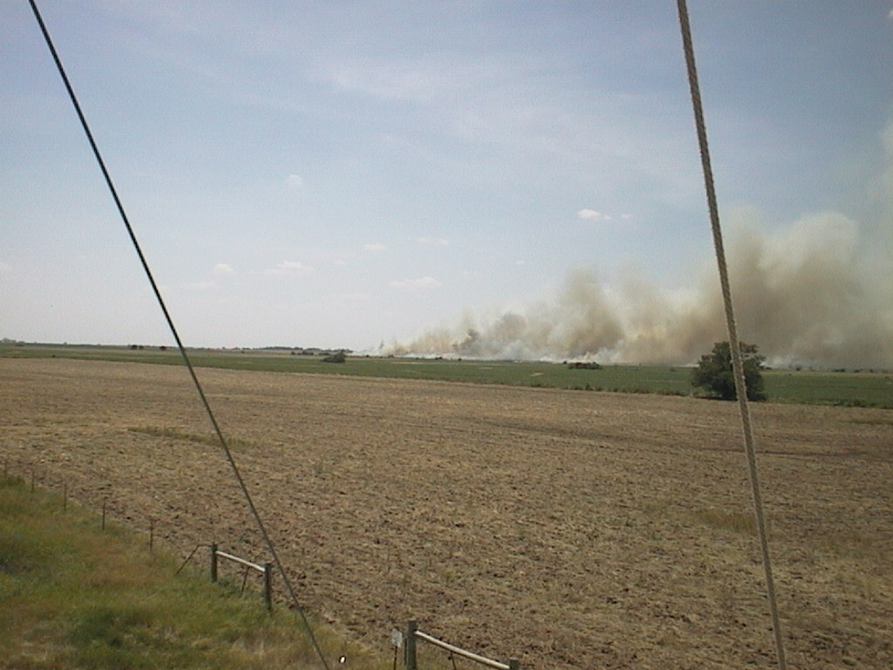
Guess the stability!

Slide 28
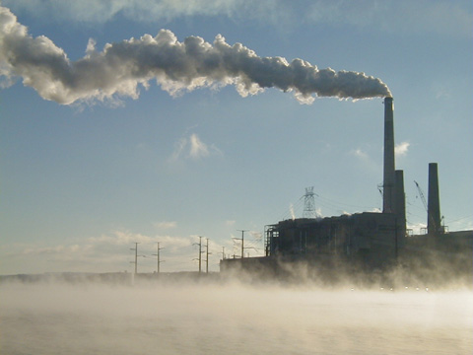
Guess the stability!

Slide 29
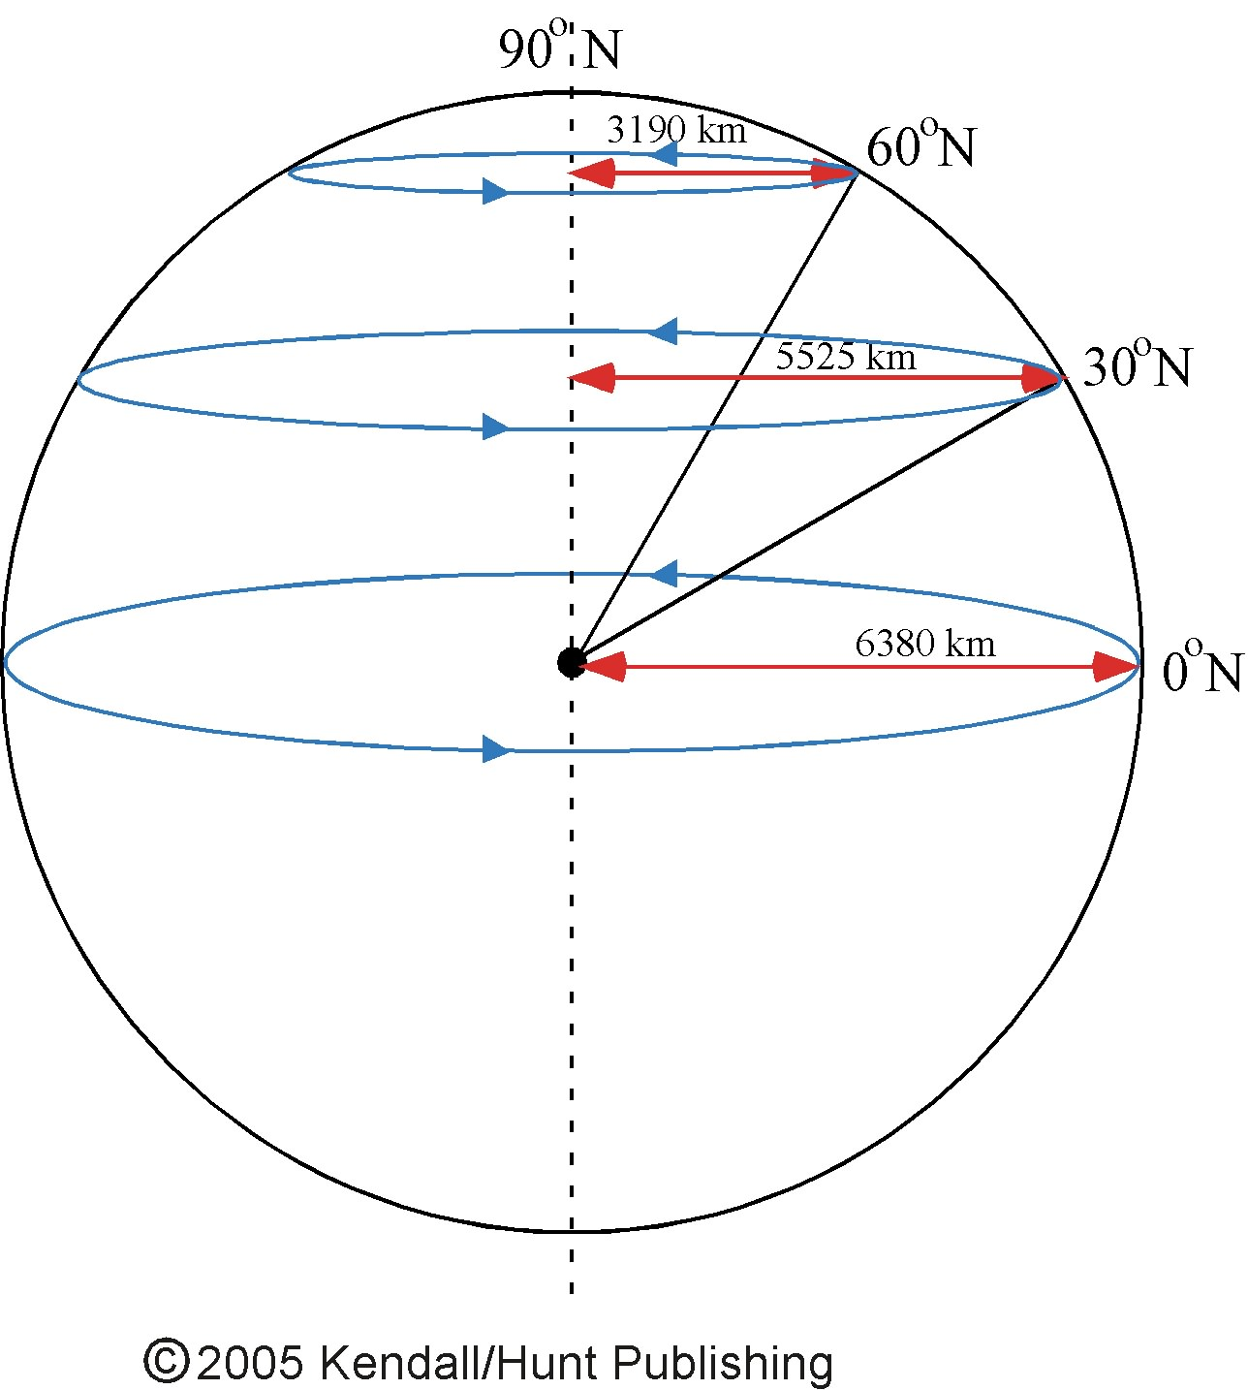
More on the Coriolis force:
Angular = mass velocity radius
momentum of air of air of rotation
X
X
Stays
the
same
Stays
the
same
So ...
As air moves northward, its radius of rotation decreases, causing its velocity
to increase. The increased velocity means
the air is moving faster relative to the earth’s
rotation, or in other words towards the east.
Thus the air appears to turn to the right.

Slide 30
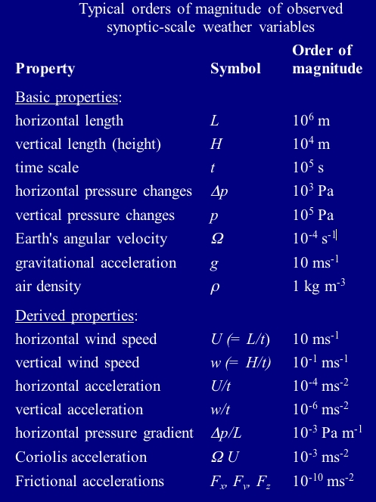

Slide 33
Stability and the shape of smoke plumes
Notes:
Discuss how smoke plumes are a visual marker for the vertical temperature profile

Slide 34
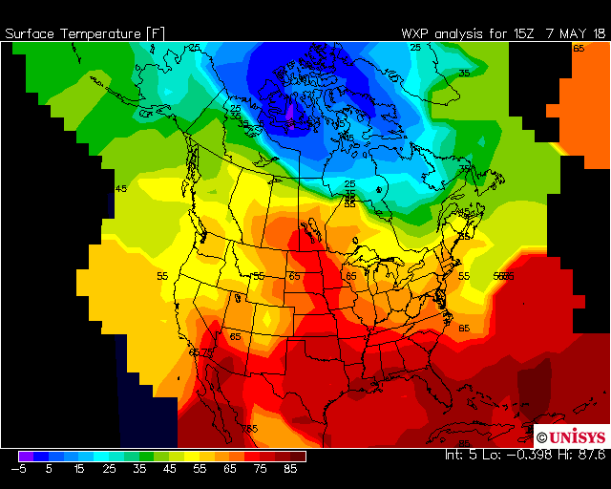
Thermal wind
Notes:
Discuss how smoke plumes are a visual marker for the vertical temperature profile

Slide 35
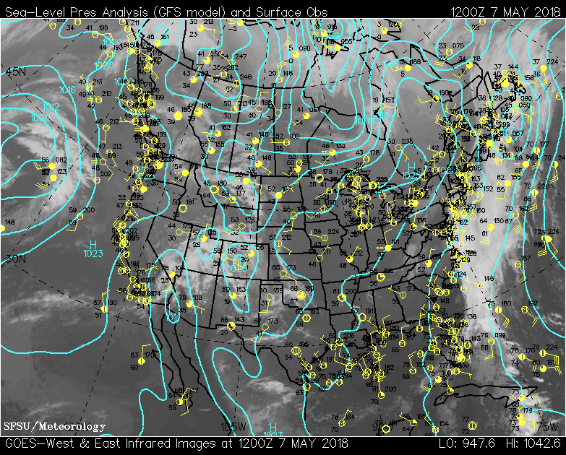
Thermal wind
Notes:
Discuss how smoke plumes are a visual marker for the vertical temperature profile

Slide 36
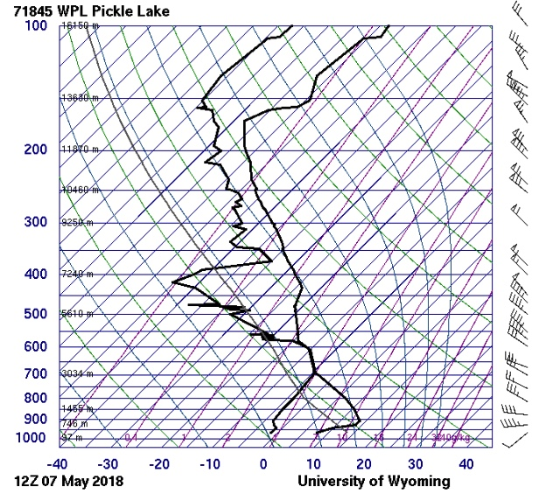
Thermal wind
Notes:
Discuss how smoke plumes are a visual marker for the vertical temperature profile

Slide 37
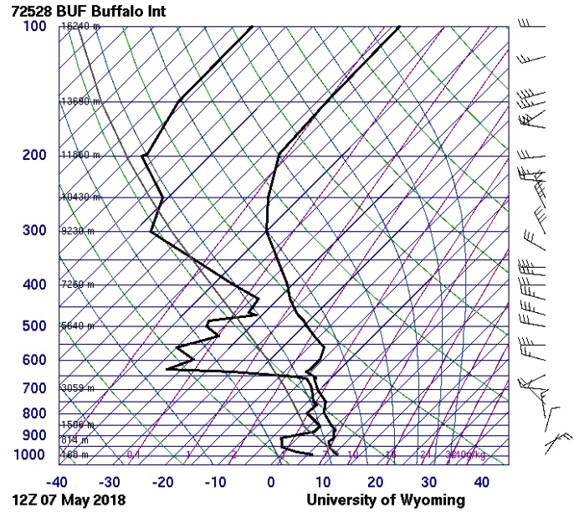
Thermal wind
Notes:
Discuss how smoke plumes are a visual marker for the vertical temperature profile

Slide 38
Thermal wind
https://www.youtube.com/watch?v=WPzb2OzeicY
https://www.youtube.com/watch?v=N2ElcN0vXLE
Notes:
Discuss how smoke plumes are a visual marker for the vertical temperature profile

