Slide 1
On the visual boundaries of Davis manifolds
Fredric D. Ancel
University of Wisconsin - Milwaukee

Slide 2
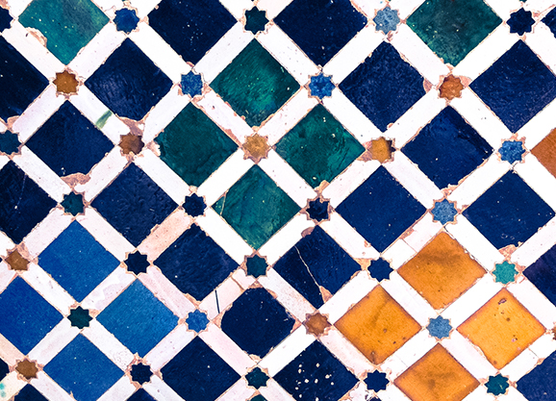
On the visual boundaries of Davis manifolds
Fredric D. Ancel
University of Wisconsin - Milwaukee

Slide 3
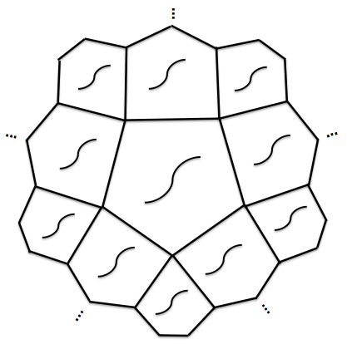
Davis (1983): ∀ n ≥ 4, ∃ a contractible open n-manifold Ω^{n} which covers a closed manifold and is not homeomorphic to ^{n}.
Construction:
Q^{n} compact contractible n-manifold, not B^{n}.
{ C_{v} : v ∈ V } is a mirror structure on ∂Q^{n}
– a cover of ∂Q^{n} by (n-1)-balls such that the intersection
of k C_{v}’s is either ∅ or an (n-k)-ball
Q^{n}
(like the faces of an n-cube).
Create Ω^{n} by repeatedly reflecting Q^{n}’s across C_{v}’s.
A right angled Coxeter group Γ acts on Ω^{n}
generated by the reflections in the C_{v}’s
permuting the Q^{n}’s transitively.
Γ has a torsion free finite index subgroup Δ.
So Ω^{n}/Δ is a closed n-manifold and
Ω^{n} → Ω^{n}/Δ is a covering map.
Q^{n}
Q^{n}
Q^{n}
So Ω^{n}/Γ ≈ Q^{n}.
Q^{n}
Q^{n}
Q^{n}
Ω^{n}
Question: Does Ω^{n} embed in S^{n}?

Slide 4
Observations:
…
Can erect collars between successive Q^{n}’s in Ω^{n}.
A collar is like a layer of ice: a Q^{n} can skate
to a new position along the collar.
Hence, the topology of Ω^{n} is unchanged by
moving the attaching disks of successive Q^{n}’s.
…
Q^{n}
…
Q^{n}
Q^{n}
…
…
Q^{n}
…
…
Q^{n}
Q^{n}
…
…
Ω^{n}
For example:
Ω^{n} ≈
…
Q^{n}
Q^{n}
Q^{n}
Q^{n}
Q^{n}

Slide 5
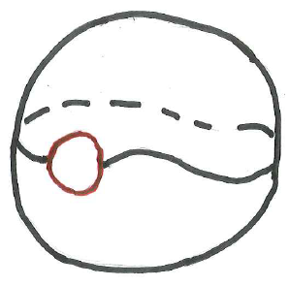
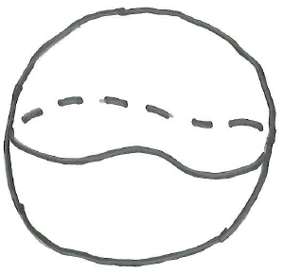
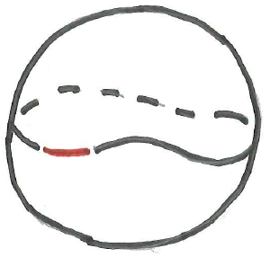
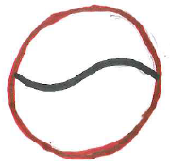
More observations:
The n-dimensional Poincare Conjecture implies: Q^{n} ∪_{∂Q} Q^{n} ≈ S^{n}.
Q^{n}
Let D be an (n-1)-ball in ∂Q^{n}.
Let P = ∂Q^{n} – Int(D).
“Inflate” D to an n-ball D in S^{n}.
Let B^{n} = S^{n} – Int(D).
Invert S^{n} in ∂D.
D
~
~
D
~
D
P
~
∂Q^{n}
D
Q^{n}
S^{n}
D
Q
Hence, B^{n} ≈ Q^{n} ∪_{P} Q^{n}.
P
B^{n}
Q
D

Slide 6
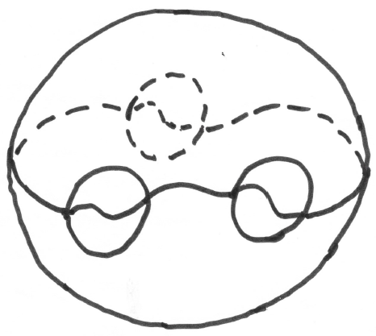
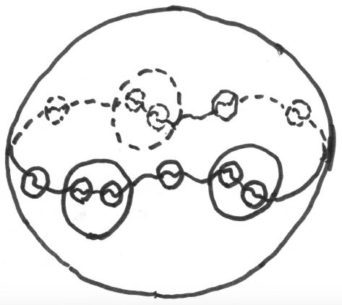
In S^{n}: “inflate” small (n–1)-balls in ∂Q^{n} and “plug in” Q^{n} ∪_{P} Q^{n}.
Now S^{n} = the double of Q^{n} ∪_{D} Q^{n} ∪_{D} Q^{n} ∪_{D} Q^{n} along a “seam”
that is homeomorphic to ∂Q^{n} # ∂Q^{n} # ∂Q^{n} # ∂Q^{n}.
D
Q^{n}
P
Q^{n}
Q^{n}
Q^{n}
Q^{n}
Q^{n}
D
S^{n}
P
Q^{n}
Q^{n}’s
Iterate this process densely.

Slide 7
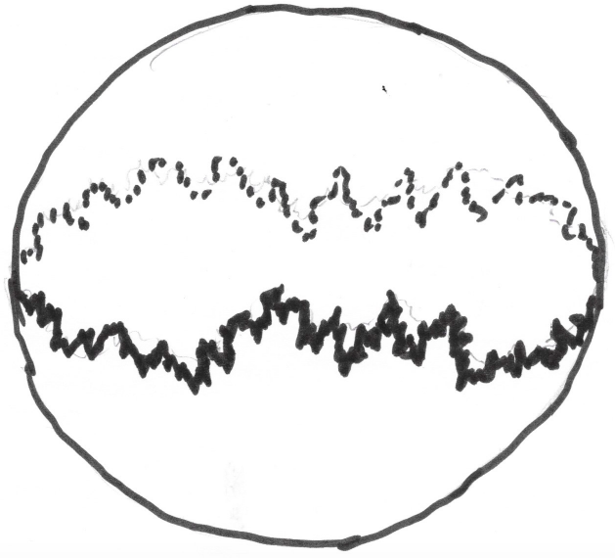
In the limit, S^{n} = the double of Q^{n} ∪_{D} Q^{n} ∪_{D} Q^{n} ∪_{D} … ≈ Ω^{n}
along a “seam” J = lim { controlled sequence of connected sums of ∂Q^{n} }.
Ω^{n}
J
S^{n}
Ω^{n}

Slide 8
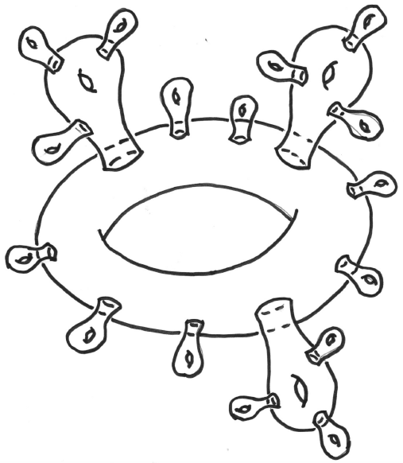
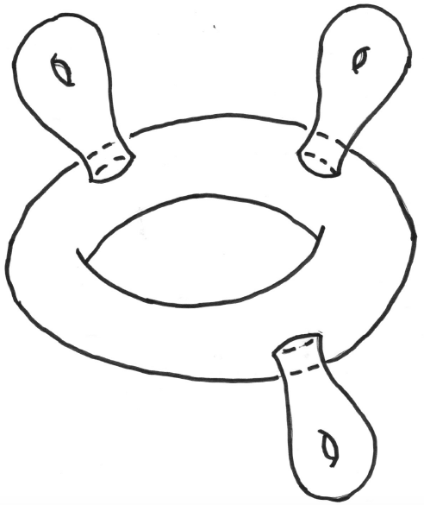
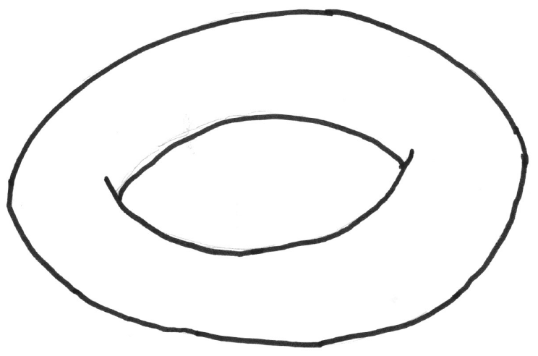
J is the inverse limit of a controlled sequence of the form
…
where each punctured torus is really a punctured ∂Q^{n}.

Slide 9
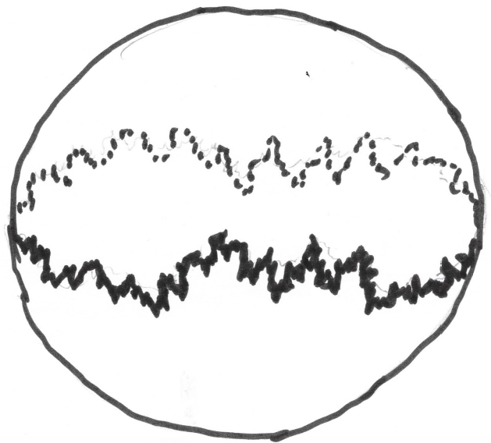
Summary (A – Siebenmann, 1985):
There is a compactification Ω^{n} = Ω^{n} ∪ J of Ω^{n} such that:
Ω^{n} is an AR,
J is a Z-set in Ω^{n},
J is a Jakobsche fractal based on ∂Q^{n} [Jakobsche 1980]
(Hence, J is a homogeneous non-ANR Cech homology (n-1)-manifold
and Cech homology (n-1)-sphere),
Ω^{n} ∪_{J} Ω^{n} ≈ S^{n}.
_
_
_
_
_
Ω^{n}
S^{n}
Ω^{n}
J

Slide 10
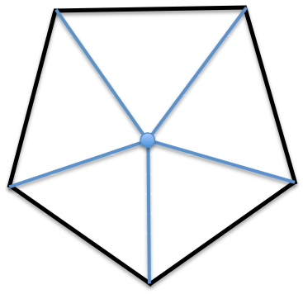
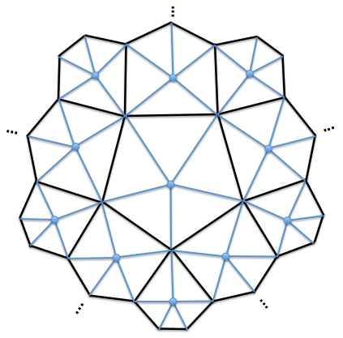
Question: Can this compactification be made Γ-equivariant?
Answer: Yes – Fischer (1998), A-Guilbault (1999)
Fischer’s Idea: Consider the Davis complex Ξ^{n} based on ∂Q^{n}.
To obtain Ξ^{n} from Ω^{n}, replace each Q^{n} by Cone(∂Q^{n}).
Q^{n}
φ
Cone(∂Q^{n})
Φ
Ω^{n}
Ξ^{n}
equivariant
proper
homotopy
equivalence

Slide 11
Outline of Fischer’s proof:
Cone(∂Q^{n}) is a CAT(0) cube complex
(because the mirror structure { C_{v} : v ∈ V } comes from a
flag triangulation of ∂Q^{n}).
Hence, the Davis complex Ξ^{n} is a CAT(0) cube complex.
The visual boundary ∂Ξ^{n} of Ξ^{n} is equivariantly attached.
Use Φ to attach ∂Ξ^{n} equivariantly to Ω^{n} as a Z-boundary.
!!! ∂Ξ^{n} ≈ J – the Jakobsche fractal based on ∂Q^{n}. !!!
A-Guilbault (1999): The double of Ω^{n} ∪ ∂Ξ^{n} along ∂Ξ^{n} is homeomorphic to S^{n}.

Slide 12
The proof that ∂Ξ^{n} ≈ J:
The natural proof should have followed from a Morse Theory for manifolds
with singularities developed by Davis-Januszkiewicz [DJ] (1991).
But there was a flaw in [DJ]’s proof
(corrected in recent paper by Swiatkowski – with help from D and J and the referee).
So Fischer took a less obvious approach.

Slide 13
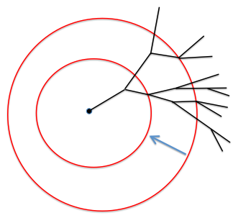
Outline of the natural proof that ∂Ξ^{n} ≈ J:
∂Ξ^{n} = lim { S_{r}(p), g_{tr} : t > r > 0 }
where
S_{r}(p) = metric sphere of radius r centered at base point p in Ξ^{n} and
g_{tr} : S_{t}(p) → S_{r}(p) is geodesic retraction.
p
S_{r}(p)
g_{tr}
S_{t}(p)

Slide 14
{ S_{r}(p), g_{tr} : t > r > 0 } is a controlled inverse sequence of connected sums of ∂Q^{n}
because:
1) If S_{a}(p) contains a singularity q, then for suffiently small r > 0,
S_{a + r}(p) ≈ (controlled) S_{a}(p) # Link(q, Ξ)
2) If S_{r}(p) contains no singularities for a ≤ r < b, then g_{ba} : S_{b}(p) → S_{a}(p)
is a cell-like map and, hence, a near homeomorphism.
(The flaw in [DJ]’s proof was here.)
Therefore, ∂Ξ = lim { controlled sequence of connected sums of ∂Q^{n} }.
So ∂Ξ^{n} ≈ J.
≈ S_{a}(p) # ∂Q^{n}.

Slide 15
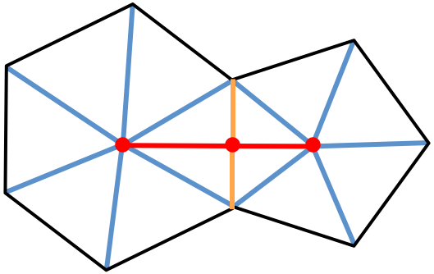
A-Davis-Guilbault (1997): Ω^{n} has a natural CAT(0) structure.
Proof [based on A-Guilbault (1995)]:
Q^{n} ≈ the union of two cones along a cone.
Therefore, Q^{n} is a CAT(0) cube complex.
Hence, so is Ω^{n}.
Q has an arc of singular points
(points whose links aren’t PL spheres).
Hence, the singular points of Ω^{n} form a discrete collection of arcs
– not isolated points.
So the Morse theory of [DJ] doesn’t apply here.
Question: Is the visual boundary of Ω^{n} homeomorphic to the
Jakobsche fractal J based on ∂Q^{n}?
singular arc

Slide 16
Two questions of Kim Ruane:
Must all visual boundaries of a given right angled
Coxeter group be homeomorphic?
If a given CAT(0) group G has a locally connected
visual boundary, must all the visual boundaries of G
be homeomorphic?
Observation:
If the visual boundary of Ω^{n} is not homeomorphic to the
Jakobsche fractal J based on ∂Q^{n}, then the answer to
both these questions is “no”.

