Slide 1
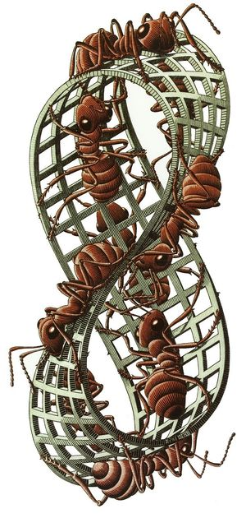
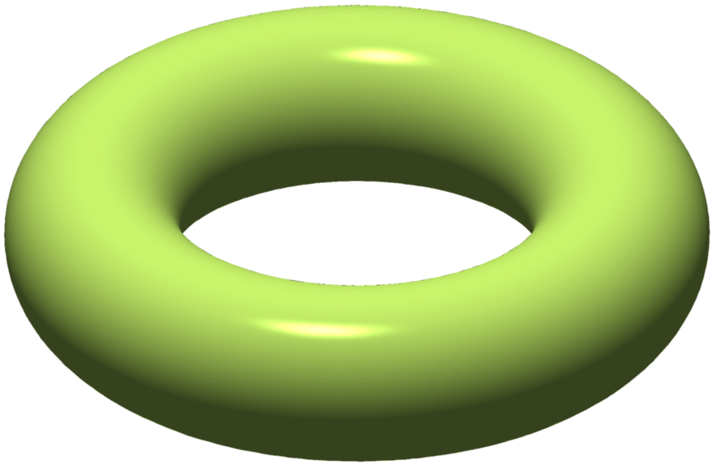
It’s time to talk about…
Seven special surfaces
because the orbifold of each wallpaper group
is one of these seven surfaces.

Slide 2
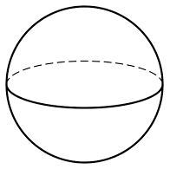
Here are the first five special surfaces.
Disk – D²
Annulus – A²
Mobius strip – M²
2-sphere – S²
Torus – T²

Slide 3
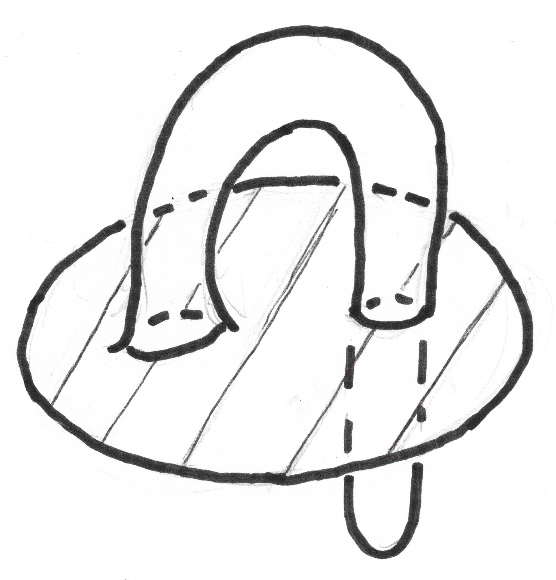
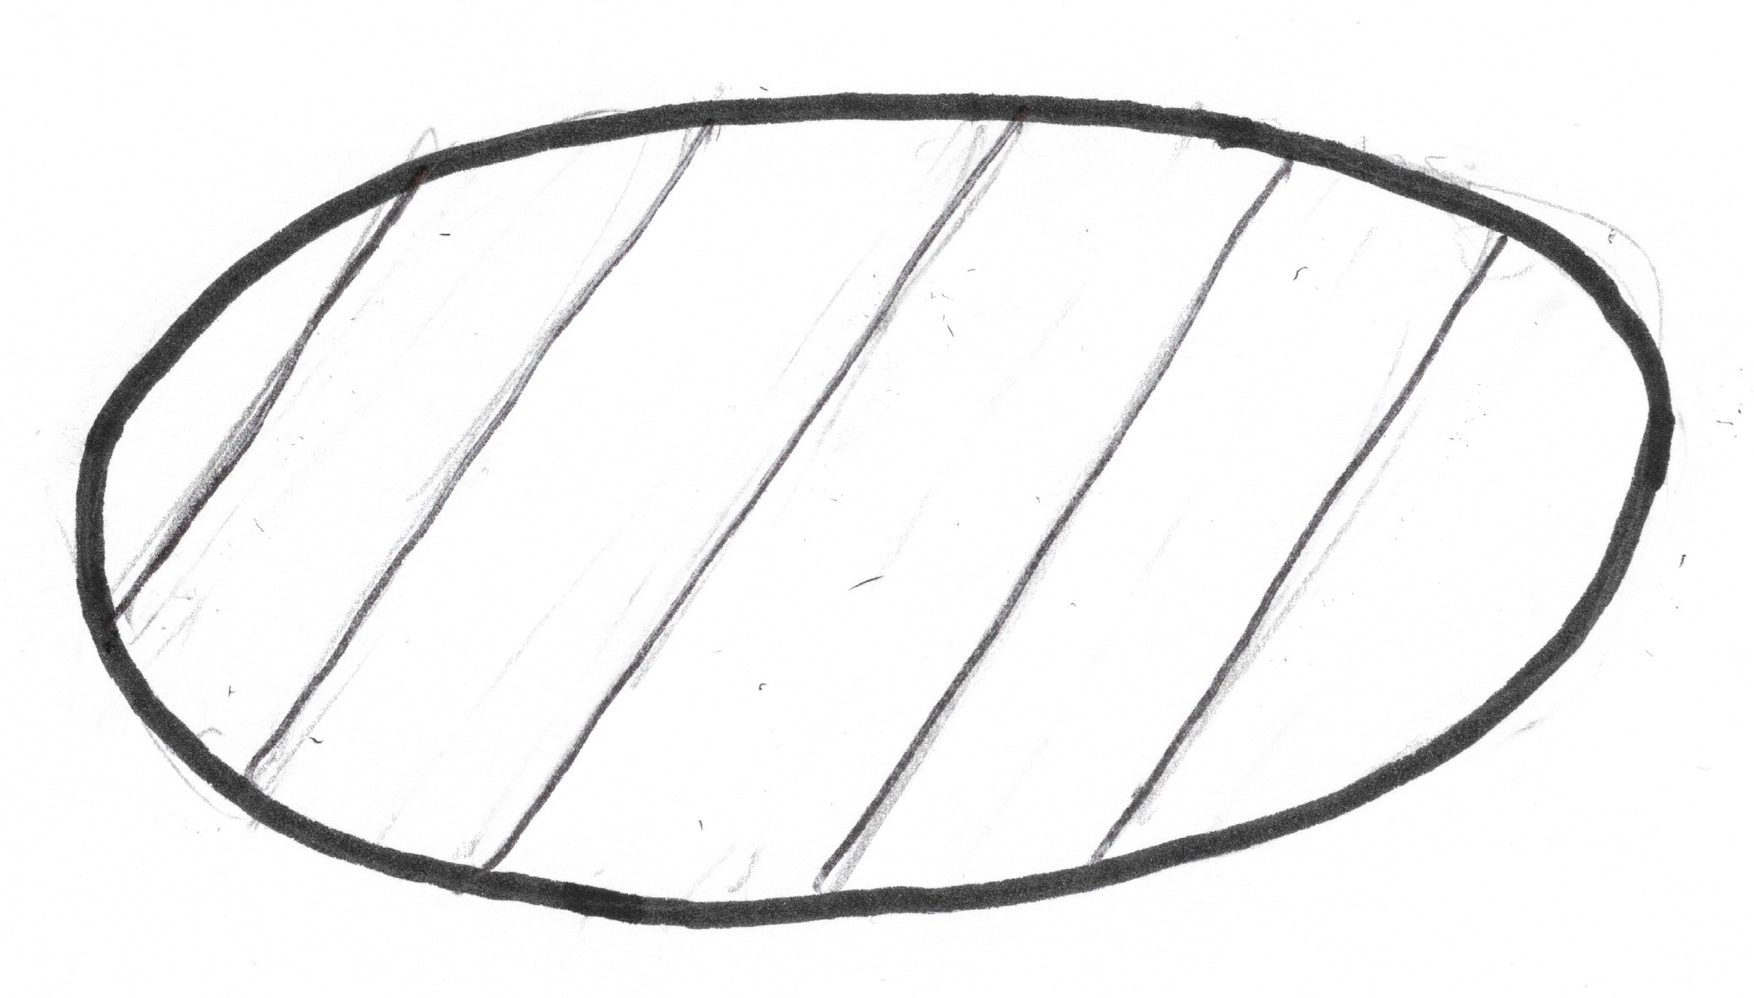
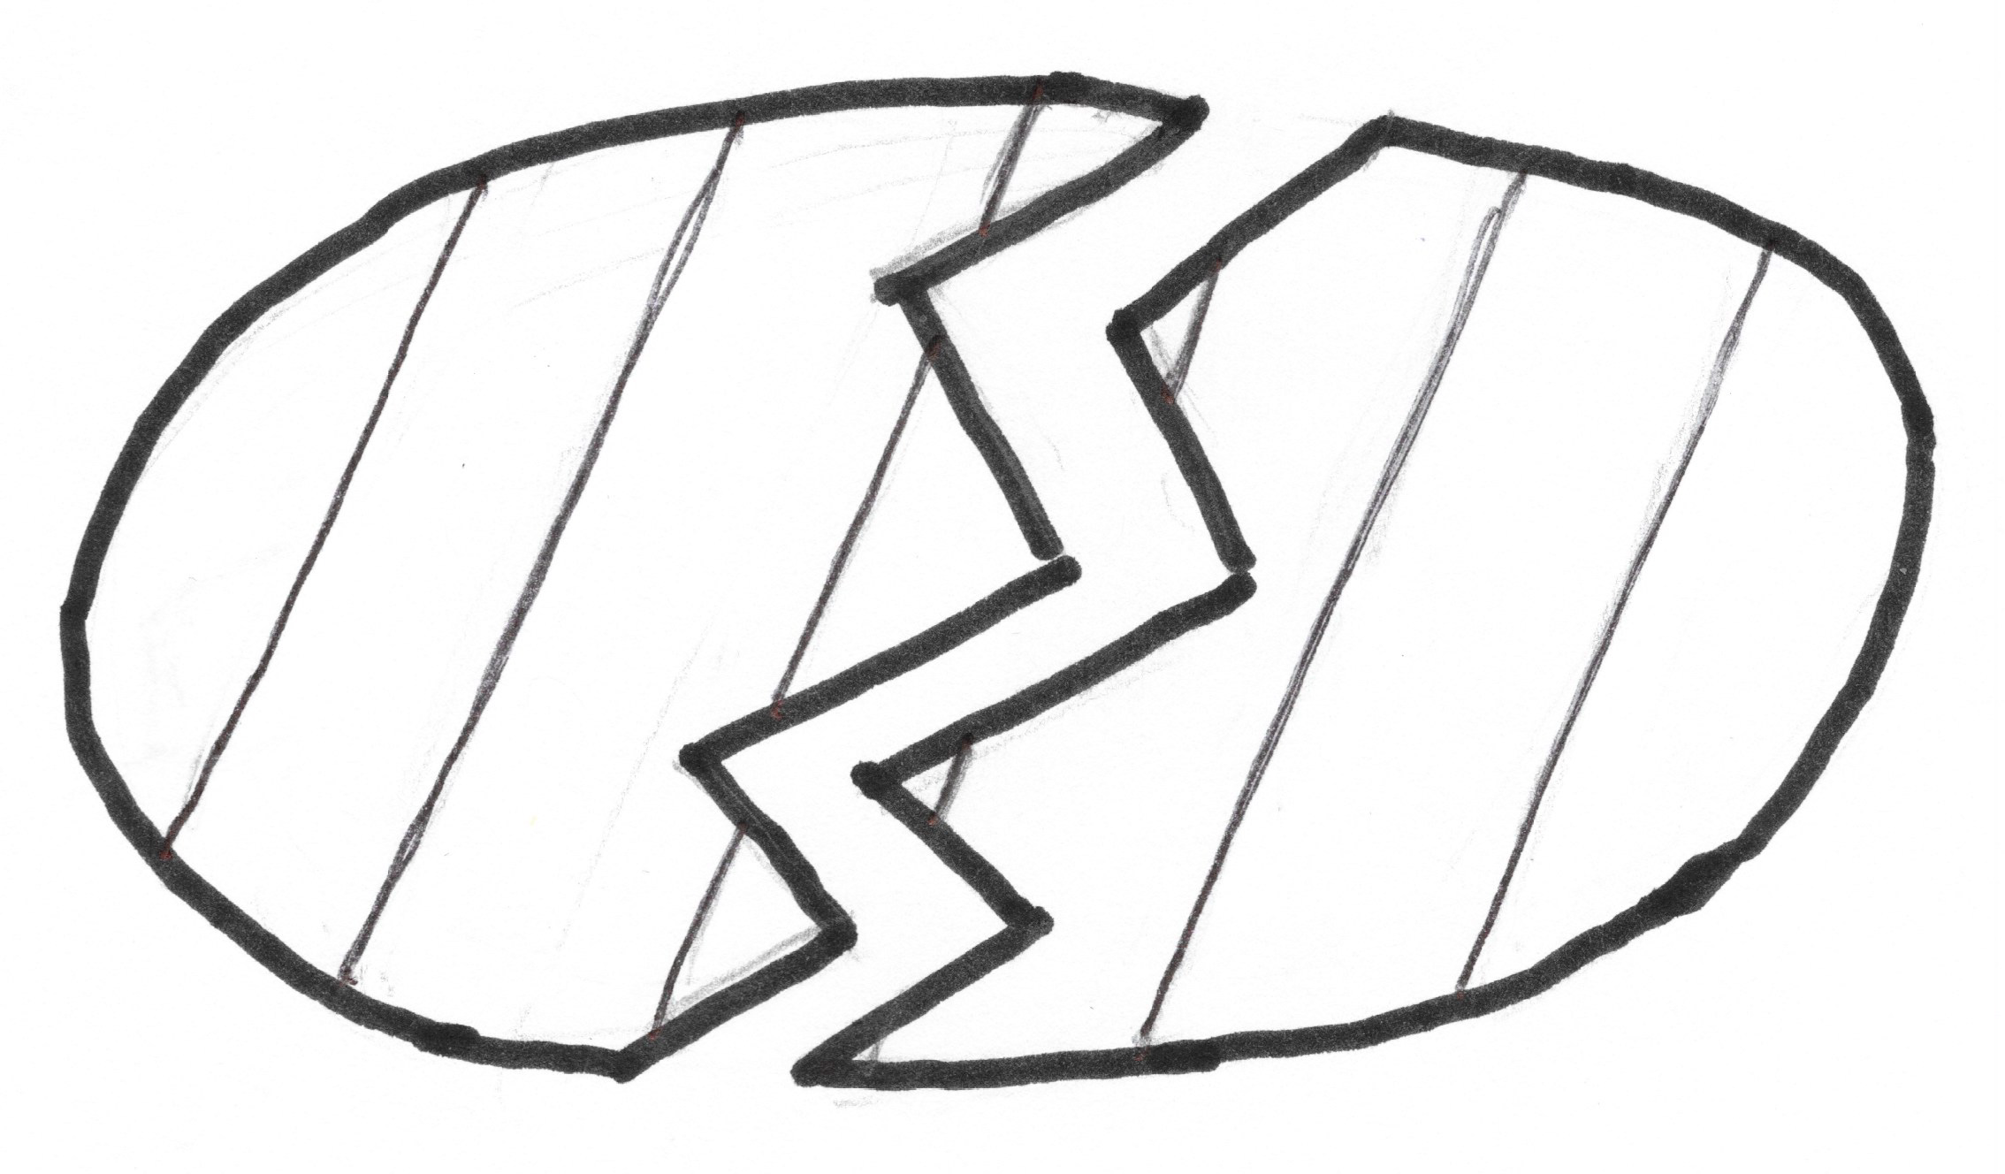
Surfaces live in the world of topology.
In topology: two objects are regarded as the same if
they are homeomorphic.
be deformed into the other without
tearing apart points and not reattaching
them as they were initially
and without
sticking together points that aren’t initially
stuck together.
This means: one object can
not homeomorphic
≈ means “is homeomorphic to”.
not homeomorphic

Slide 4
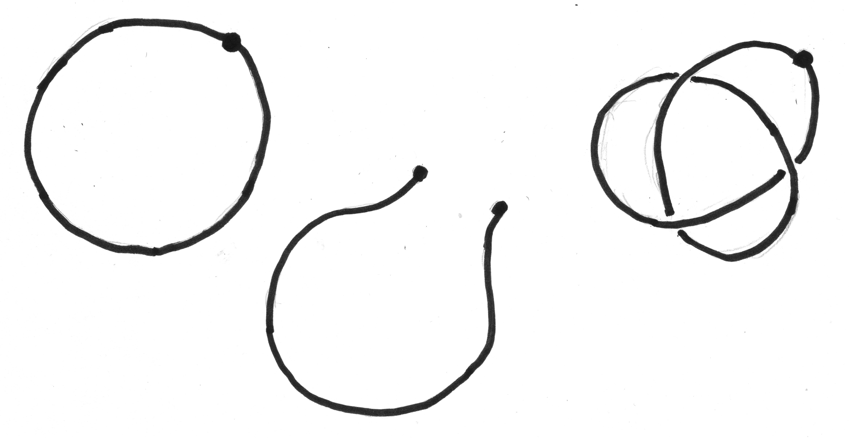
homeomorphic
not homeomorphic
not homeomorphic

Slide 5
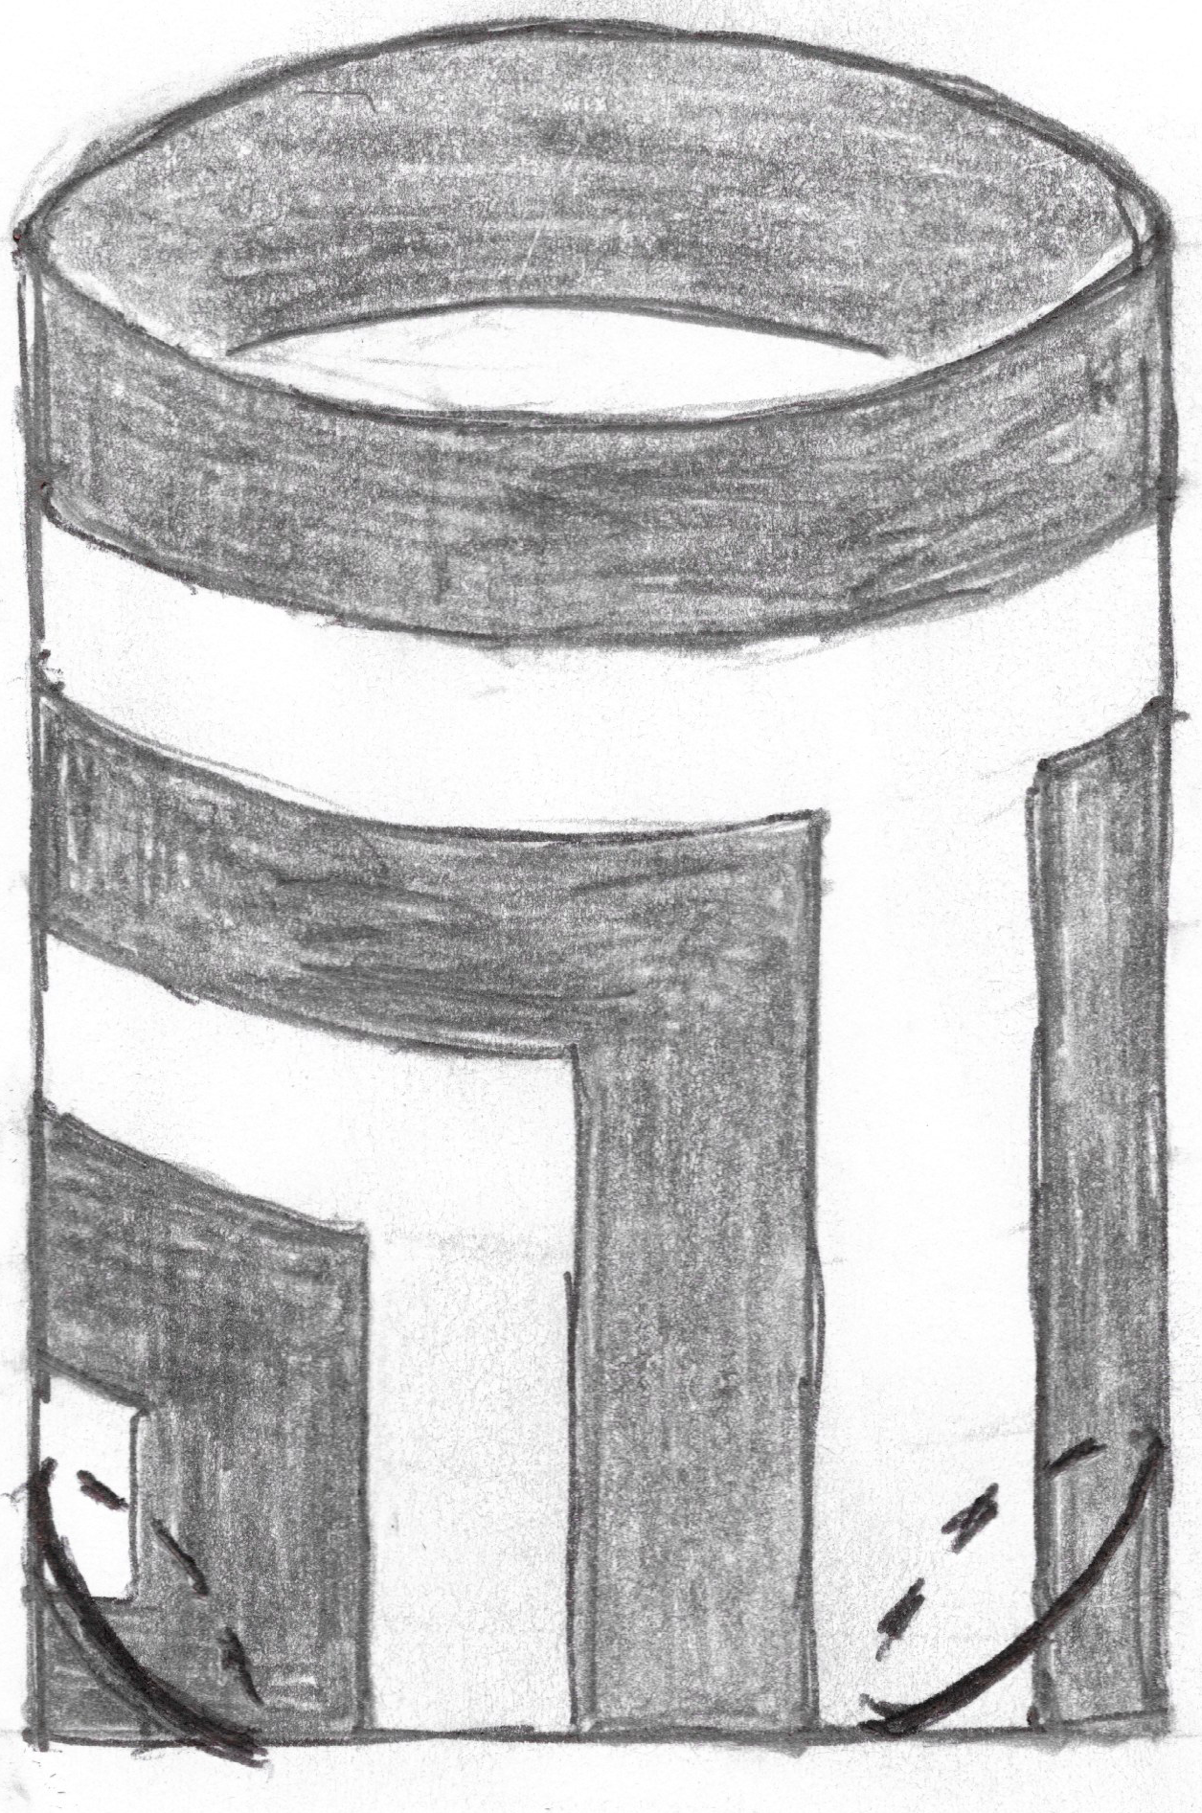
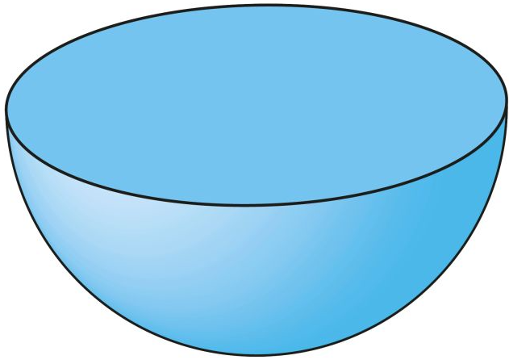
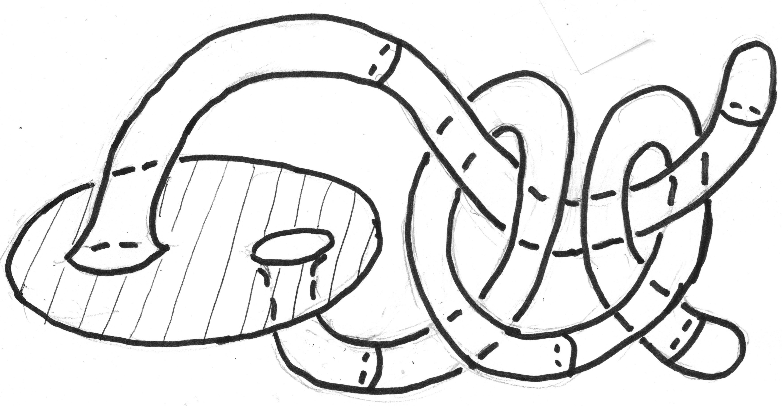
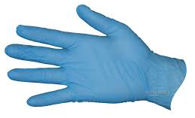
The following objects are all homeomorphic.
Oval
Bowl
Cone
Tote bag
Disk with knotted feelers
Glove
They are all disks.

Slide 6
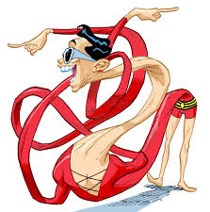
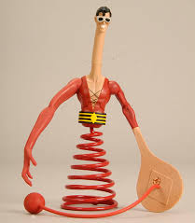
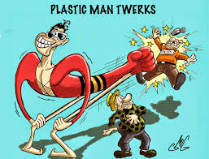
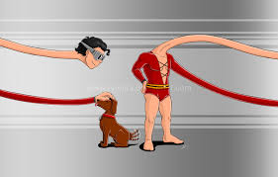
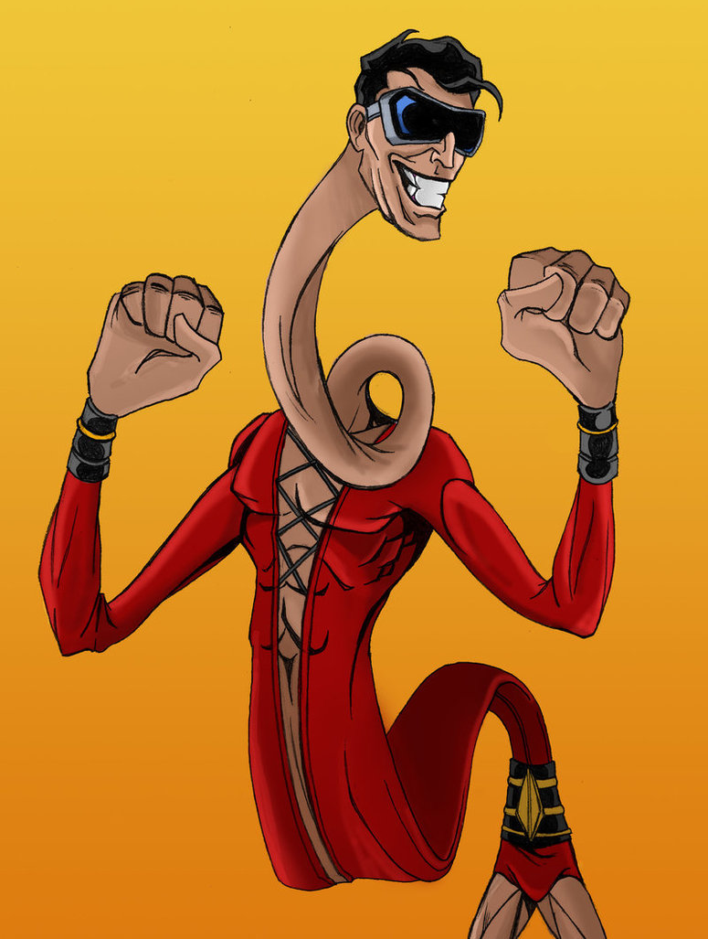
The muse of topology
Plastic Man

Slide 7
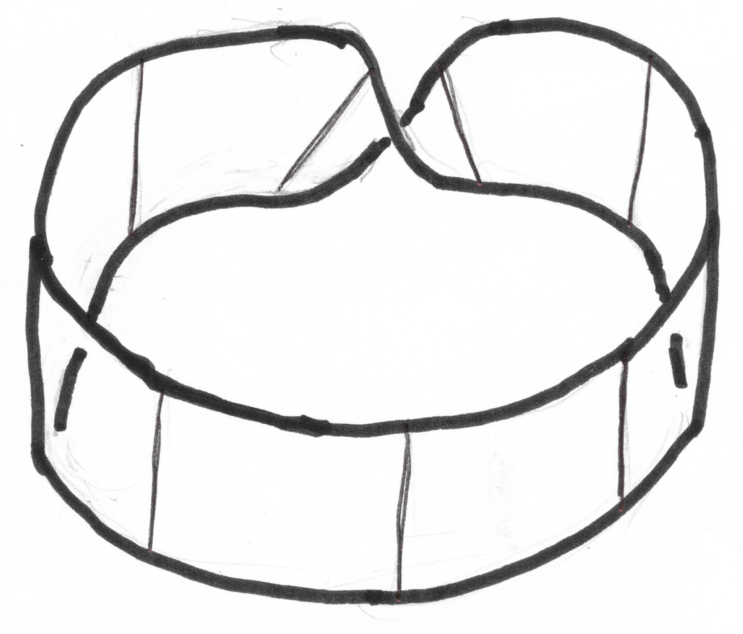
Identification is an important tool for constructing surfaces.
identify
≈
≈
Rectangle with
ends identified
Annulus
Cylinder
(Identify)
≈
≈
Rectangle with
ends identified
Mobius strip
Another view of
the Mobius strip

Slide 8
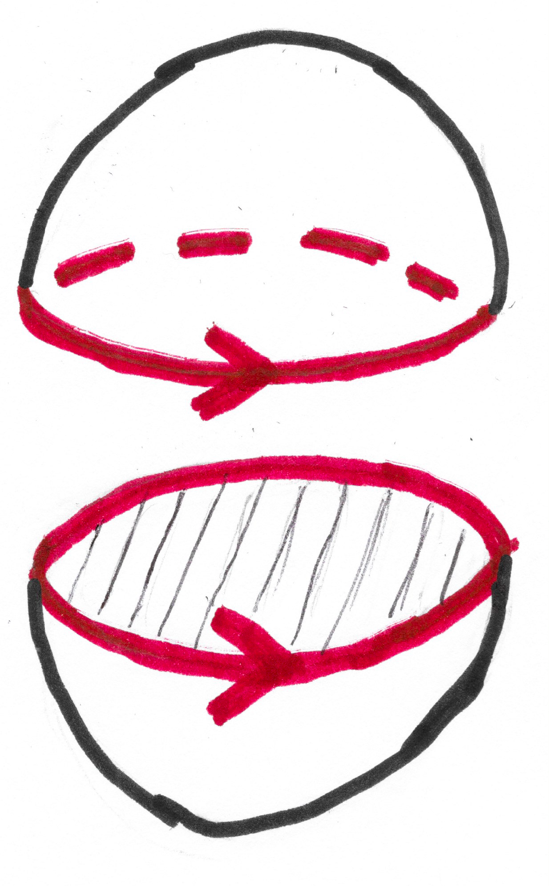
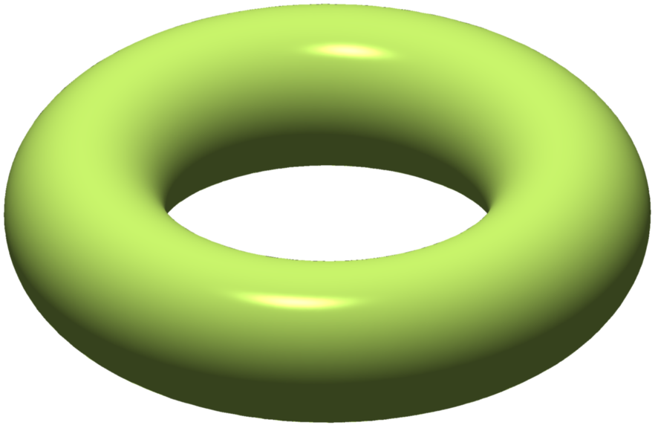
≈
2-sphere
Two bowls with
edges identified
≈
Cylinder with
ends identified
torus

Slide 9
?
≈
identify
Cylinder with ends identified
in opposite directions

Slide 10
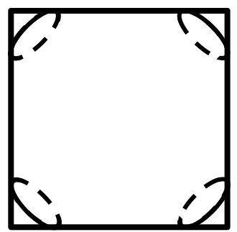
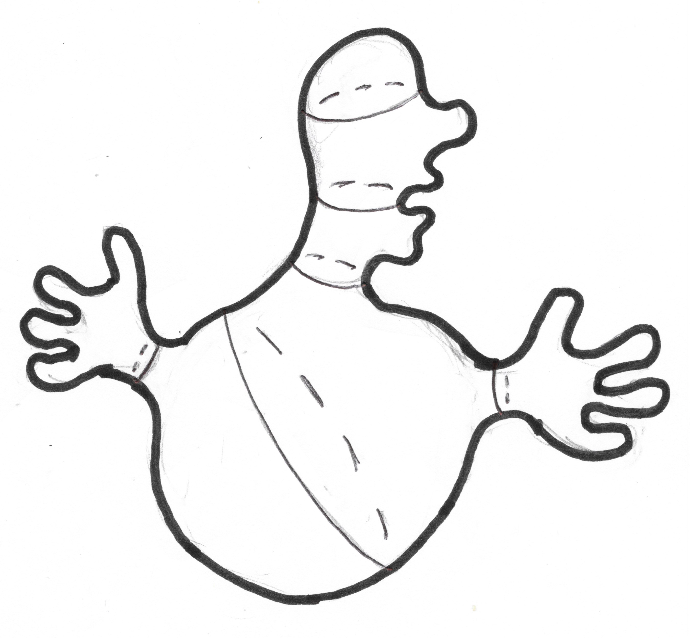
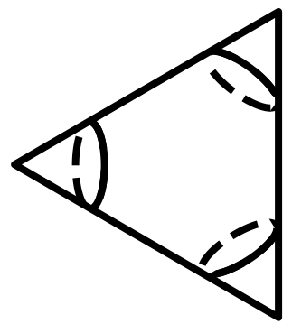
Observe that:
≈
wallpaper
pattern
orbifolds
2-sphere
Pillowcase
≈
≈
Turnover
(Samosa)
Creepy the 2-sphere

Slide 11
An important difference
between the annulus the Mobius strip:
The annulus has two edges,
but the Mobius strip has only one edge.

Slide 12
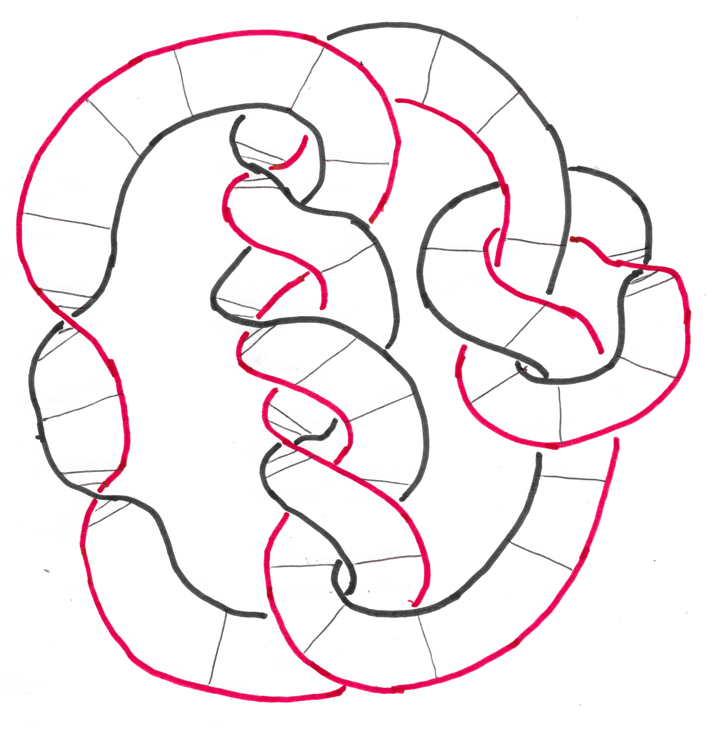
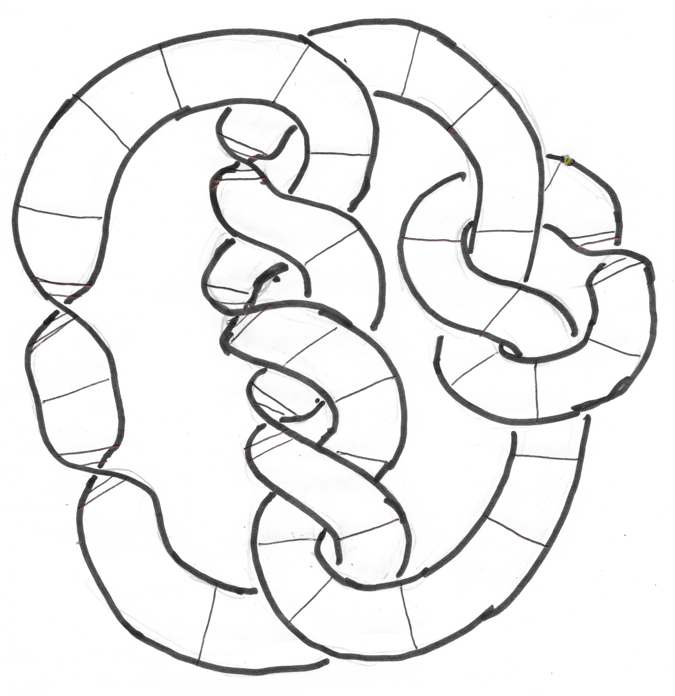
Annulus or Mobius strip?

Slide 13
We now create the sixth and seventh special surfaces.
These surfaces exist theoretically
but they can’t be constructed in 3-dimensional space.
The sixth special surface is called the projective plane – P².
The boundaries of both the disk and the Mobius strip are
single loops.
The resulting surface is the projective plane – P².
Identify
them!

Slide 14
The seventh special surface is our old friend –
the cylinder with ends identified in opposite directions.
This surface is called the Klein bottle – K²
– discovered by and named after Felix Klein
– not constructible in 3-dimensional space!
identify

Slide 15
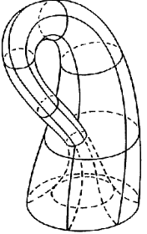
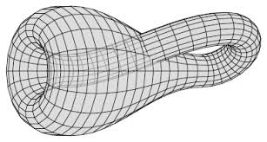
Two pictures of the Klein bottle in 3-dimensional space:
Self-intersections are not really there.

Slide 16
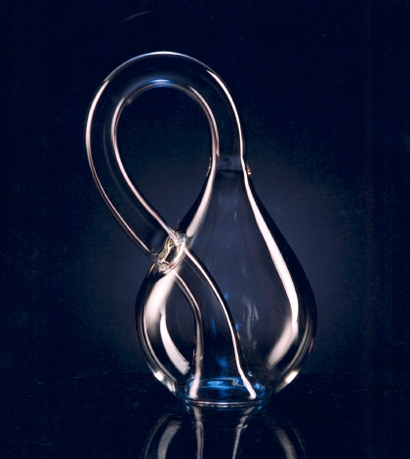
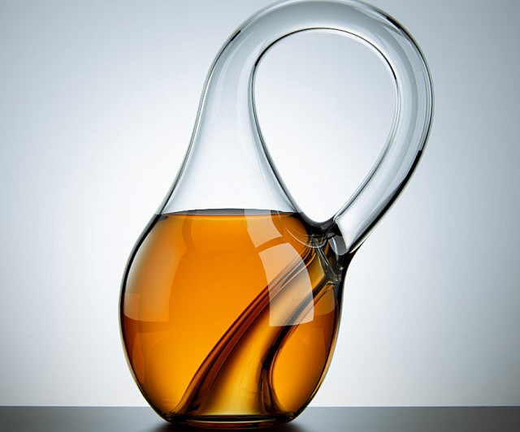
Glassblower’s Klein bottles
– not real Klein bottles.

Slide 17
Two Homework Problems:
1. Prove the projective plane
is homeomorphic to the disk
with diametrically opposed
boundary points identified
(right).
2. Prove the Klein bottle is
homeomorphic to the surface
obtained by identifying the
boundaries of two Mobius
strips (right).
identify
identify

Slide 18
We are ready to look at
Wallpaper patterns
and their
Orbifolds

