Slide 1
We are ready to look at
Wallpaper patterns
and their
Orbifolds

Slide 2
Step 1: Find a fundamental chamber.
To find the orbifold of a wallpaper pattern:
F
F
F
F
F
F
F
F
F
F
F
F
F
F
F
F
F
F
F
F
F
F
F
F
F
F
F
F
F
F
F
F
F
F
F
F
F
F
F
F
F

Slide 3
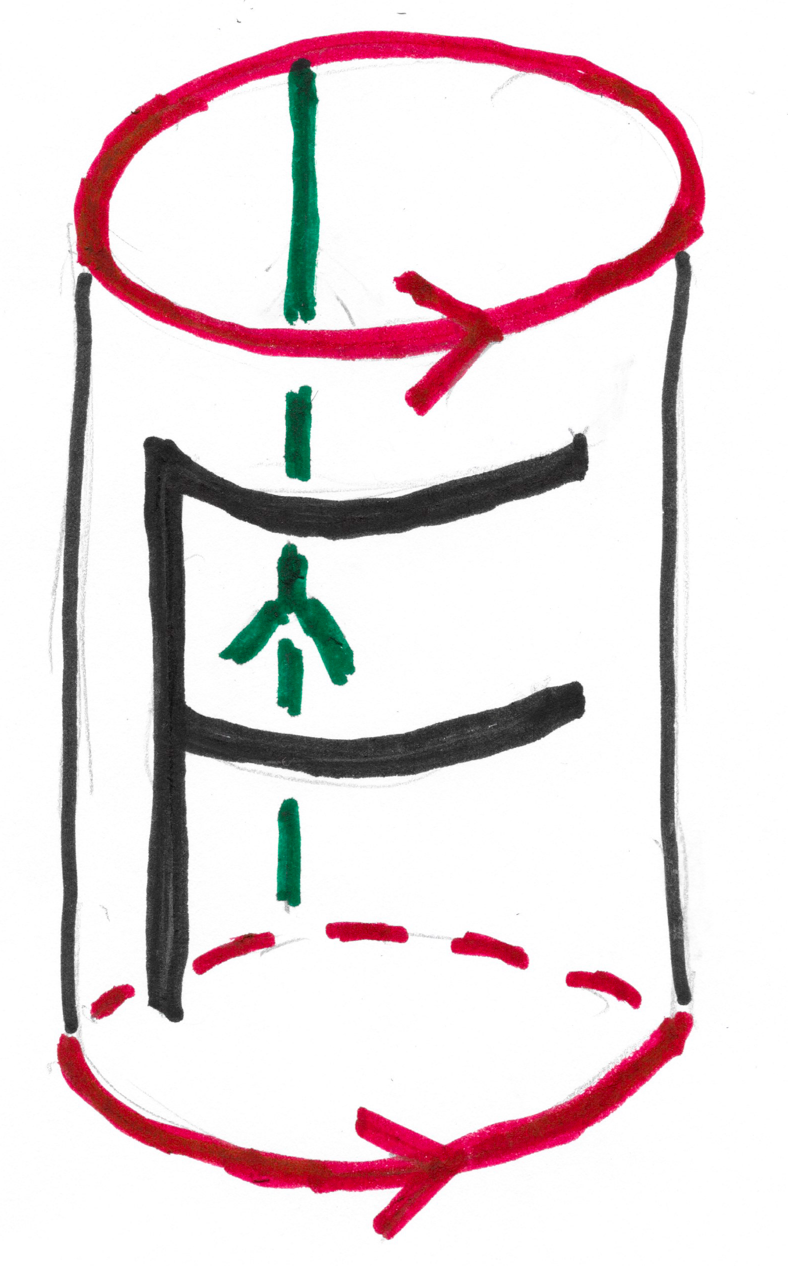
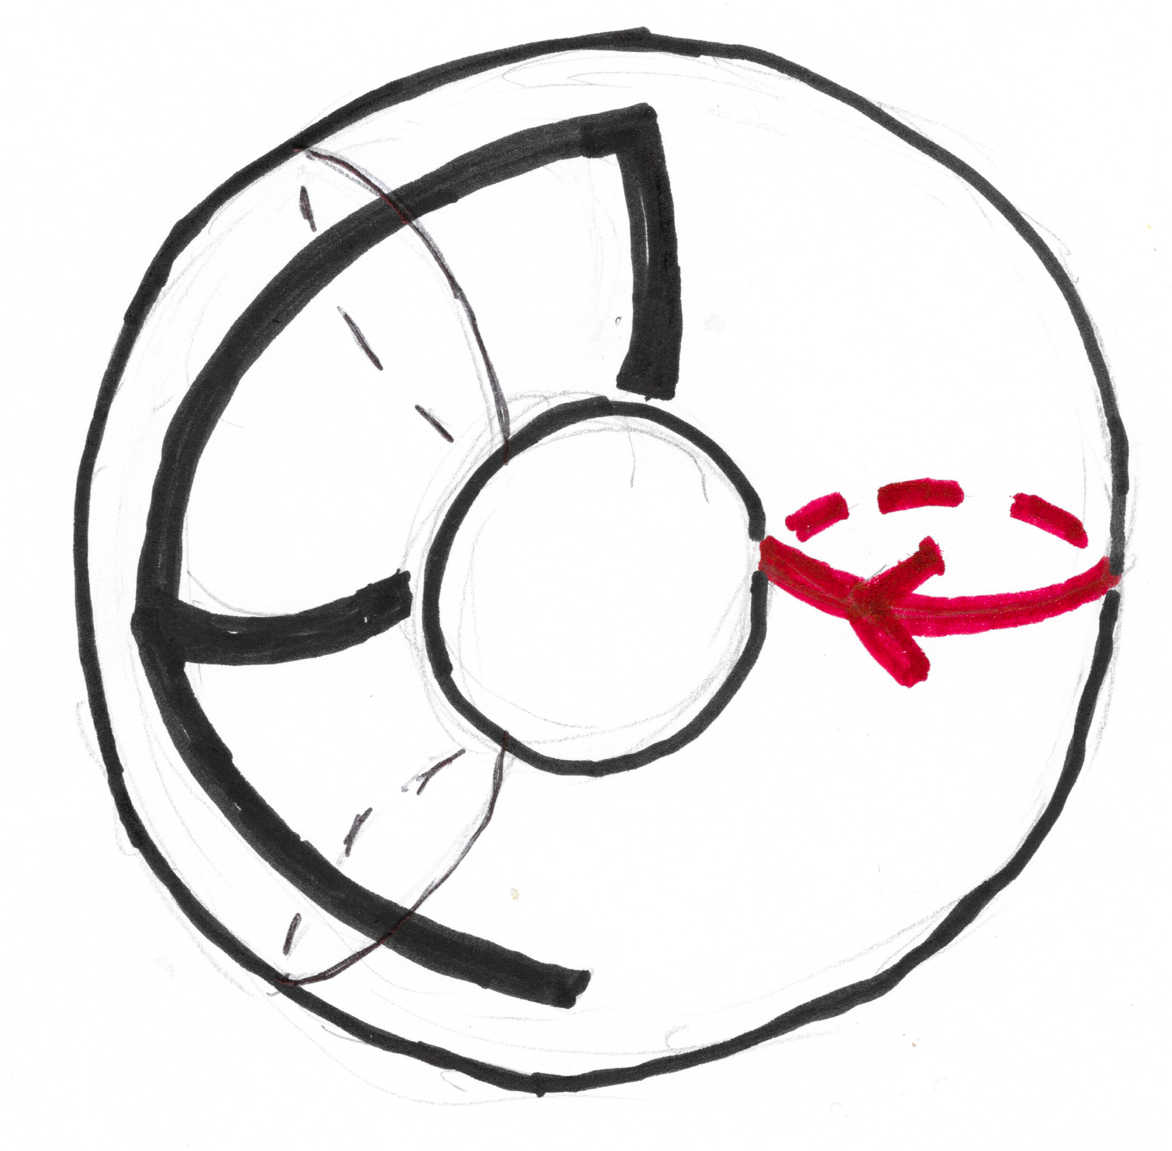
Step 2: Let elements of symmetry group
identify parts of the fundamental chamber.
( ≈ means “is homeomorphic to”)
F
≈
≈
The orbifold is a torus!
Orbifold symbol: T

Slide 4
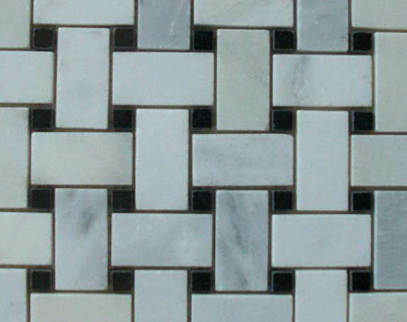
reflection
Fundamental
chamber
¹/₄ – twist

Slide 5
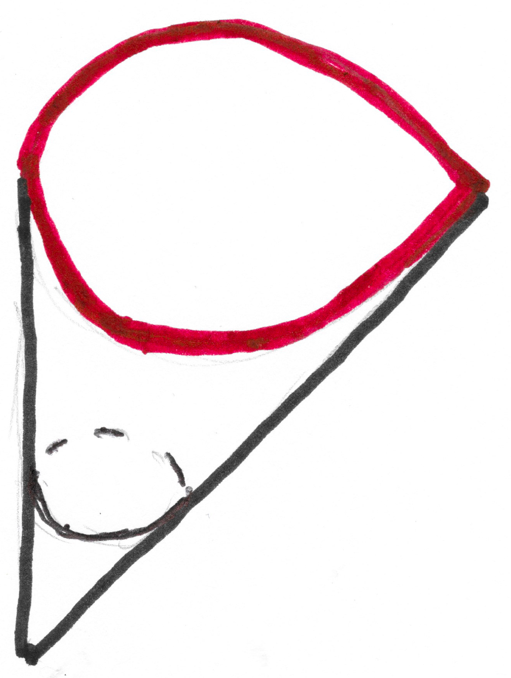
Fundamental chamber
two mirrors
¼-twist
Green arrows are
identified by ¼-twist.
m
Orbifold:
cone
Order 4 cone point
Mirror
Order 2 corner point
Orbifold symbol: D4m2
2
4
(D stands for disk)

Slide 6
¹/₃-twist
Fundamental chamber

Slide 7
Fundamental chamber
3
Orbifold:
“turnover”
or “samosa”
Three order 3
cone points
Orbifold symbol: S333
(S stands for 2-sphere.)
3
¹/₃-twist
3
Arrows of same color
are identified by 1/3-twist.

Slide 8
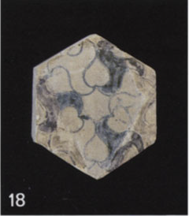
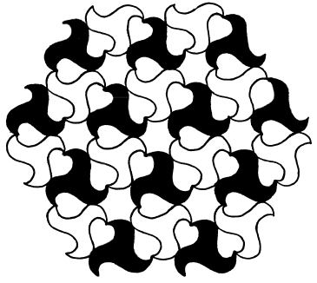
The previous wallpaper pattern is a simplification of:
– a drawing by Jose Montesinos illustrating the
the wallpaper pattern implicit in the Alhambra tile:

Slide 9
Alhambra. Floor. Mirador de Lindaraja

Slide 10
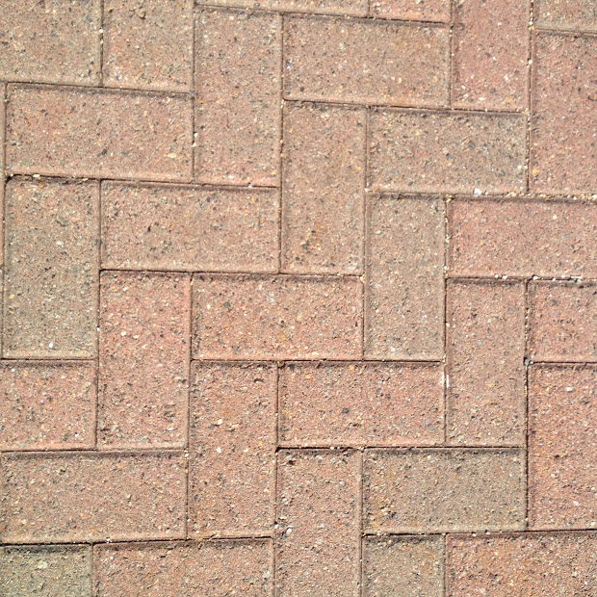
½ twist
Glide
reflection
Fundamental
chamber
Pavement. Hudson River Walk. Jersey City, NJ

Slide 11
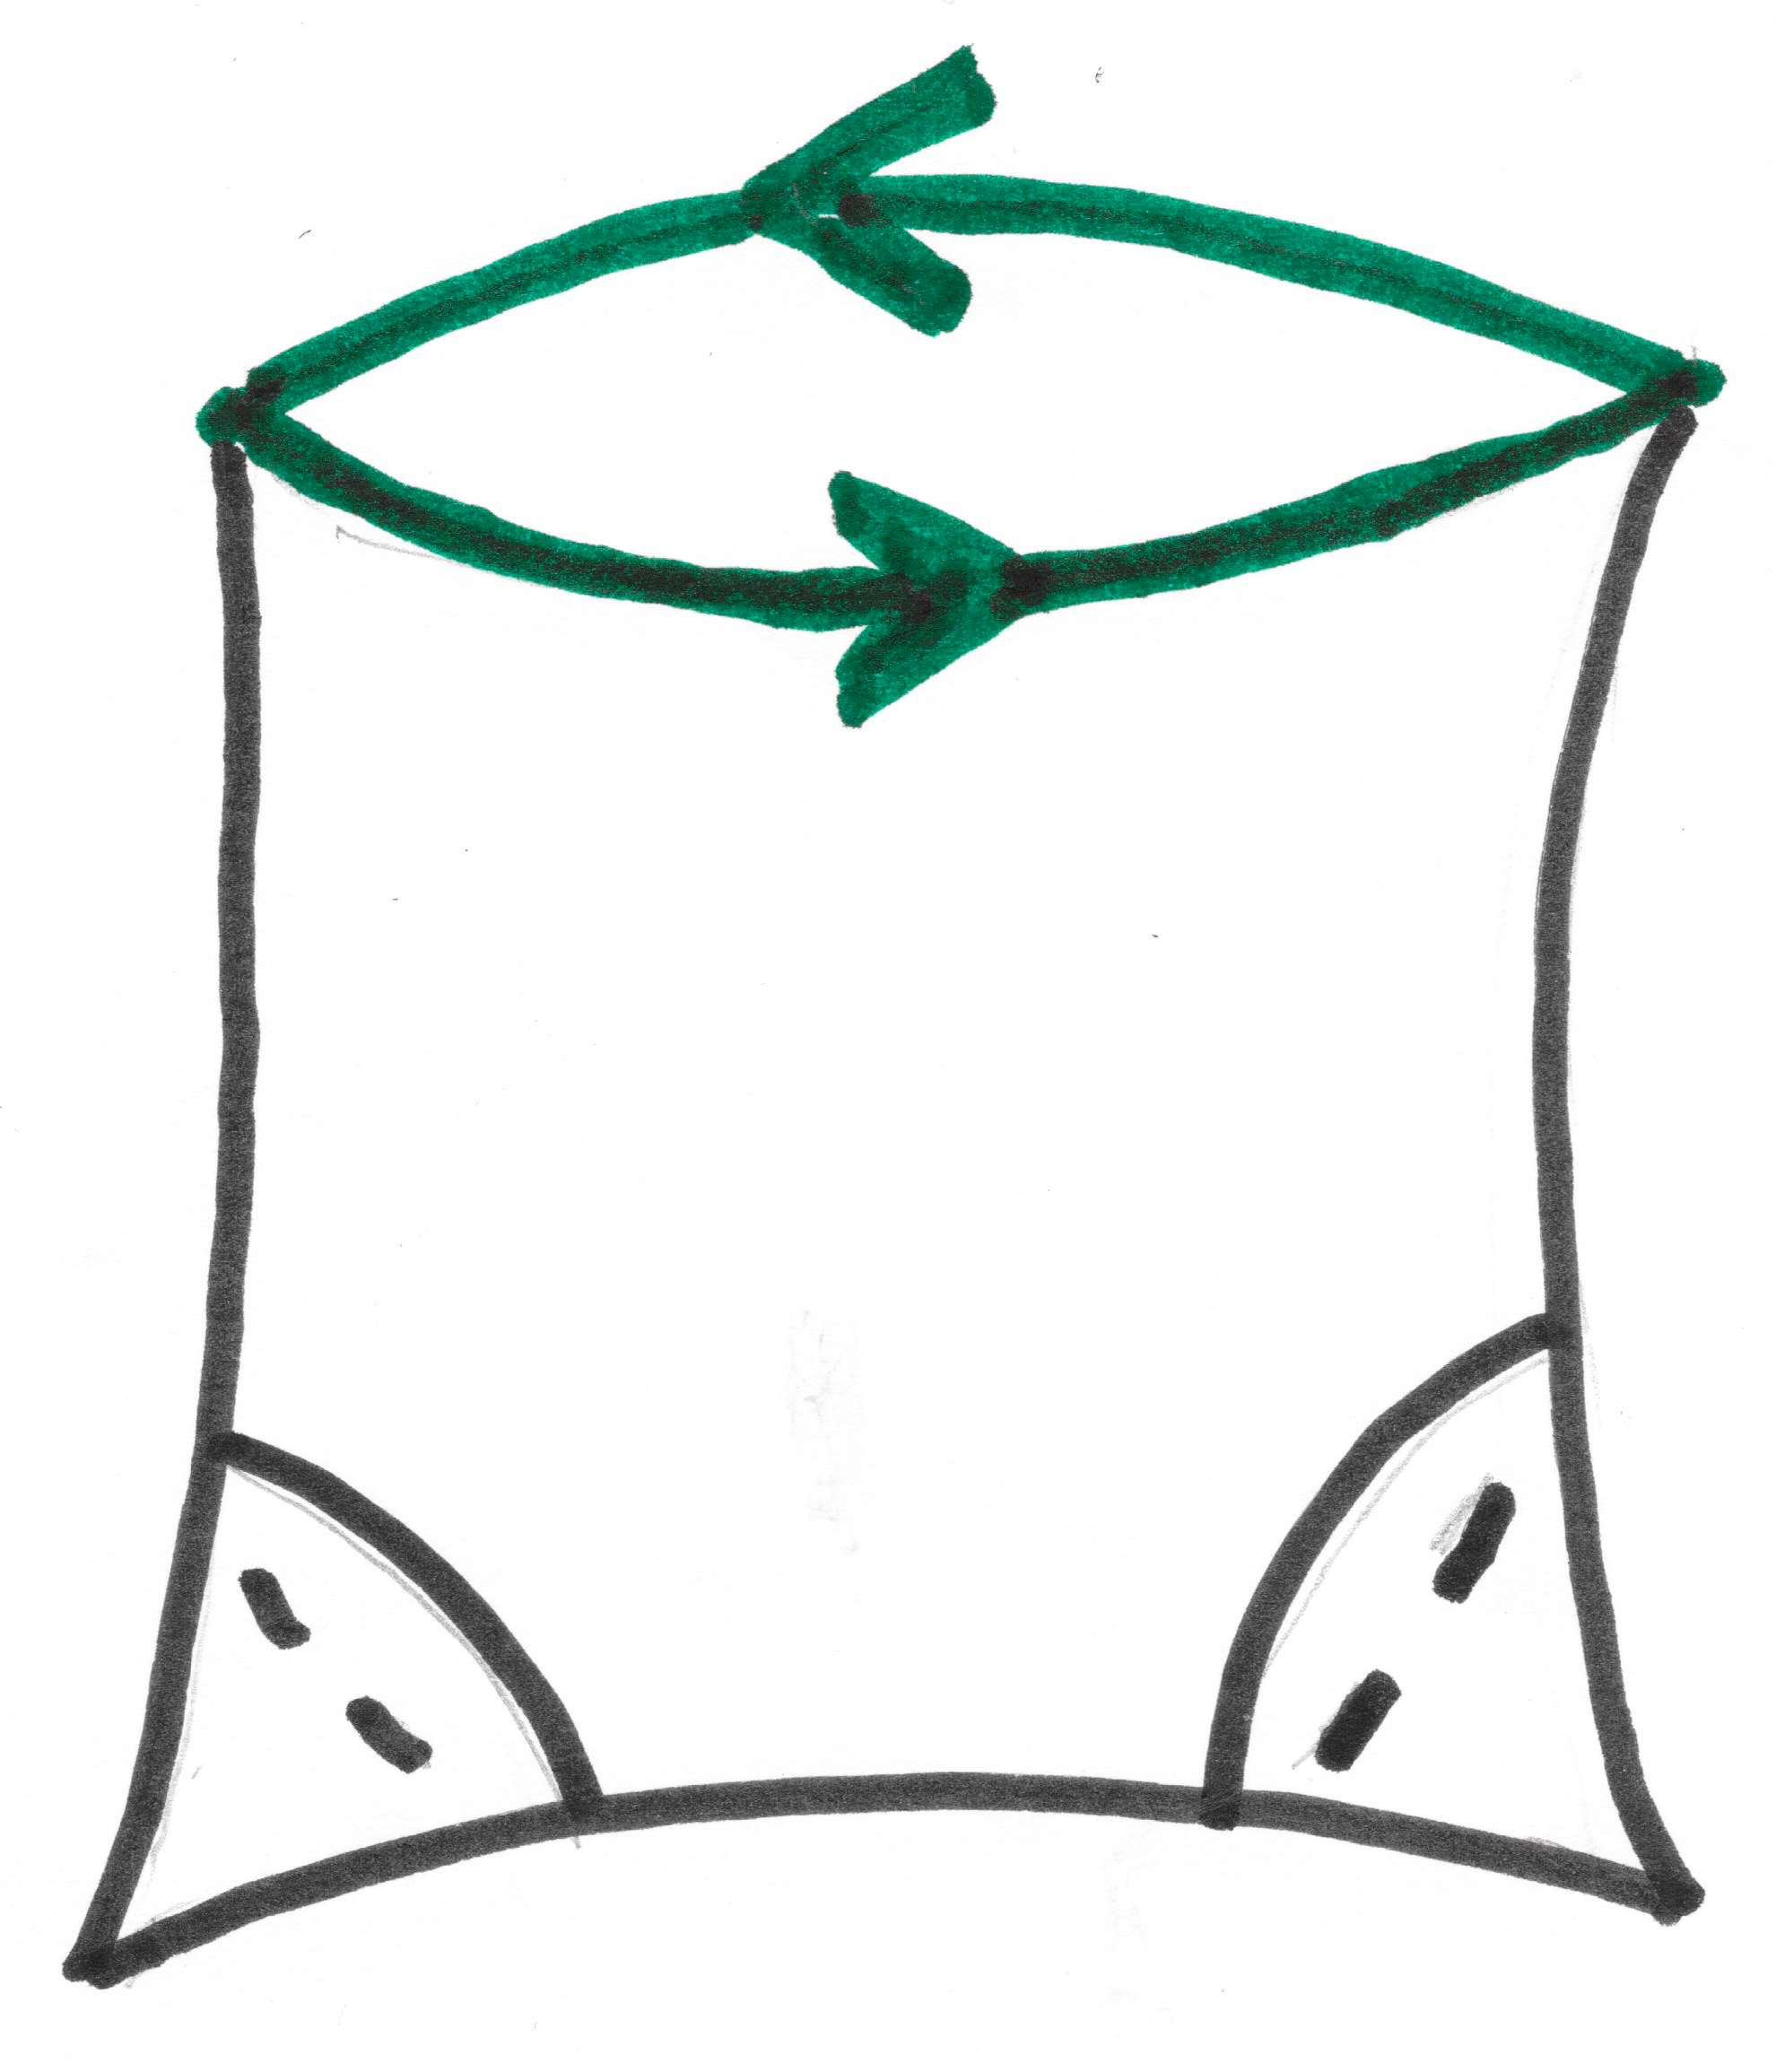
Fundamental chamber
2
Arrows of same color
identified by ½ twist,
slide and glide reflection
2
2
Orbifold:
“purse with
twisted zipper”
two order 2 cone points
Orbifold symbol: P22
(P stands for projective plane.)
2
2

Slide 12
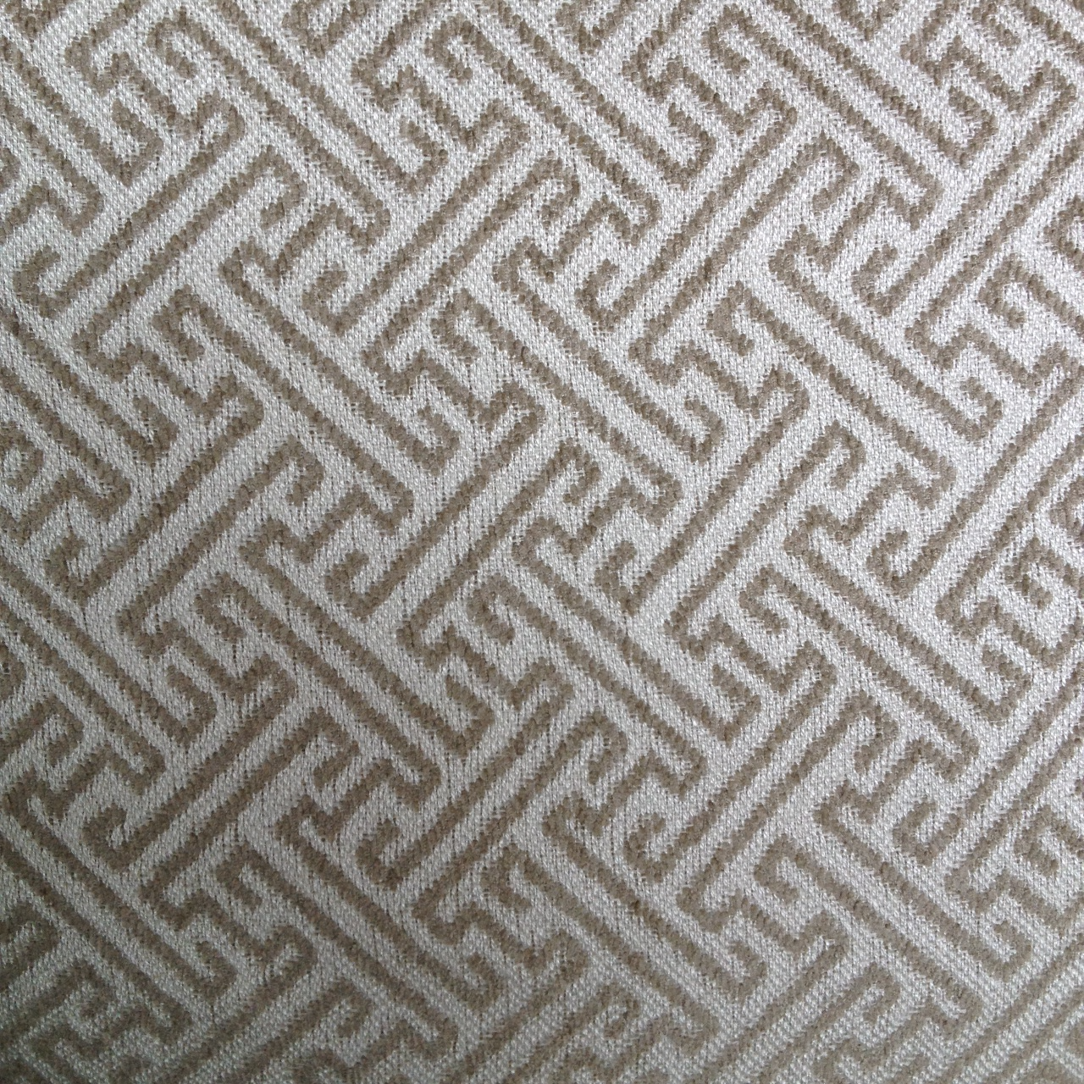
This pattern also has orbifold P22.
Homework: Find a fundamental chamber and verify this.

Slide 13
Recall: There are exactly 17 different wallpaper groups.
(Evgrav Fedorov, 1891)
Why?
Recall: There is a one-to-one correspondence between
wallpaper groups and their orbifolds.
So an equivalent question is:
Why do wallpaper patterns have only
17 different orbifolds?

Slide 14
Key idea:
if X is the orbifold of a wallpaper pattern,
then it obeys the
Generalized Riemann Hurwitz Formula:
χ(X) = ∑ ( 1 – 1/n_{a} ) + (¹/₂) ∑ ( 1 – 1/r_{b} )
a is a b is a
cone point corner point
where χ(X) is the Euler characteristic of X,
n_{a} is the order of the cone point a,
and r_{b} is the order of the corner point b.
( ∑ means add up everything. )

Slide 15
The Euler characteristic χ(X) of a surface X
is a whole number – positive, 0 or negative.
The seven special surfaces are the only surfaces with
non-negative Euler characteristics.
The Generalized Riemann Hurwitz Formula –
has only 17 different solutions
Each solution represents a wallpaper pattern orbifold.
So there are only 17 different wallpaper pattern orbifolds.
So there are only 17 different wallpaper groups.
χ(X) = ∑ ( 1 – 1/n_{a} ) + (¹/₂) ∑ ( 1 – 1/r_{b} )
a is a b is a
cone point corner point
– by elementary arithmetic.
QED

Slide 16
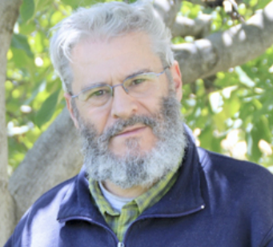
Who is right?
Montesinos:
All 17 wallpaper groups
appear in the Alhambra.
Grunbaum:
Not really.

Slide 17
HISTORY:
1944: Edith Muller, Swiss math graduate student –
visits Alhambra – finds 12 groups – for her Ph.D. thesis.
1983: Branko Grunbaum visits Alhambra on a Guggenheim
fellowship – finds a 13th group.
1987: Jose Montesinos publishes book – claims all 17
groups are present in Alhambra – provides photographs!
2006: Grunbaum writes paper disputing Montesino’s claim
(on occasion of International Congress of Mathematicians
meeting in Madrid – Montesinos’ home town).
Since then: other papers published on both sides – including
a 2011 paper with very clear photographs of all 17 groups.

Slide 18
Two comments:
1. The 13th century artisans of Granada could not have
known about symmetry groups or orbifolds.
If the 17 wallpaper groups appear in the Alhambra,
it is simply evidence of the richness of their art
– which was fabulous in any case.
2. Color reduces symmetry.
no twists
¼ twist
If you ignore color, all 17 groups are clearly present!

Slide 19
Grunbaum’s gripes (2006):
1. Montesinos disregards colors when convenient.
– unfair (Montesinos is careful about color).
2. Montesinos doesn’t give a clear definition of what
constitutes a mosaic.
Montesinos turned
the single tile on the
left into the mosaic
on the right.
Mosiac – shmosaic?

Slide 20
Grunbaum’s gripes (2006):
1. Montesinos disregards colors when convenient.
– unfair (Montesinos is careful about color).
2. Montesinos doesn’t give a clear definition of what
consitutes a mosaic.
3. Montesinos includes mosaics that are badly worn
by time and mosaics found in the Alhambra Museum
(on the grounds) but not in the palaces themselves.
?????

Slide 21
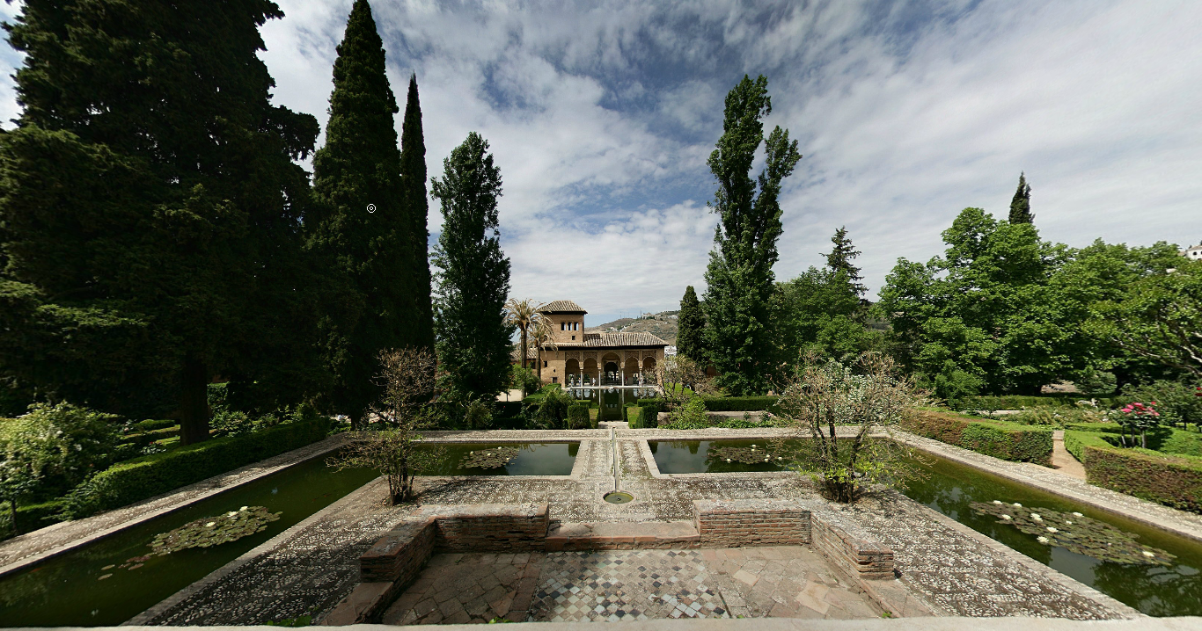
My humble opinion:
Visit the Alhambra and decide for yourself.
It’s worth the trip!

Slide 22
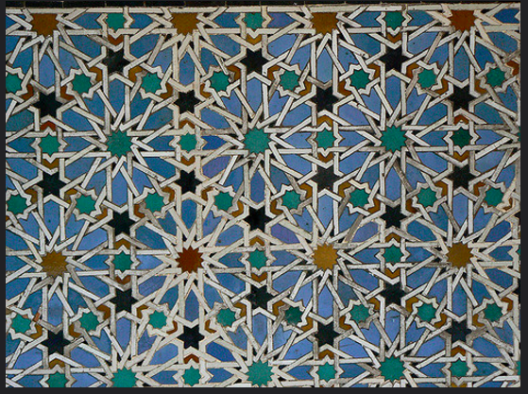
Homework Problems with Hints,
Power Point Slide Shows,
etc.
can be found at:
http://people.uwm.edu/ancel/sciencebag/

