Slide 1




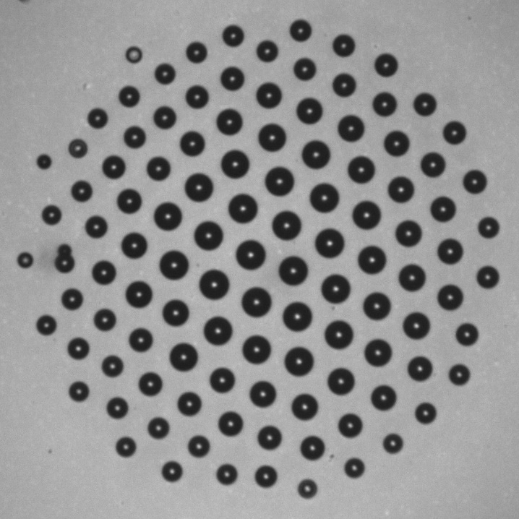
PHYSICS OF SELF-ASSEMBLED LEVITATING CLUSTERS OF WATER DROPLETS
Alexander A. Fedorets ¹, Leonid A. Dombrovsky ^{1,2},
Edward Bormashenko ³, Michael Nosonovsky ^{1,4}
¹University of Tyumen, Tyumen, Russia
²Joint Institute for High Temperatures, Moscow, Russia
³Ariel University, Ariel, Israel
⁴University of Wisconsin–Milwaukee, USA
June 12-14, NISE-2019, Conference, Stevens Institute of Technology
New Jersey, USA

Slide 2

Why is hot water foggy?
What is the structure of the fog?

Slide 3
Outline
What is a “droplet cluster”?
Ordering in a droplet cluster
Physical reasoning of ordering in a droplet cluster
Phenomenological model of ordering is suggested
Micro-manipulation of biological objects with a droplet cluster.
Transition droplet cluster – chain droplet cluster was observed
Motivation:
The levitating droplet cluster of water droplets is a novel state of existence of condensed matter.
Physical reasoning of ordering observed in droplets clusters remains debatable.
A droplet cluster enables contactless manipulation of chemical and bio-chemical samples.
The external electric field enables the control of the parameters of droplet clusters.

Slide 4
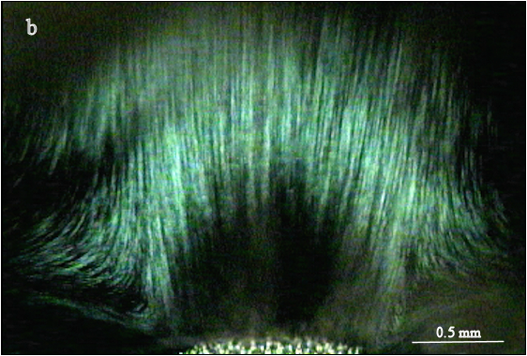
INTRODUCTORY INFORMATION ABOUT THE DROPLET CLUSTER
The levitating clusters of regularly positioned small droplets are formed over the locally heated water surface. This phenomenon was observed for the first time by Alexander Fedorets in 2004.
Fedorets, A. Droplet Cluster Journal of Experimental and Theoretical Physics Letters, 2004, 79 (8) 372–374 .
View from above
Upward flow of condensing steam

Slide 5
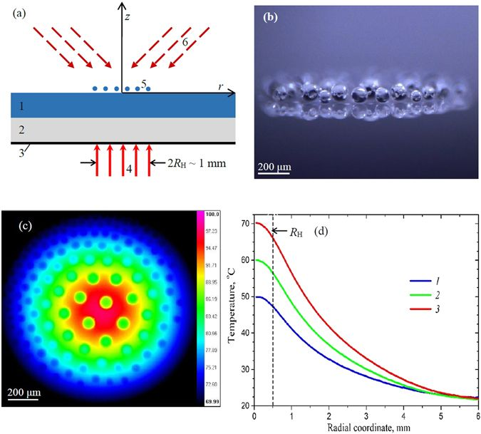
The schematic of experimental setup: the water layer (1) on glass-ceramic substrate (2) with light-absorbing coating (3) is heated by laser beam (4) and generates droplet cluster (5) stabilized by infrared irradiation (6). (b) Side view of the cluster. (c) Top view, the infrared image and (d) radial temperature profiles of water surface under the cluster at the laser power of 208.6 mW (1), 297.1 mW (2), and 411.4 mW (3).

Slide 6
Life of the droplet cluster
Droplet_Cluster.avi

Slide 7
Droplets are ordered within the cluster!
Voronoi Tessellation was applied for quantification of ordering
Voronoi Entropy
where P_{n} is the fraction of polygons with k sides or edges (also called the coordination number of the polygon) in a given Voronoi diagram)
Ed. Bormashenko, M. Frenkel, A. Vilk, I. Legchenkova, A. A. Fedorets, N. E. Aktaev, L. A. Dombrovsky, M. Nosonovsky, Characterization of Self-Assembled 2D Patterns with Voronoi, Entropy 2018, 20(12), 956.

Slide 8
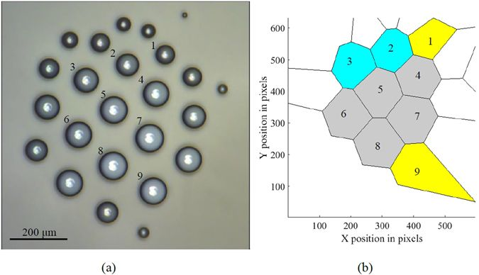
Self-organization of a droplet cluster. (a) The image of the cluster and (b) the Voronoi tessellation of the cluster. Yellow (1,9), gray (4–8), and blue (3,2) polygons have five, six, and seven neighbors, correspondingly

Slide 9
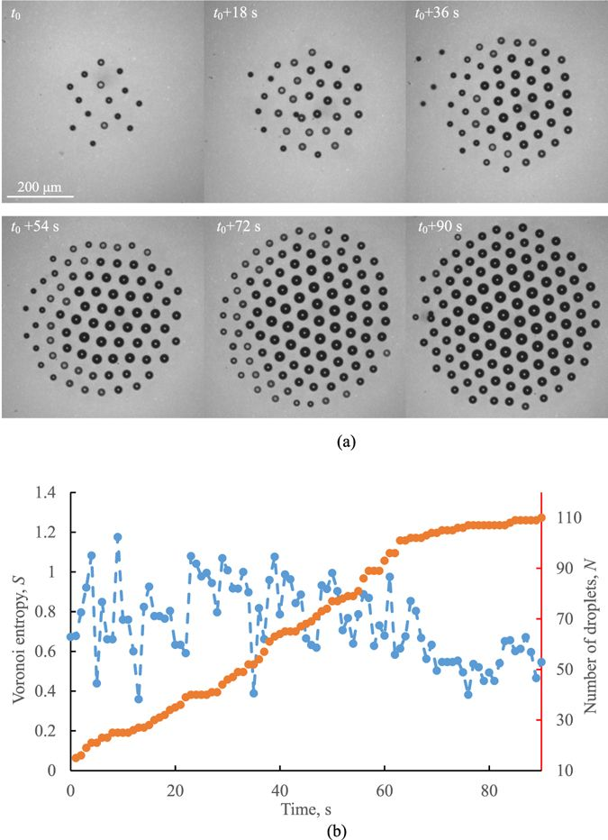
Self-assembly of a droplet cluster over a heated water and (b) the Voronoi entropy, S (blue), correlated with the number of droplets, N (red).

Slide 10
The Voronoi entropy tends to grow immediately after a new droplet joins the cluster; however, after that, due to the ordering of the cluster arrangement, the entropy tends to decrease.
Note that the Voronoi entropy is an intensive property (unlike the thermodynamic entropy, which is an extensive property), and it is independent of the number of droplets and reflects only their ordering.
A. A. Fedorets, Ma. Frenkel, E. Shulzinger, L. A. Dombrovsky, Ed. Bormashenko, M. Nosonovsky, Self-assembled levitating clusters of water droplets: pattern-formation and stability, Scientific Reports, 7, 1888 (2017)

Slide 11
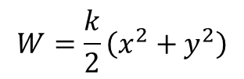
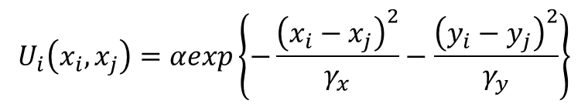
What is the physical reasoning for ordering?
Phenomenological model of ordering
Numerical simulations with the Langevin method taking into account droplet repulsion and random diffusion have been carried out
Potential of interaction between droplets:
$$U_{i}\left(x_{i},x_{j}\right)=αexp\left\{−\frac{{\left(x_{i}−x_{j}\right)}^{2}}{γ_{x}}−\frac{{\left(y_{i}−y_{j}\right)}^{2}}{γ_{y}}\right\}$$
“Aerodynamic Potential”
$$W=\frac{k}{2}\left(x^{2}+y^{2}\right)$$
Aktaev N., Fedorets A. A., Bormashenko E., Nosonovsky M., Langevin Approach to Modeling of Small Levitating Ordered Droplet Clusters, J. Phys. Chem. Lett. 2018, 9, 14, 3834-3838.

Slide 12
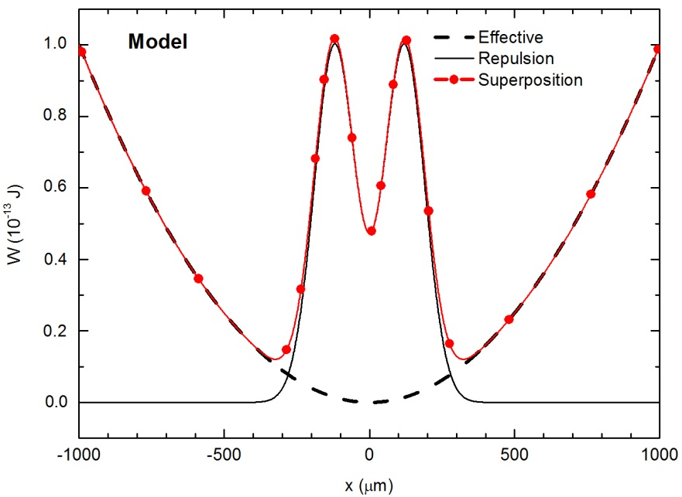
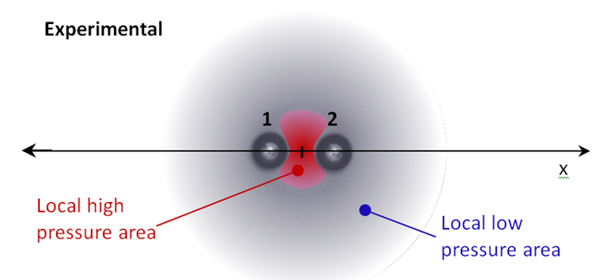
. The effective potential for two droplets in the cluster located at x₁ =x and x₂=-x. The effective “main” force, repulsion force, and their superposition are shown.

Slide 13
Aktaev N., Fedorets A. A., Bormashenko E., Nosonovsky M., Langevin Approach to Modeling of Small Levitating Ordered Droplet Clusters, J. Phys. Chem. Lett. 2018, 9, 14, 3834-3838.

Slide 14
THE MAIN RESULTS ON MANAGING THE CLUSTERS
Stabilization of droplet clusters
Clusters of a small number of similar droplets
The cluster life is not long because droplets are growing due to condensation of steam. This process is finished by the coalescence of droplets with the layer of water.
Therefore, an effective suppression of the droplet growth and stabilization of a cluster is one of the key problems.
Two ways of the cluster stabilization has been discovered:
The external infrared irradiation.
The modulation of the laser power used for the local heating of water layer.
The developed process consists of two stages:
The laser power output is maintained at the low level, which allows the droplets to migrate toward the center;
The laser power is abruptly increased. This leads to a high velocity of gas flow and removing small droplets.
For more details:
L.A. Dombrovsky, A.A. Fedorets, D.N. Medvedev, The use of infrared radiation to stabilize levitating clusters of water droplets, Infrared Phys. Techn. 75 (2016) 124–32.
A.A. Fedorets, N.E. Aktaev, L.A. Dombrovsky, Suppression of the condensational growth of droplets of a levitating cluster using the modulation of the laser heating power, Int. J. Heat Mass Transf. 127-A (2018) 660–4.
A.A. Fedorets, M. Frenkel, E. Bormashenko, M. Nosonovsky, Small levitating ordered droplet clusters: Stability, symmetry, and Voronoi entropy, J. Phys. Chem. Lett. 8 (22) (2017) 5599–602.
A.A. Fedorets, L.A. Dombrovsky, Self-assembled stable clusters of droplets over the locally heated water surface: Milestones of the laboratory study and potential biochemical applications, Proc. 16th Int. Heat Transfer Conf. (IHTC-16), August 10-15, 2018, Beijing, China, keynote lecture IHTC16-KN02.

Slide 15
Managing the cluster with the electric field

Slide 16
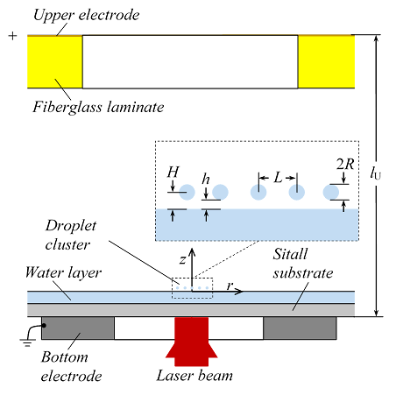
EXPERIMENTAL SET-UP
The cluster was formed over a thin layer of distilled water heated locally from the substrate irradiated by a laser beam of diameter about 1 mm.
The continuous wave laser with the wavelength of 0.808 µm at the working power of 280 mW was used.
Video images of the cluster were taken using stereo-microscope and high-speed video-camera with spatial resolution of 0.6 µm.
The lower electrode is a thin metal cylinder placed under the substrate. The upper electrode with a central hole was covered by 18 μm thick copper layer.
The external electric field was generated by a high-voltage source designed to vary the applied voltage in the range from 0.2 to 3.0 kV.
The variant with a positive electric potential of the upper electrode relative to the grounded lower electrode is denoted by U⁺, and the opposite configuration – U–.
Schematics of a side view of a laboratory set-up
For more details:
A.A. Fedorets, L.A. Dombrovsky, E. Bormashenko, M. Nosonovsky, On relative contribution of electrostatic and aerodynamic effects to dynamics of a levitating droplet cluster, Int. J. Heat Mass Transf. 133 (2019) 712–717.

Slide 17
LOCAL ELECTRIC FIELD AND POLARIZATION OF DROPLETS
The electric field was obtained using the numerical solution of an axisymmetric boundary-value problem for the Laplace equation for electric potential.
It was shown that the electric field in the location of cluster is uniform. The absolute value of field strength is equal to 220 kV/m at the voltage of 1kV.
Water droplets of a cluster are polarized in the electric field. The dipole moment of a single droplet can be calculated as follows:
Obviously, there is an attraction force between the droplet dipole and the water layer.
In the case of own electric charge of droplets, the total force depends also on the configuration of the external electric field.
A comparison of experimental data for U⁺ and U– variants makes it possible to estimate the electric charge of water droplets.
For more details:
A.A. Fedorets, L.A. Dombrovsky, E. Bormashenko, M. Nosonovsky, On relative contribution of electrostatic and aerodynamic effects to dynamics of a levitating droplet cluster, Int. J. Heat Mass Transf. 133 (2019) 712–717.

Slide 18
EXPERIMENTALLY OBSERVED UNFAVOURABLE EFFECTS
OF AN EXTERNAL ELECTRIC FIELD
Increasing the rate of growth of water droplets at every configuration of the electric field.
Too early coalescence of relatively small droplets with water layer.

Slide 19
SOME IMPORTANT PHYSICAL RESULTS
A
Three curves are almost parallel to each other and the upper and lower curves are almost symmetric with respect to the central one with the ordinate distances about 0.01nN between the neighbouring lines.
It means that the electric charge of all the droplets is practically the same for water droplets under consideration and can be calculated as follows:
where e is the elementary unit charge.
This value of droplet charge is in good agreement with an estimate of q_{dr} ~10²–10³ obtained by Shavlov et al. using quite different methods.
The weight of a steady levitating droplet
as a function of the levitation height
B
C
Theoretical estimations showed that electric attraction force between polarized droplets and water layer is responsible for the early coalescence of droplets.
The electrostatic force between the droplets is proved to be much less than the estimated aerodynamic force which is responsible for the cluster pattern.

Slide 20
Novel Phenomenon
Chain Droplet Cluster

Slide 21
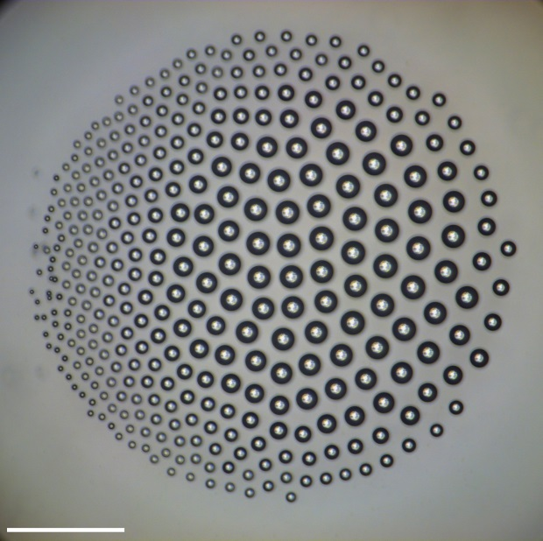
Transition from a hexagonal to chain cluster.
Scale bar is 300 µm, time interval 26 s between the frames.

Slide 22
Droplet cluster enables manufacturing of bio-aerosols
Maun problem in study of bio-aerosols: it is extremely difficult to observe airborne bacteria in situ, because it is impossible to trace individual micro-droplets constituting aerosols.
The droplet cluster technology allows the observation of isolated bio-aerosol droplets for extended periods of time (hours) and studying them with fluorescent microscopy.

Slide 23
Microorganisms encapsulated into a droplet cluster.
Chlorella vulgaris Beijer, time interval is 2s between the frames, scale bar is 200 µm

Slide 24
E-coli encapsulated into a droplet cluster. Scale bar is 200 µm, time interval between the frames is 2 s.
A. A. Fedorets, Ed. Bormashenko, L. A. Dombrovsky, M. Droplet clusters: nature-inspired biological reactors and aerosols, accepted for publication by Philosophical Transactions of Royal Society A

Slide 25
Conclusions
The levitating clusters of regularly positioned small droplets are formed over the locally heated water surface.
Ordering of droplets may be effectively quantified with the Voronoi entropy
The phenomenological model of ordering is suggested.
The effect of the electrostatic force on ordering is negligible in comparison with that of the aerodynamic force
Droplet cluster enables micro-manipulation of micro-organisms
Transition “droplet cluster – chain droplet cluster” was observed

Slide 26
Thanks for invitation!

